Slide 1

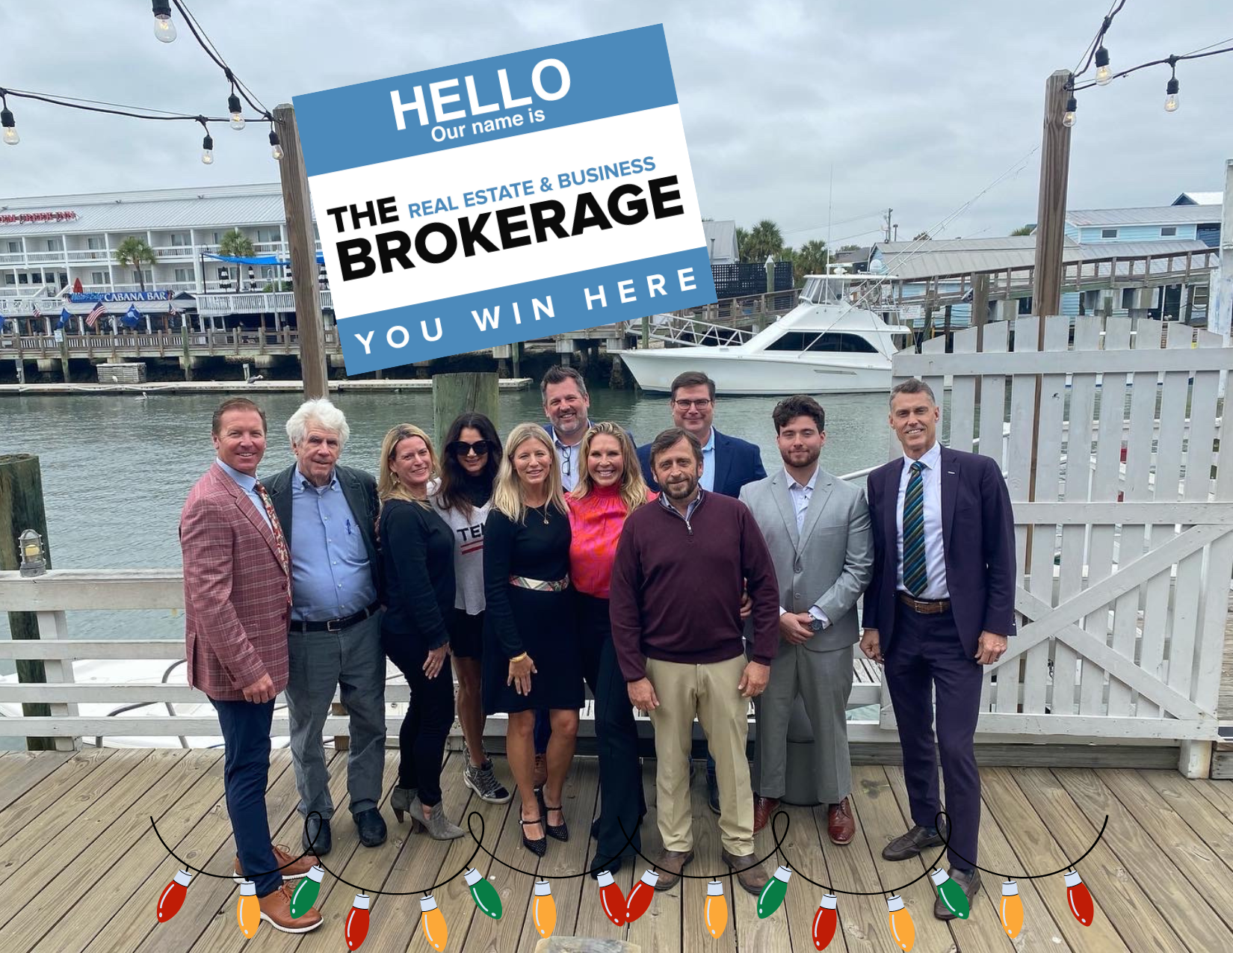

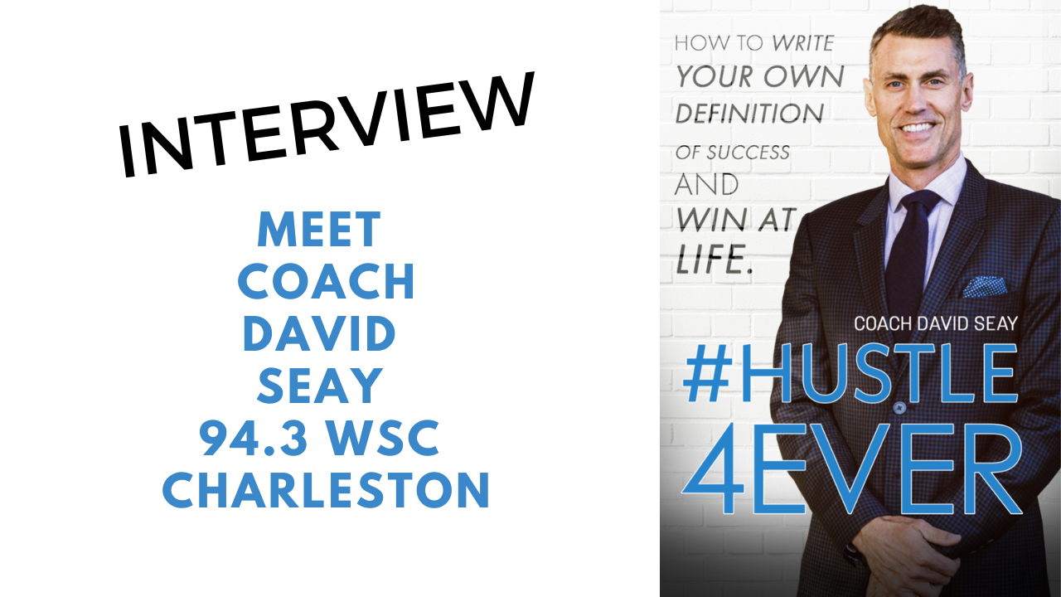
Thank you to any agent that completed a transaction with us in 2022. Other agents are our greatest customers and we appreciate you helping us. We wish you well for the New Year.
Thank you to those agents that were able to join us for the Meet and Greet.
We are excited to roll out our Elite Agent Training January 9th for any agent on our team. If you want to seriously grow your business with dedicated training and support, it is not too late to join The Brokerage and get on board by 1/9/23 for dedicated mentoring and support.
Iron sharpens iron.
David Seay
BIC, CCIM, CIPS, REDM
The Brokerage, LLC
Real Estate & Business Brokerage
david@seaydevelopment.com
www.TheBrokerageYouWinHere.com
(843) 364-6720 Direct

