Slide 1
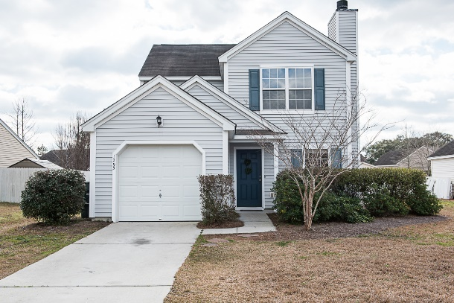
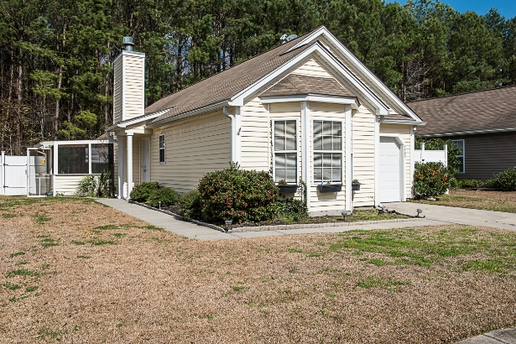
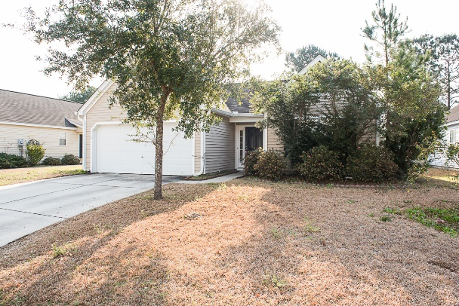
Have an Investor Looking for Property?
1295 Palm Cove Drive
1160 Marsh Harbor Lane
1113 Marsh Harbor Lane
Three great tenant-occupied properties in The Peninsula
1295 Palm Cove Drive MLS 16005218 offered at $249,500
1160 Marsh Harbor Lane MLS 16005212 offered at $249,500
1113 Marsh Harbor Lane MLS 16005213 offered at $249,500
​Connie Dittrich, Realtor, ABR, CNE, SFR
Carolina One Real Estate  628 Long Point Rd  Mt Pleasant, SC  29464  843.475.7993
cdittrich@carolinaone.com

