Slide 1
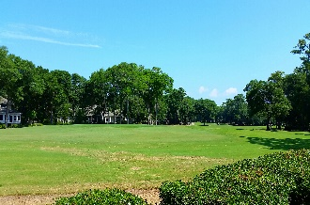
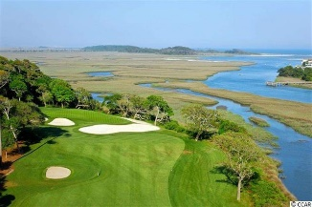
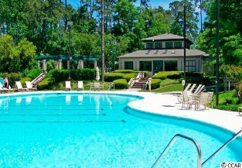
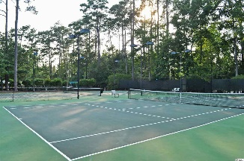
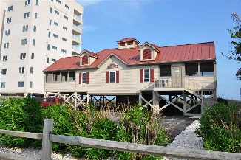
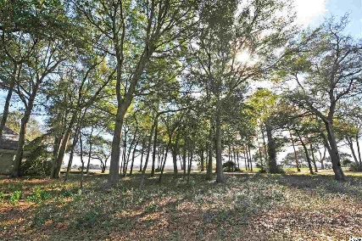
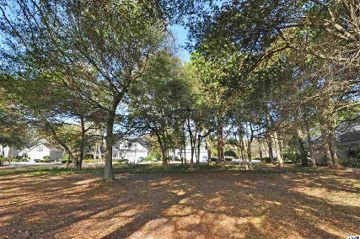
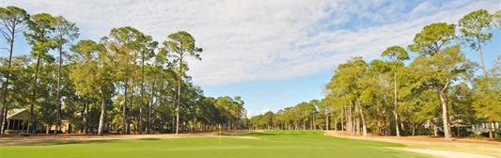
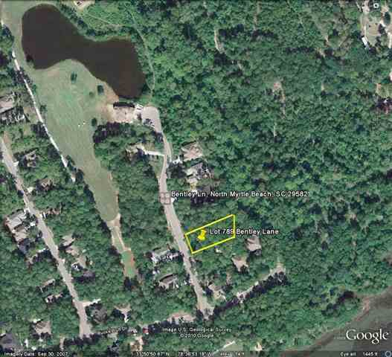
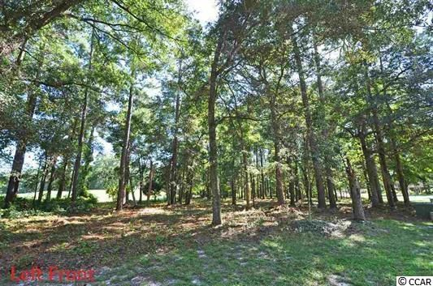
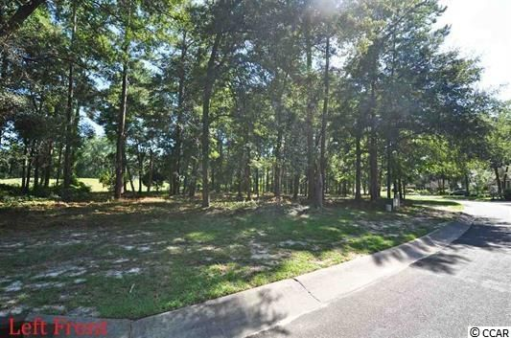
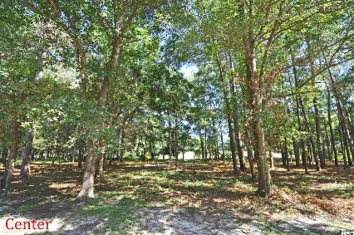
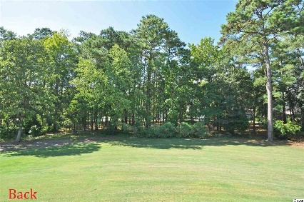


AFFORDABLE LOTS -- NO TIMEFRAME TO BUILD
Tidewater Plantation Resort ~ North Myrtle Beach
Lots of Lots in upscale Tidewater Plantation Resort, from mid-50s to rare 3-lot package on golf course, to a full tee-to-green view of the second hole & to the Cherry Grove marsh front, all with owners' private oceanfront Beach Cabana!
4914 Buck's Bluff Drive
MLS# 1703211
$229,900
4905 Buck's Bluff Dr.
MLS# 1803698
$99,900
1418 Lighthouse Drive
MLS# 1715977
$54,900
1420 Lighthouse Drive
MLS# 1617511
$99,900
HEAR THE OCEAN! 817 Morrall at only $59,900 and others on Morrall and Bentley on a full third acre, lightly wooded, with golf course and private wetland views. New listings all the time. Tour Tidewater lots with us for complete building information, including approved Tidewater builders.
Deborah Collins
843-424-9013
dctidewater@yahoo.com
Connie Ross-Karl
702-306-2643
conniesross@aol.com
NEW WAY PROPERTIES MYRTLE BEACH

