Slide 1
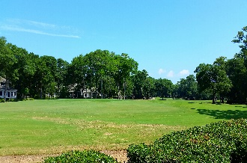
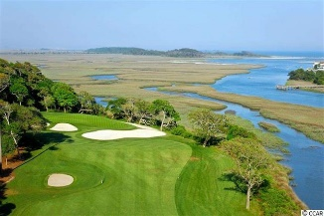
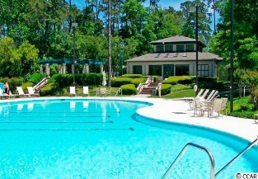
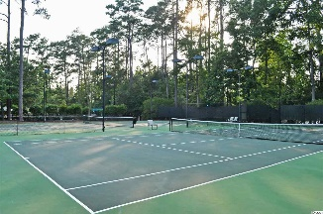
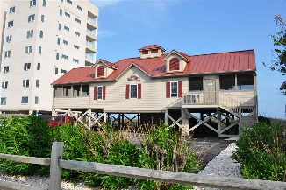
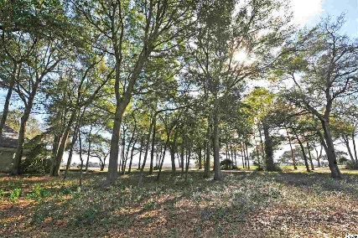
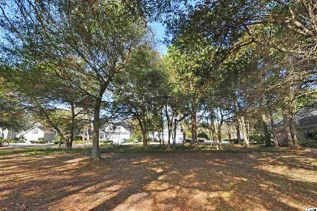
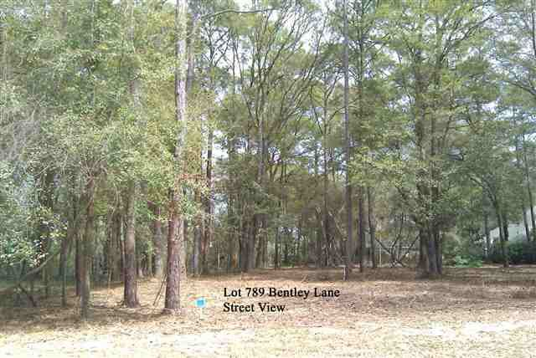
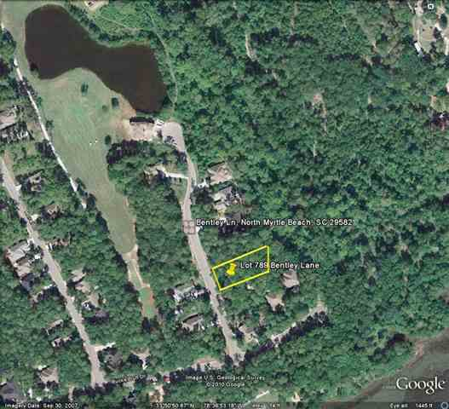
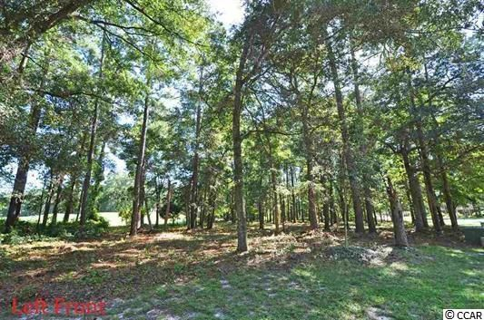
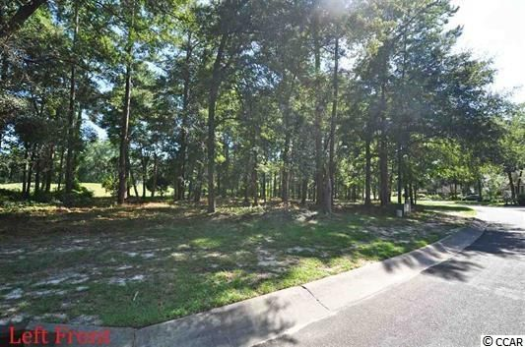
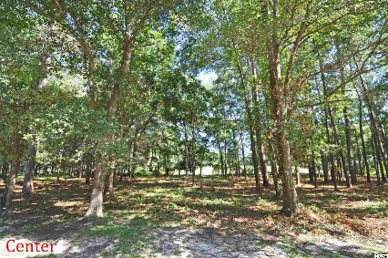
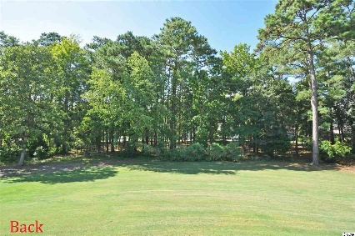


4 Buildable Lots
Tidewater Plantation Resort ~ North Myrtle Beach
Lots of Lots this fall in upscale Tidewater Plantation Resort,
from mid-50s to rare 3-lot package on golf course & to Cherry Grove marshfront,
all with private oceanfront Beach Cabana!
4914 Buck's Bluff Drive
MLS# 1703211
$229,900
789 Bentley Lane
MLS# 1007159
$54,900
1418 Lighthouse Drive
MLS# 1715977
$54,900
1420 Lighthouse Drive
MLS# 1617511
$99,900
Deborah Collins
843-424-9013
dctidewater@yahoo.com
Connie Ross-Karl
702-306-2643
conniesross@aol.com
NEW WAY PROPERTIES MYRTLE BEACH

