Slide 1
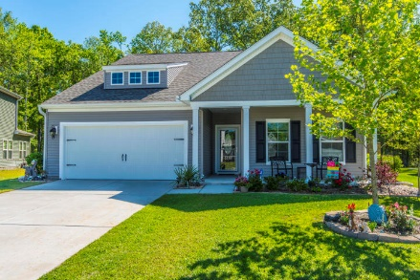
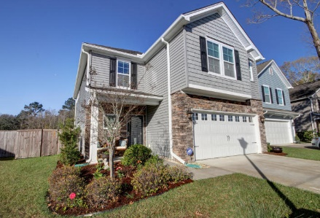
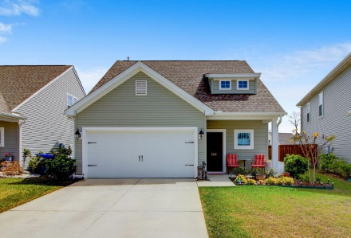
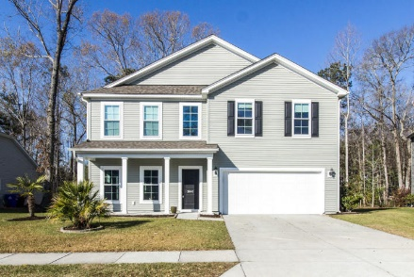
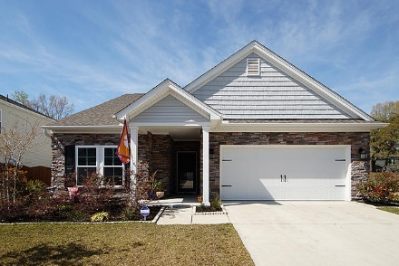
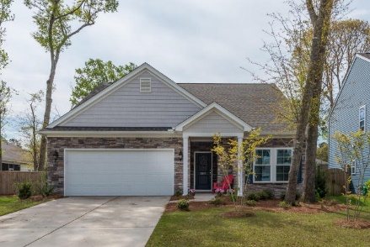
Tupelo Agent Open House Tour
Mount Pleasant
Thursday, April 26 · Noon-2pm
Progressive Lunch · $150 Gift Card Raffle
2036 Welsh Pony Drive
$450,000
3Bdrms/2 Baths/2464 SF
Listed by
Del Shaffer
Carolina One Real Estate
843-408-6821
1401 Oldenburg Drive
$435,000
4Bdrms/2.5 Baths/2510 SF
Listed by
Geri Lipps
Carolina One Real Estate
843-810-8398
1436 Oldenburg Drive
$400,000
4Bdrms/3 Baths/2095 SF
Listed by
Ashley Donovan
DR Horton
843-901-4936
3840 Hanoverian Drive
$509,900
4Bdrms/3.5 Baths/3704 SF
Listed by
Beth Bird
ERA Wilder Realty Inc.
843-327-8315
1307 Paint Horse Court
$479,000
3Bdrms/2 Baths/2487 SF
Listed by
John A Beall
Carroll Realty
843-469-2909
3917 Percheron Drive
$439,000
4 Bdrms/3 Baths/2500 SF
Listed by
Sharyn Nichols/Nichols Team
Carolina One
843-345-6934
You must stop at ALL Homes and Have Your Business Card Stamped to win . . .
We look forward to seeing you on Thursday at these beautiful Tupelo Homes.

