Slide 1
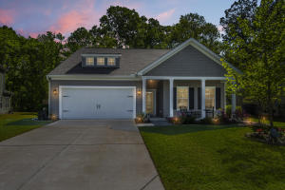
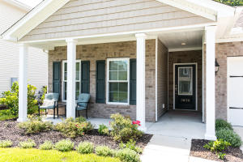
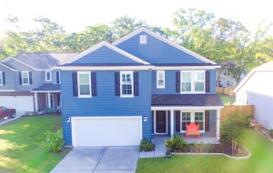
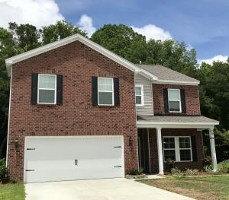
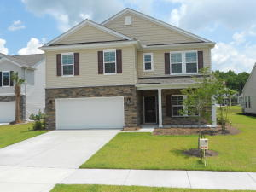
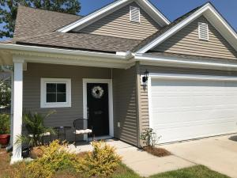
Tupelo Open Houses Tomorrow
Mount Pleasant - Saturday, June 30th - 1-3pm
Around the Corner:
New Costco just weeks away from opening
40,000 sq. ft. public library taking shape, spring 2019 completion
New Lowe's Open
Why wait for New Construction?!?!
3.5 miles from the corner of Highways 17 & 41... Same distance from that corner up Highway 41 to Park West, RiverTowne, Planters Point and Dunes West!
So, why wait in traffic when you could be home enjoying this beautiful home!
Bring your
buyers
Bring your
buyers
2036 Welsh Pony Drive
$447,900
3 Bdrms/2 Baths/2,464sf
Listed by
Del Shaffer
Carolina One Real Estate
843-408-6821
3820 Hanoverian Drive
$390,000
3 Bdrms/2 Baths/1,780sf
Listed by
Carey Nikonchuk
The Brennaman Group
843-276-1701
1304 Belgian Draft Drive $445,000
4 Bdrms/2.5 Baths/2,663sf
Listed by
Lisa Martin
Century 21 Properties Plus
843-633-3289
2052 Welsh Pony Drive
$489,000
5 Bdrms/3 Baths/2,648sf
Listed by
Susan Bryant
AgentOwned Preferred Group
843-224-0804
1024 Banker Court
$443,500
5 Bdrms/3 Baths/2,632sf
Listed by
Brian Shaw
Weichert Palmetto Coast
256-322-1583
1449 Oldenburg Drive
$399,000
4 Bdrms/3 Baths/1,985sf
Listed by
Greg Day
Brand Name Real Estate
843-367-6368

