Slide 1
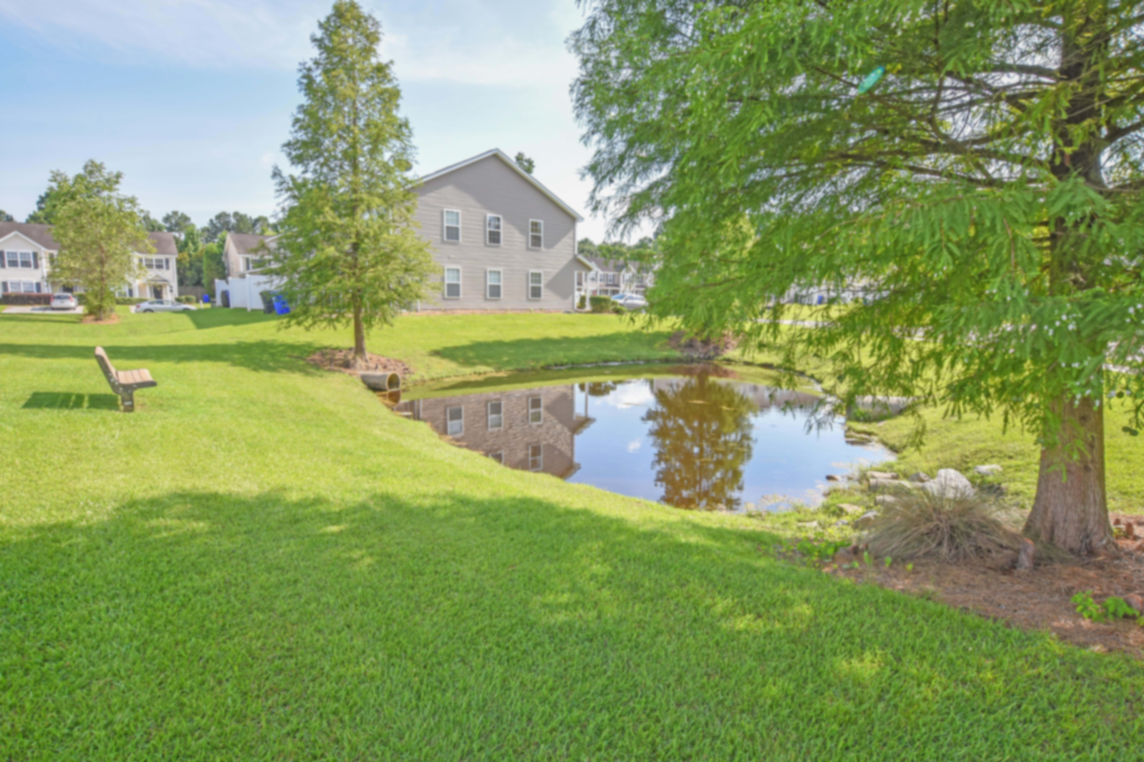
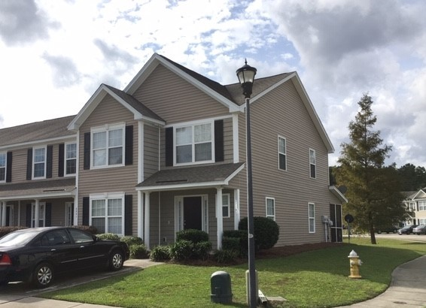
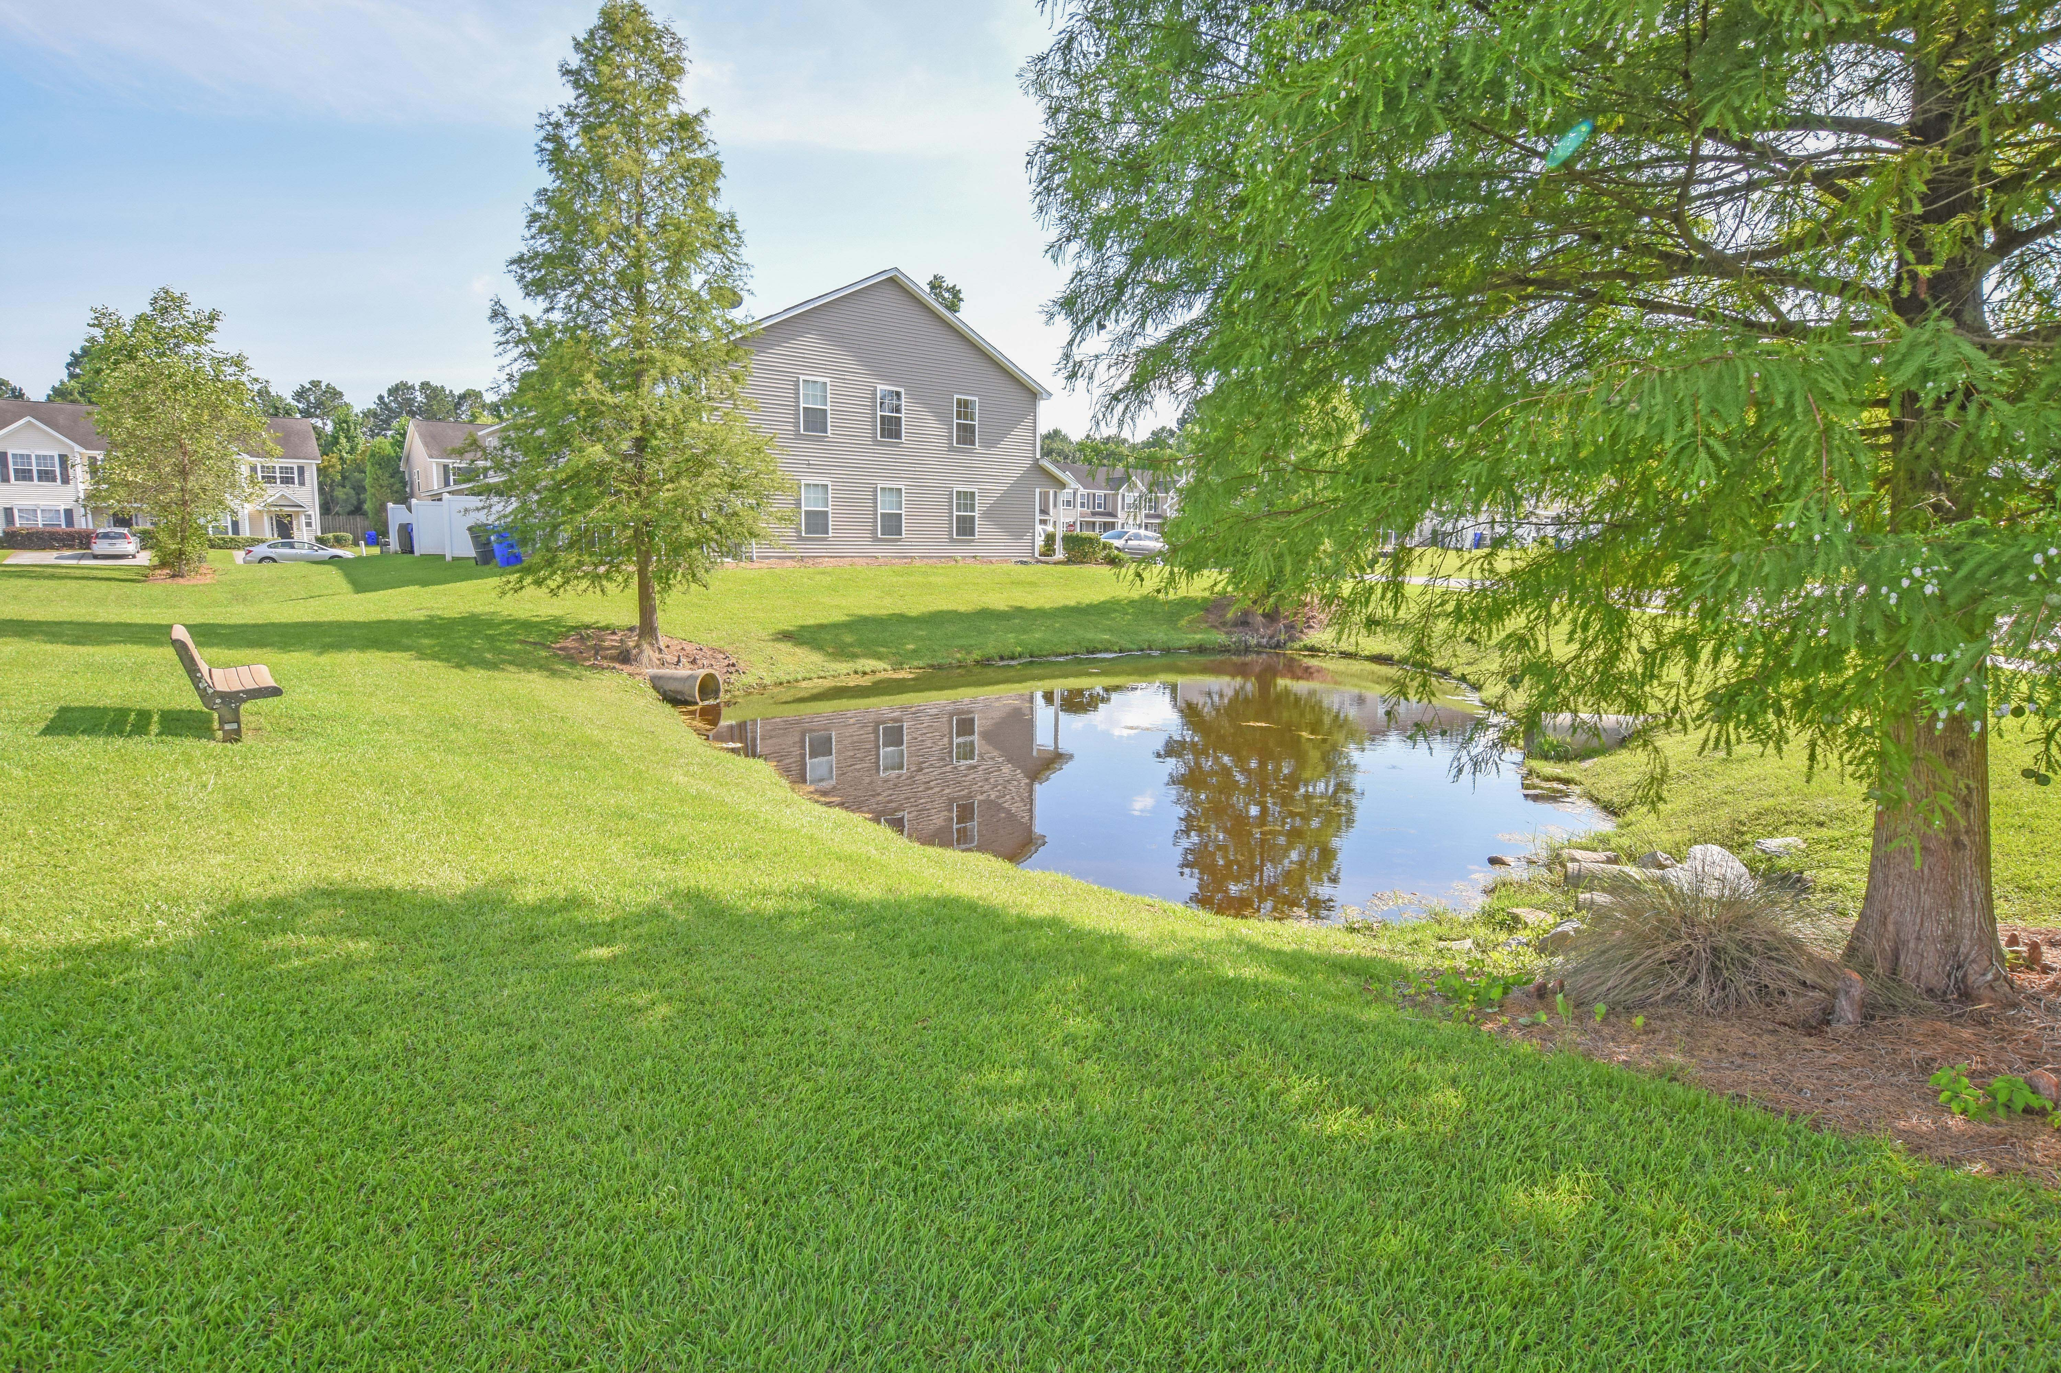

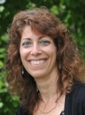
Off Market Investment Opportunity
6.94% Cap Rate | $193k
Turnkey investment opportunity with tenants in place. Premium 4BR, 2.5BA end unit townhome with loft built in 2007 AND on a pond lot. This unit is in great condition and is perfect for a first time investor or anyone looking to expand their investment portfolio. Very low HOA fee handles lawn care, annual power washing and more.
Excellent commuting location in University Park, N. Charleston minutes to I-26, Trident Medical, Charleston Southern University, Wanamaker Park, Northwoods Mall, etc. If you are working with investors then you know how hard it is to find a nearly 7% cap rate. Asking $193k. Off market - call me for details.
Bonnie Sitsis
C (843) 973-0062
bonnie.sitsis@gmail.com
Bonnie Sitsis
(843) 973-0062 | bonnie.sitsis@gmail.com
AgentOwned Preferred Group | 1400-G Palm Blvd. | Isle Of Palms, SC 29451
AgentOwned Preferred Group | 1400-G Palm Blvd. | Isle Of Palms, SC 29451

