Slide 1
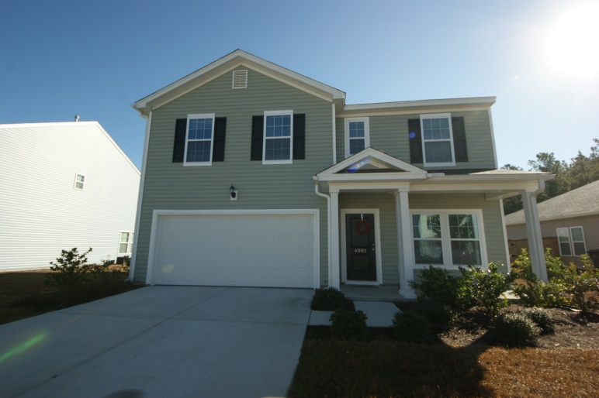
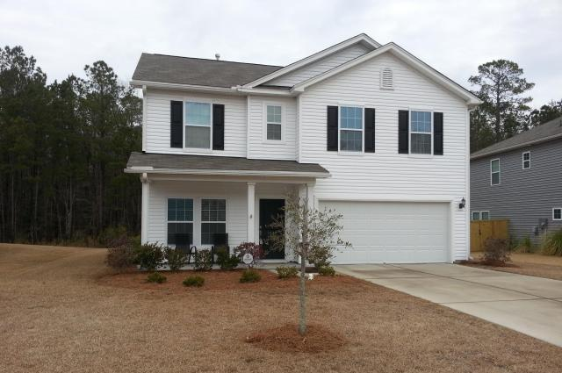
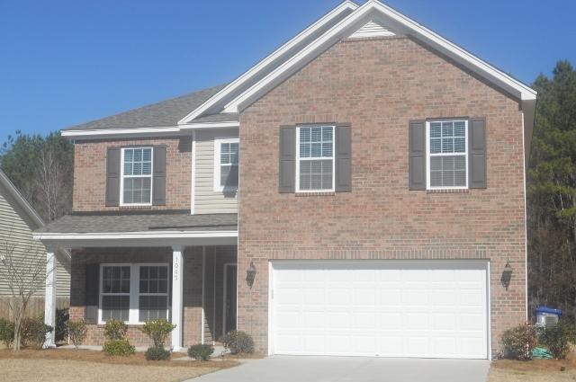
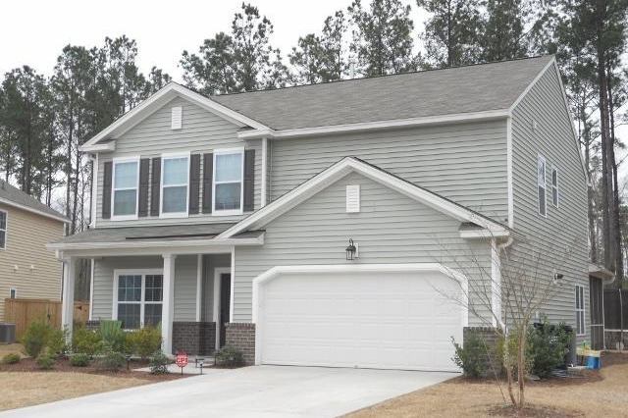
Victoria Pointe Open Houses
Sunday, March 8th, from 1-4p
Refreshments Provided … Visit each home to enter a drawing
Price Reduced!
4002 Chadford Park Drive
MLS# 14030560
Offered at $209,900
Listed by Sandra Siegling
843-343-1119
sandy.siegling@gmail.com
ERA Wilder Realty
1049 Victoria Pointe Lane
MLS# 15004206
Offered at $220,000
Listed by Craig Jamison
843-810-6969
craig.jamison@carolinaone.com
Carolina One Real Estate
1045 Victoria Pointe
MLS# 15003859
Offered at $264,900
Listed by Celisa Woodward
843-991-5536
woodwardcm@hotmail.com
Keller Williams Realty
7009 Kingsley Vale
MLS# 15005169
Offered at $249,900
Listed by Celisa Woodward
843-991-5536
woodwardcm@hotmail.com
Keller Williams Realty

