Slide 1
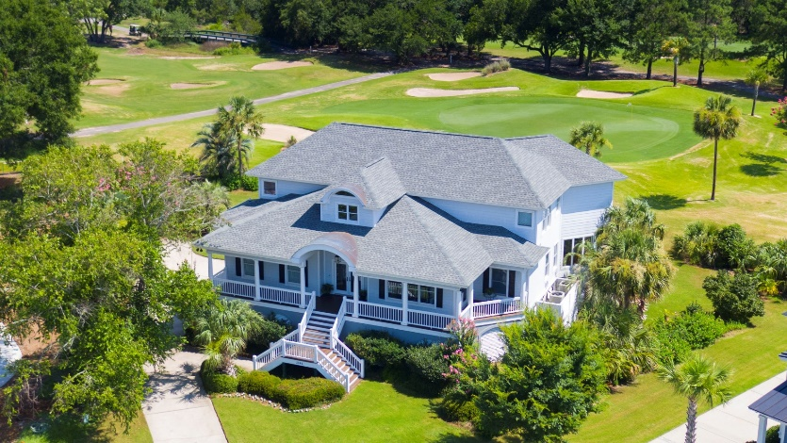
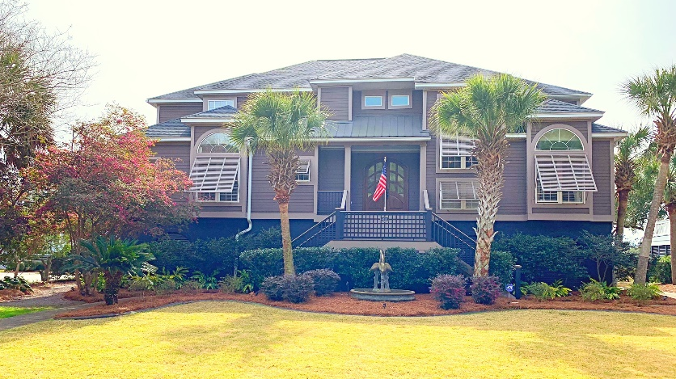
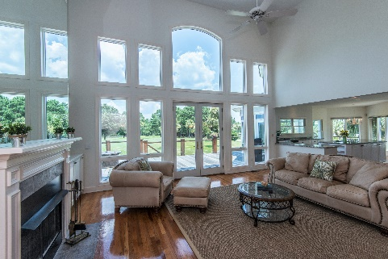
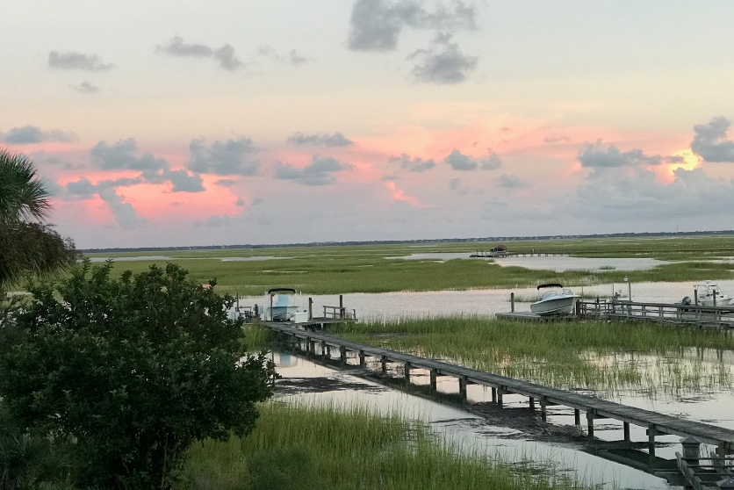


5046 Victory Pointe Court Charleston National :: Mt Pleasant :: MLS# 18019763 :: $830,000
New
Construction
Broker Open House Thursday 10:30-1:00
2 Fabulous Homes in Private Gated Victory Pointe at Charleston National
Light lunch, Snacks, and Mimosas Provided
Visit both homes to be eligible for $50 Visa Gift Card drawing!
Victory Pointe Gate Code: #1212
5046 Victory Pointe Court
List price: $850,000
3712 Sq ft on Golf Course (3 Holes!)
4 Bedrooms with 3.5 Baths
Just Renovated in Jan 2019!! (New floors, New kitchen, Added a Full Bath!)
1418 Victory Pointe Dr
List price: $1,250,000
4200 sq ft on deep tidal water on the Copahee Sound in Mt Pleasant with dock
4/5 beds with 4.5 baths
Totally renovated in 2014
Wendy Arnsdorff
843-364-8619
wendy.arnsdorff@carolinaone.com
Jonnie Furmanchik
843-270-4452
jonnie.furmanchik@carolinaone.com
Carolina One Real Estate :: Mt. Pleasant North Office :: 2713 N Highway 17 :: Mt. Pleasant, SC 29466

