Slide 1
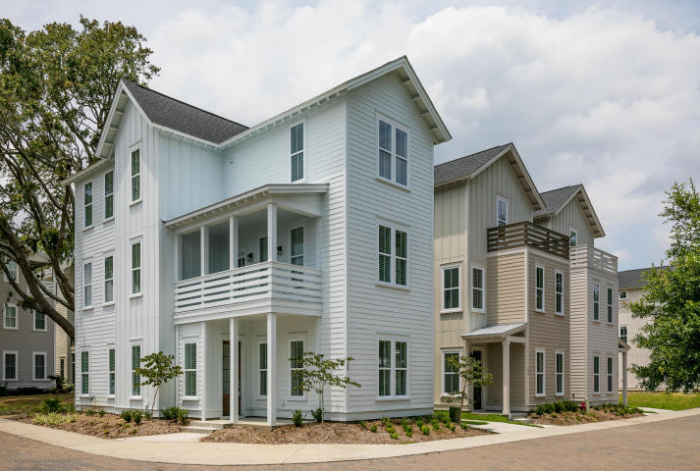
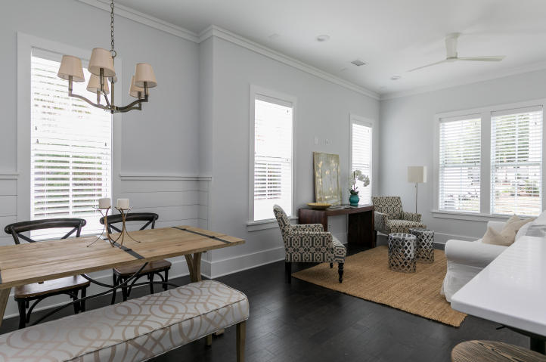
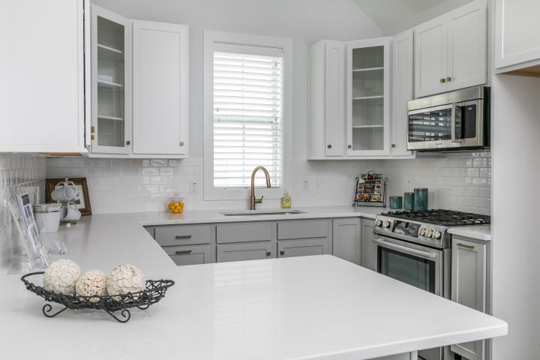
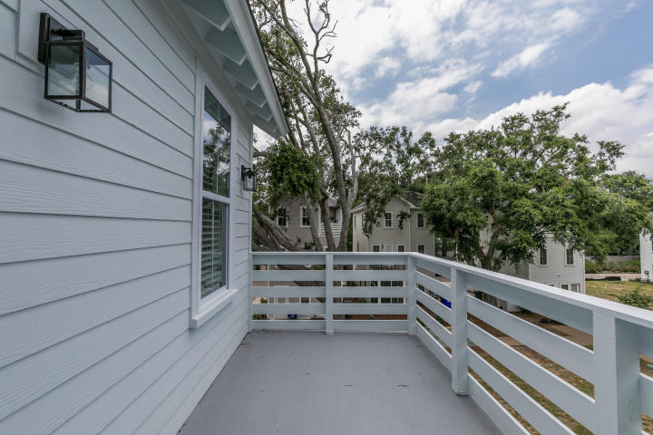
Please join us for music, food, and drinks to celebrate The New Village Park Subdivision 129 Bratton Circle Mt Pleasant, SC 29464 Wednesday July 26, 2017 ~ 6-8pm
You’re Invited
New construction urban living in the green of high demand Old Mt Pleasant ~ These stunning tree top homes are nestled in the middle of this vibrant community ~ Turn left to the sea, turn right for opera and art ~ Bike to Sullivan’s Island, walk to the grocery, coffee shop, restaurants, and more ~ Amazing 10' Ceilings, Beautiful 5" hardwood floors throughout, Custom ship lap, designer lighting, and a gourmet kitchen are just some of the amazing finishes ~
RSVP (Yes only) Susan Aviles: 843-697-2383 Text / Call Darlene Tanenbaum : 843-817-9700 Text / Call
Directions: Take Coleman Avenue to Chuck Dawley Blvd, take the first right onto Schirmer Ave. Village Park will be on your right. Turn right onto Bratton Circle.

