Slide 1
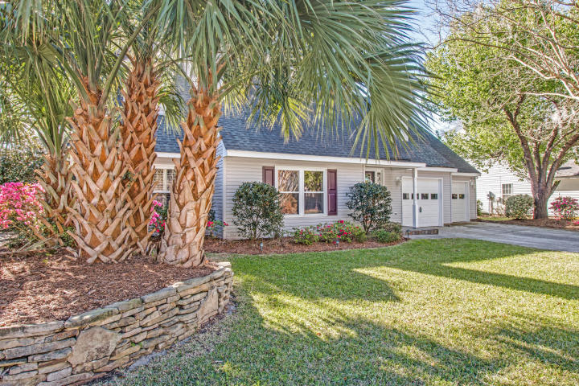
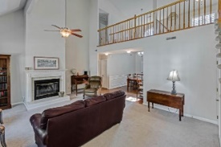
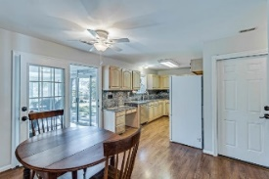
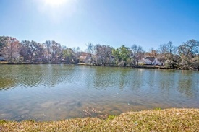
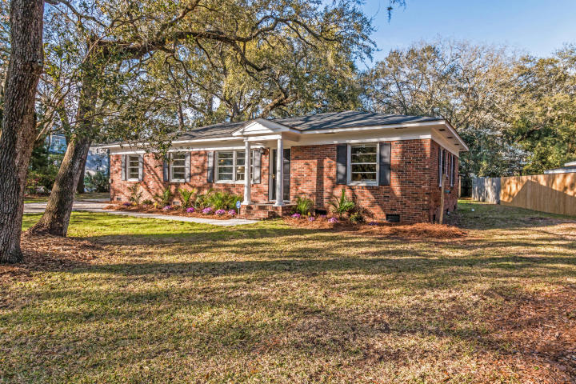
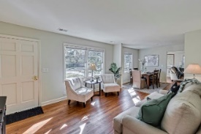
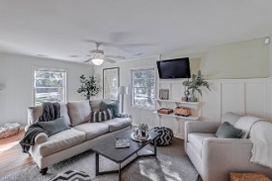
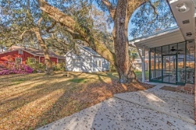
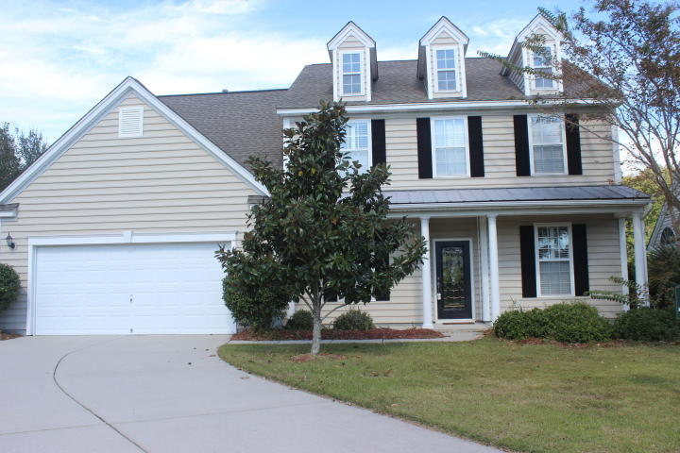
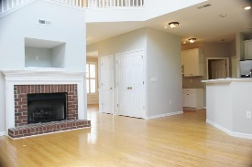
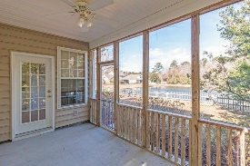
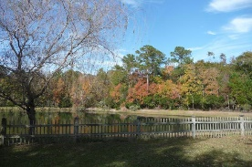
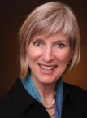

Three Fabulous Mount Pleasant Listings Move-in Ready!
1340 Center Lake Dr Center Lake
MLS# 18007302
$499,900
60 Vincent Dr Brookgreen Meadows
MLS# 18007300
$489,900
1672 Jorrington Street Park West
MLS# 17002828
$485,000
Kay Kennerty MBA, ABR, CRS, GRI
843-345-5011
KKennerty@aol.com www.KayKennertyHomes.com
The AgentOwned Realty Company
824 Johnnie Dodds Blvd, Mt. Pleasant, SC 29464

