Slide 1
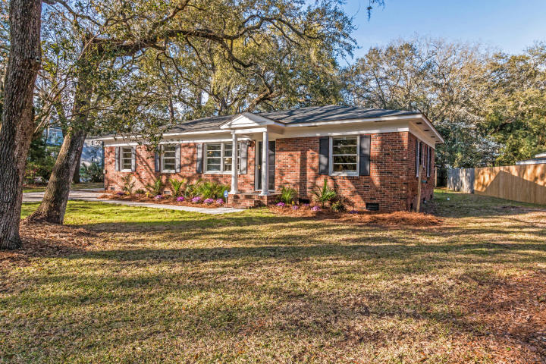
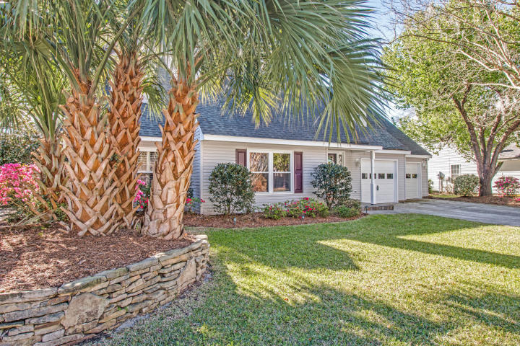
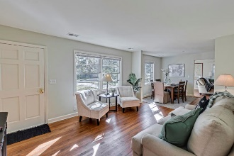
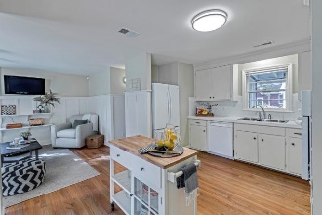
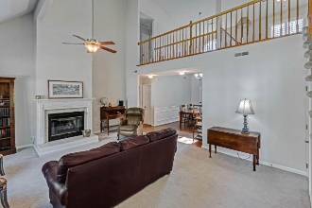
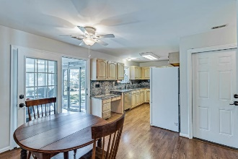
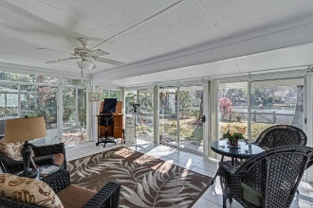
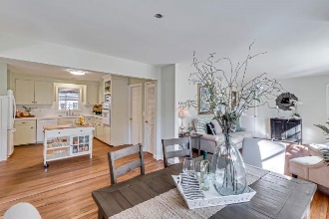
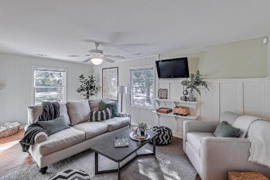
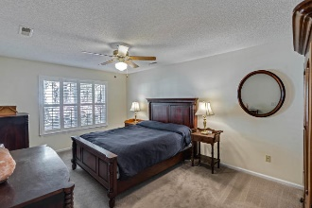
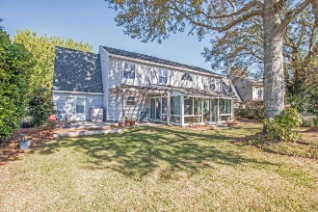
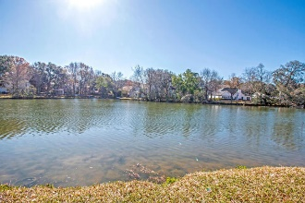
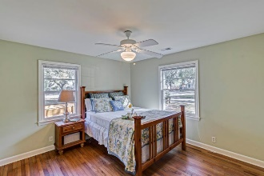
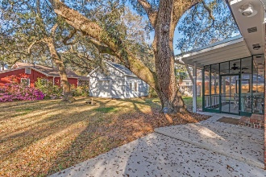
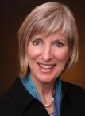

Mount Pleasant Open House 1340 Center Lake ~ Wednesday ~ 11:30-1 Open House for 60 Vincent is cancelled
60 Vincent Dr Brookgreen Meadows
Mount Pleasant, SC 29464
MLS# 18007300
$489,900
1340 Center Lake Dr Center Lake ~ Mount Pleasant, SC 29464
MLS# 18007302 ~ $499,900
Kay Kennerty MBA, ABR, CRS, GRI
843-345-5011
KKennerty@aol.com www.KayKennertyHomes.com
The AgentOwned Realty Company
824 Johnnie Dodds Blvd, Mt. Pleasant, SC 29464

