Slide 1
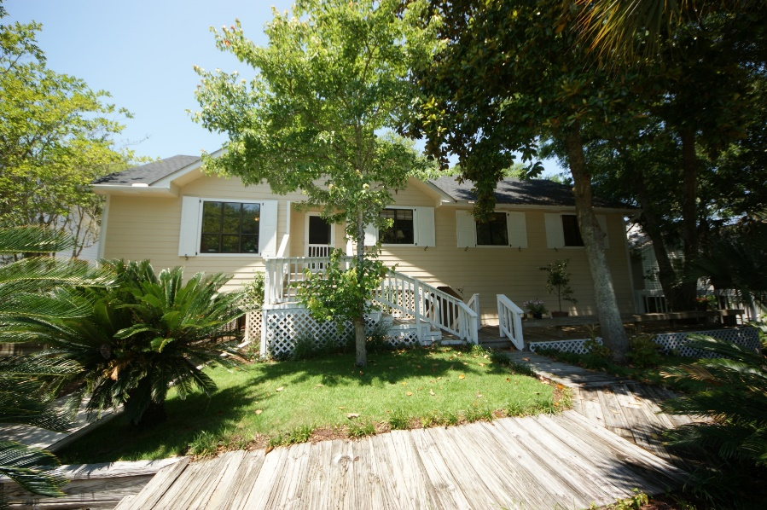


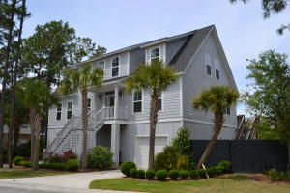
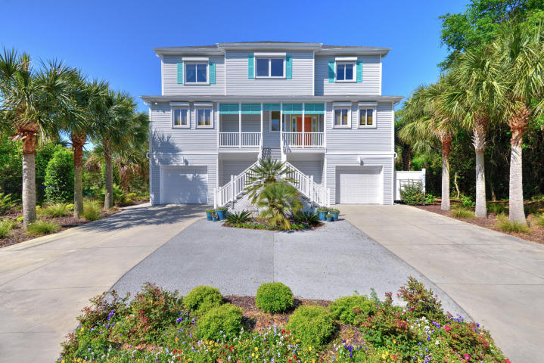
Folly Beach Open House & Progressive Luncheon
Wednesday, July 15 from 11:00-1:00
318 W Indian Ave
MLS# 15014492
$649,000
Ellen Murray
843 813-2006
chaspremierprop@bellsouth.net
318 W Indian Avenue ~ MLS# 15014492 ~ $659,000
Ellen Murray
843 813-2006
chaspremierprop@bellsouth.net
306 W Indian Ave
MLS# 15010409
$799,990
Joshua Walden
843-343-7546
josh@southernshoresre.com
436 W Indian Ave
MLS# 15017489
$997,500
Jimi Craddock
843-906-8724
jimi@statestreetreg.com
Handsome Properties, Inc
53 Broad St
Charleston, SC 29401

