Slide 1
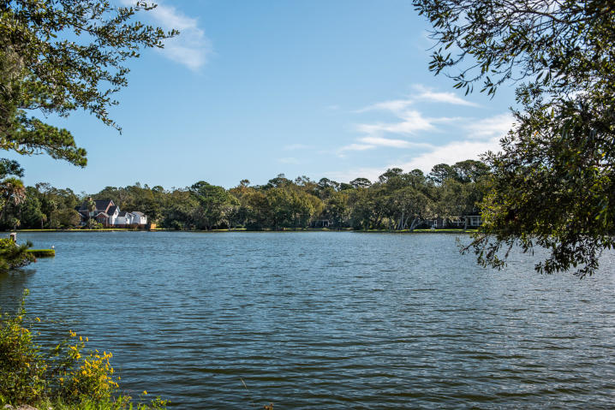
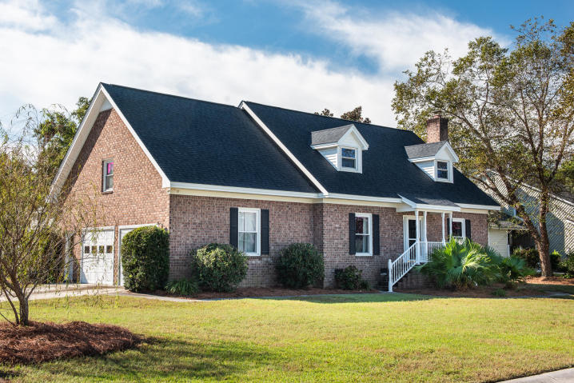
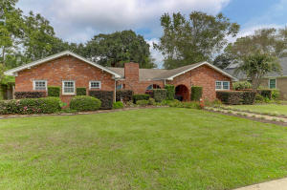
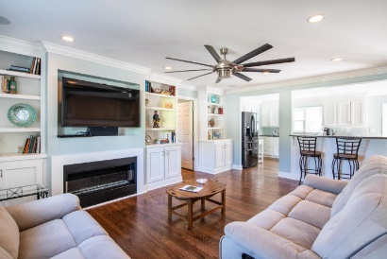
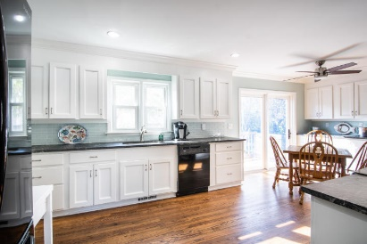
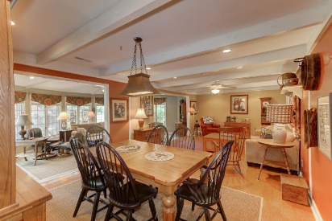
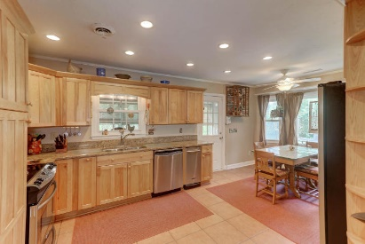

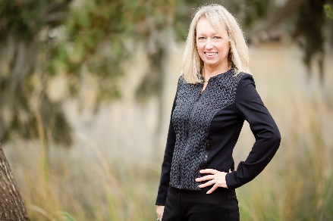
648 Oak Marsh Drive MLS# 19029477 | $525,000
Wakendaw Lakes Open Houses
Sunday, December 8th from 2-4pm
Enjoy Neighborhood Lakes
1282 S Barksdale Road MLS# 19025663 | $545,000
Charla McDonald (843) 343-1456
cmcdonald@carolinaone.com
Jeanie Acsell (843) 224-9589
jean.acsell@carolinaone.com
Mary Molony
843-478-8460
mmolony@carolinaone.com
Carolina One Real Estate
628 Long Point Rd.
Mt Pleasant, SC 29464-3032

