Slide 1
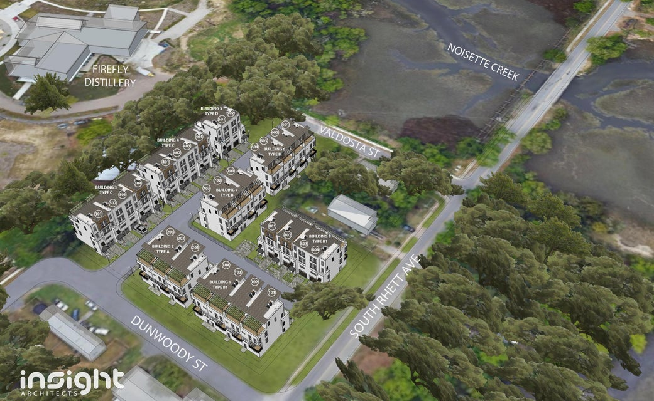
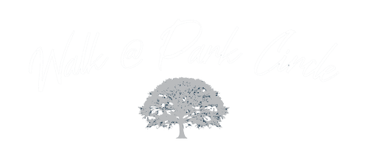
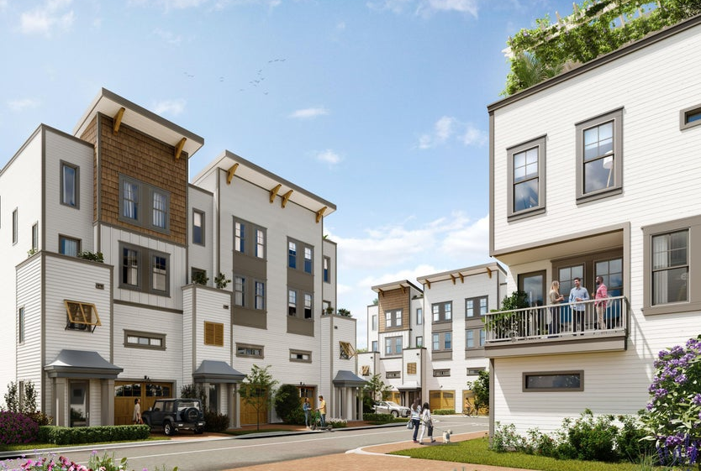
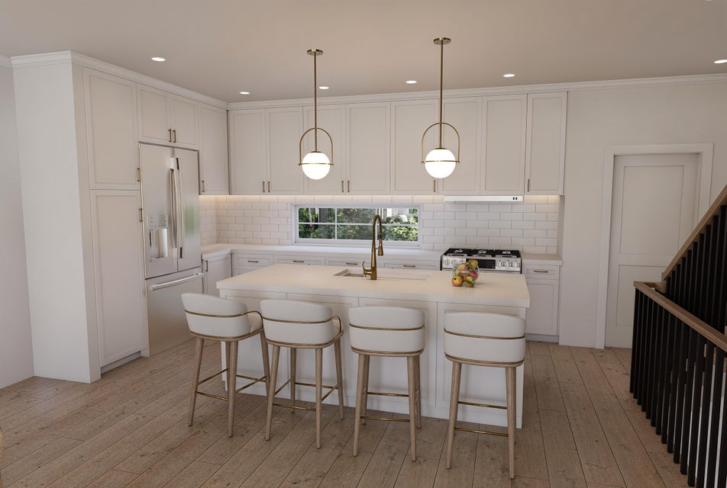
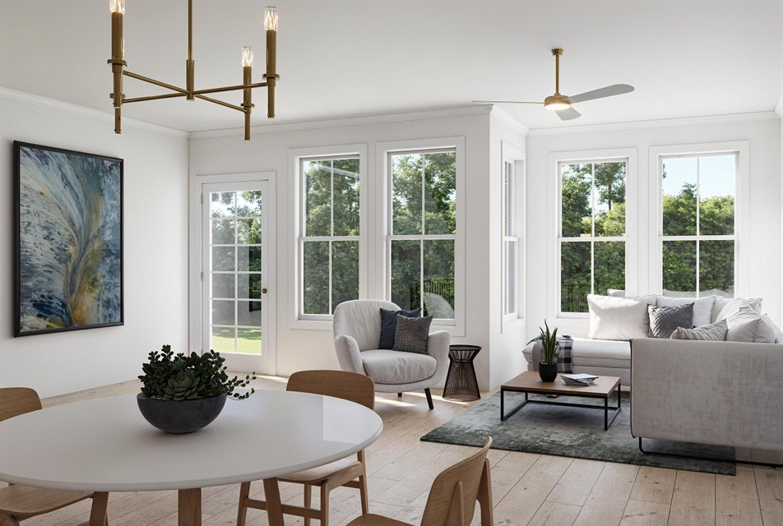
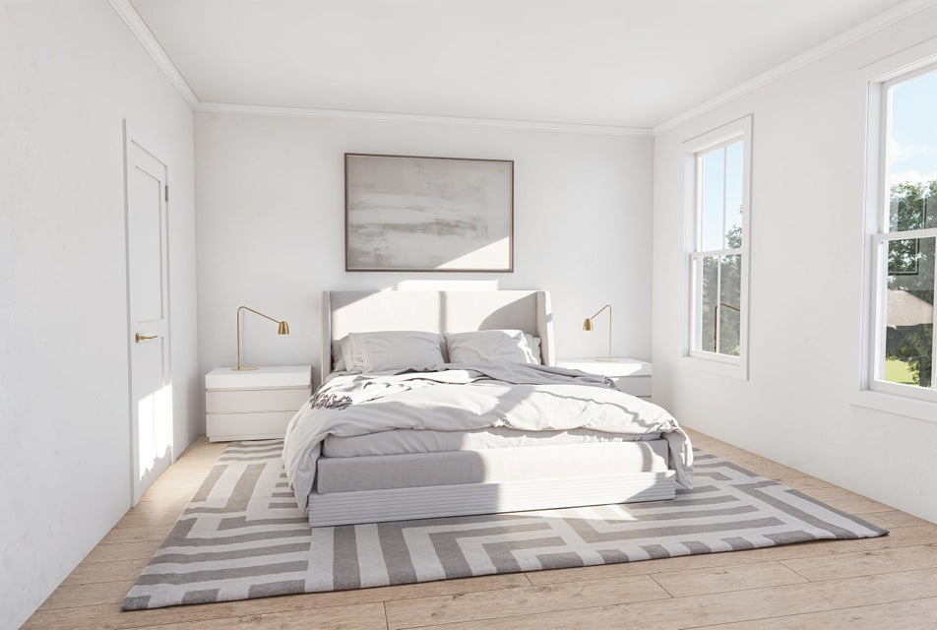
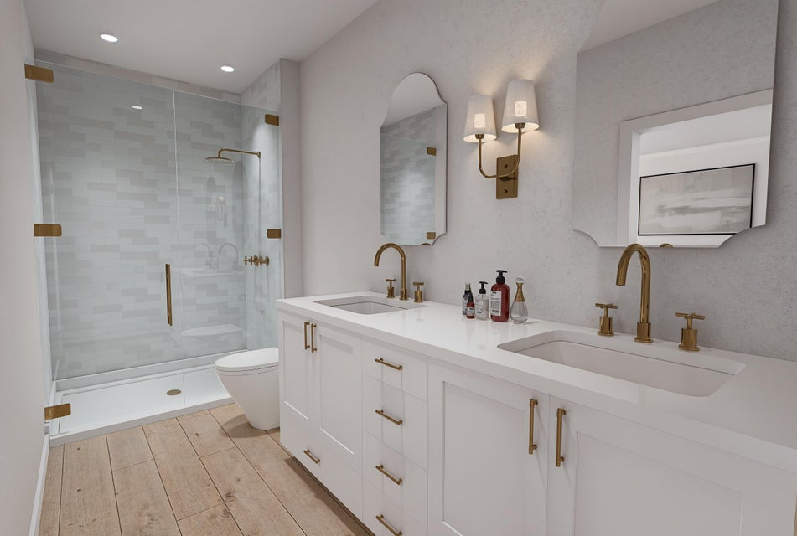
The Walk at Park Circle
1150 Valdosta Street, North Charleston, SC 29405
Phase 1 of a 28 Unit Luxury Development Available Now
Please come to our Boots On The Ground Event January 29th at 9:00 on site at The Walk at Park Circle for a tour and more information about the exciting development on Noisette Creek. Please call us for more information about this event.
Walk at Park Circle offers sophisticated and timelessly designed residences along the banks of Noisette Creek, showcasing a splendid natural backdrop. CK Development has an eye for high-end construction creating quintessential modern, Lowcountry design. The Walk, nestled in the heart of Park Circle has walkable accessibility via the plans for The Noisette Creek boardwalk, which is being constructed by the City. Unique to this community, an outdoor living space is included on each floor, with the top floor featuring an expansive walk-out balcony that provides one-of-a-kind views of Firefly Distillery, Noisette Creek, and long-range views of Riverfront Park. All residences will feature luxury high-end finishes with 10' ceilings and modern designs. All selection packages include stainless steel appliances, large kitchen islands with quartz countertops and an open living concept.
11 Residences being offered in Phase One:
(8) 4 bedroom / 4.5 bath units with potential 1st floor Mother-in-Law suites.
(3) 3 bedroom / 3.5 bath units
Visit our website for more information: www.walkatparkcircle.com
John Rice
843-708-2515
johnrice6@gmail.com
Bluestone Realty
Betsy Strott
504-301-8604
BetsyStrott@gmail.com
AgentOwned Realty Charleston Group

