Slide 1
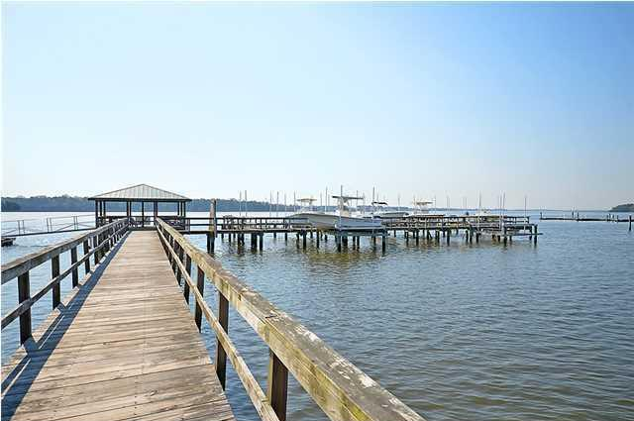
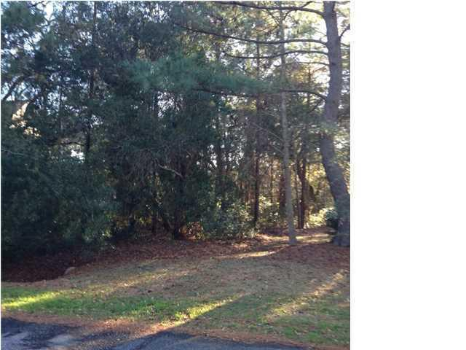
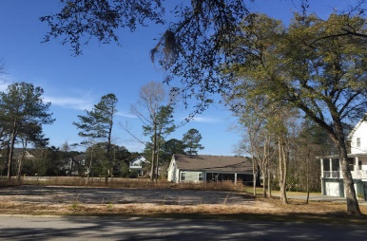

143 Wando Reach Road Wando Point Wando, SC 29492 MLS# 16006375 $266,000
Open House Sunday 2-4
Gate Open!
Open House Sunday 2-4
Gate Open!
Loaded with Updates
Cleared Lot with Boat Slip & Lift
139 Wando Reach Road Wando Point Wando, SC 29492 MLS# 15007827 $120,000
Stan Huff
843-670-2835 stan.huff@agentowned.com
Jill Marcacci
843-297-5590 jill@agentowned.com
www.agentownedrealty.com
AgentOwned Realty Co. Preferred Group, Inc. | 824 Johnnie Dodds Blvd | Mt Pleasant, SC 29464

