Slide 1
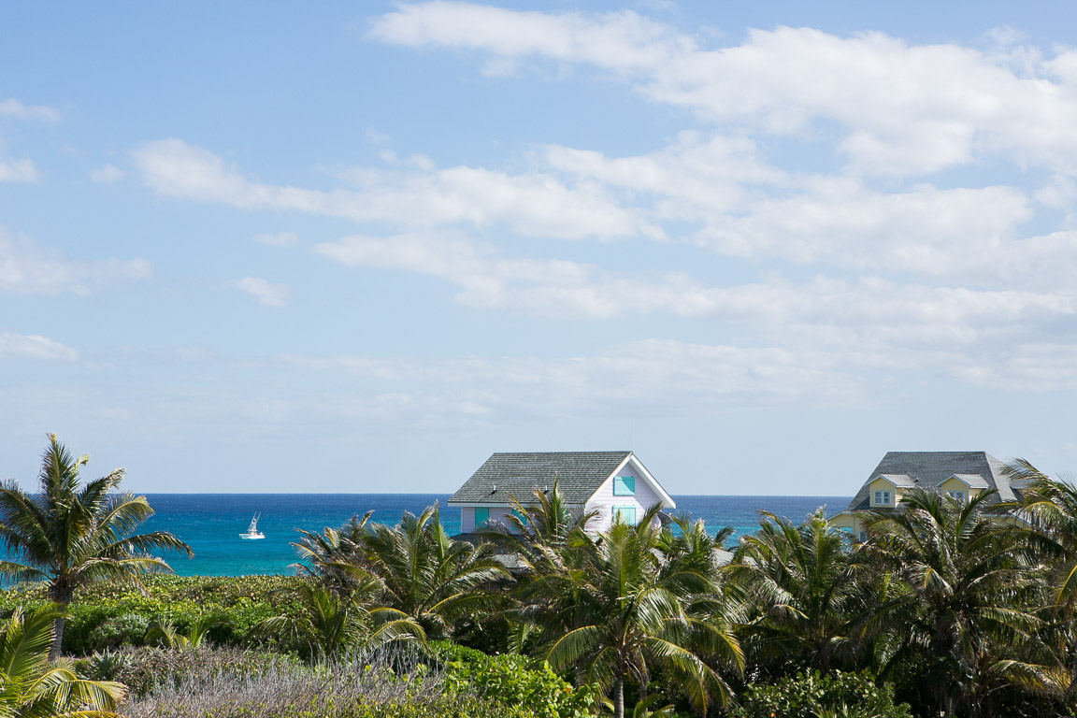

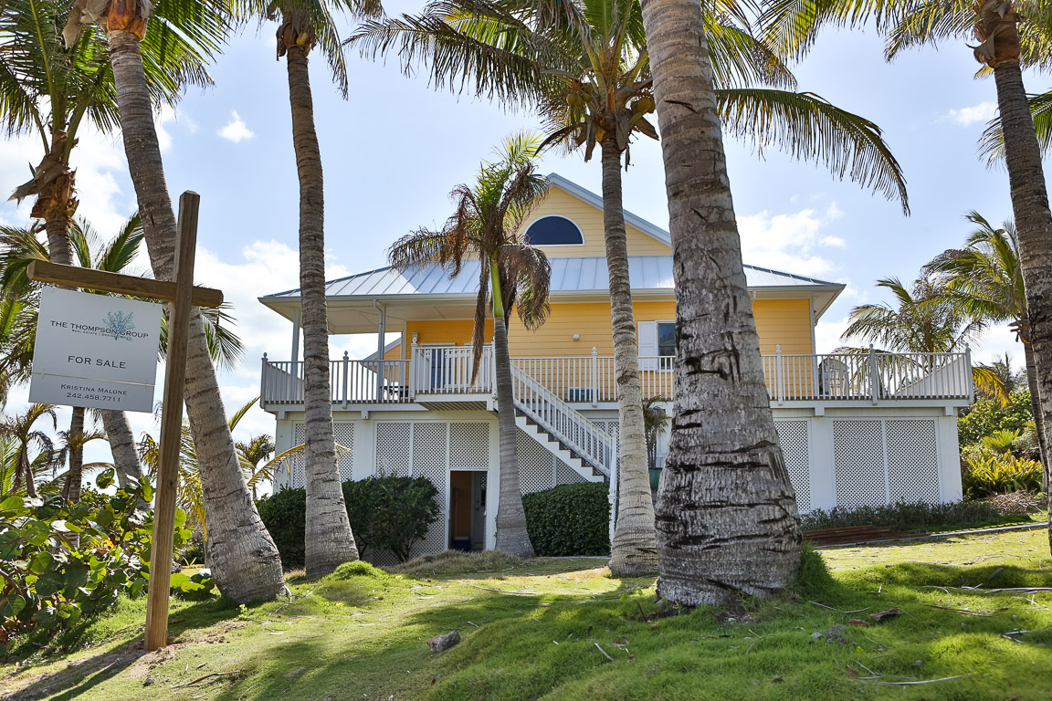
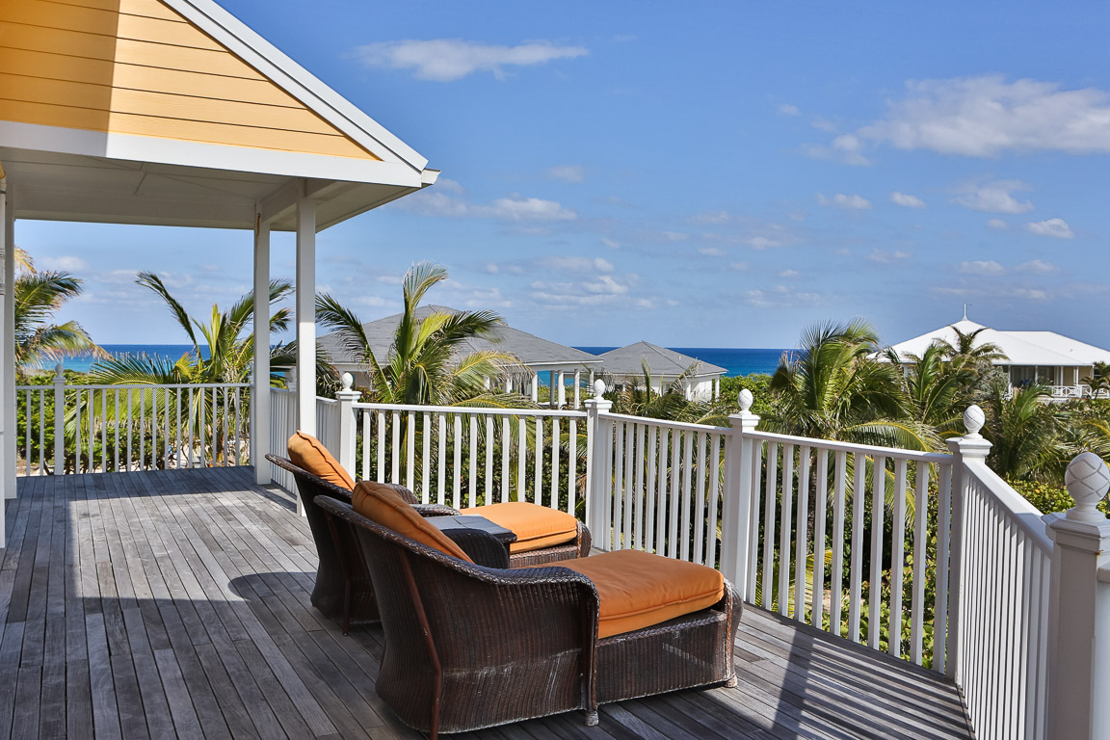
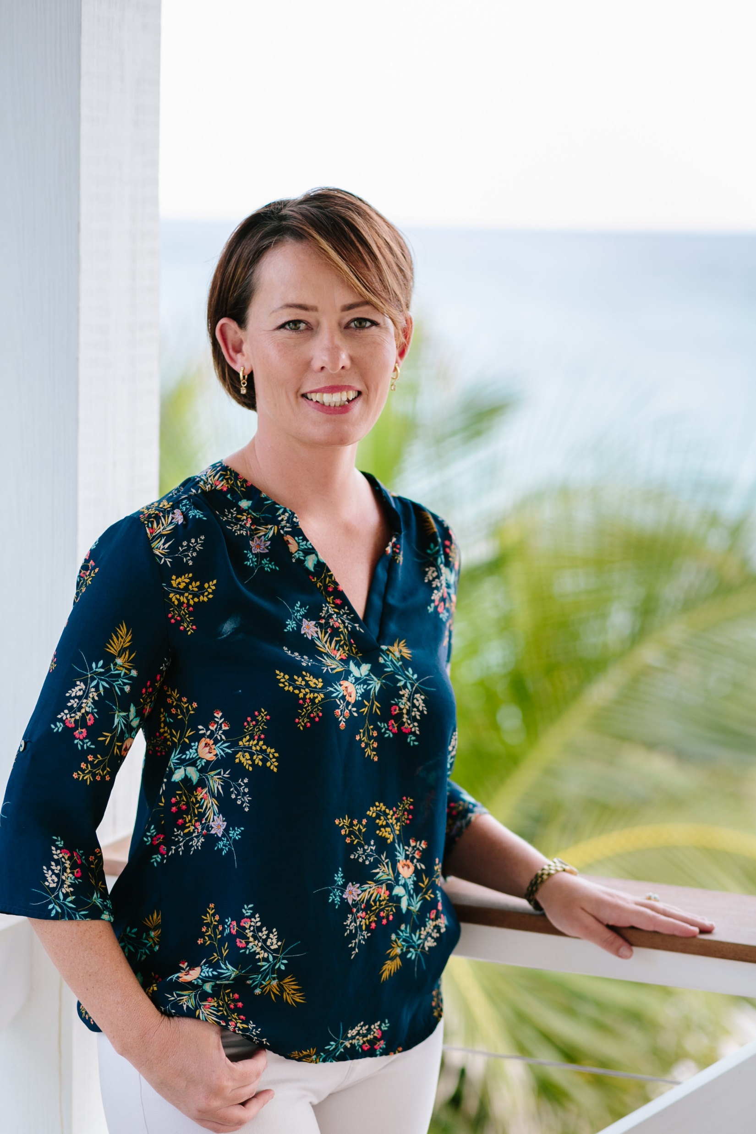
Water Wings is a quintessential Bahamian island home that sits on a grassy corner lot of almost a half-acre in the Marine's Creek neighborhood of Elbow Cay. Located just a stone's throw from one of the most beautiful beaches on the island, it's also just a ten minute golf cart ride from the Hope Town settlement and some of the most popular bars and restaurants. Constructed in 2003 and outfitted with a new roof in 2015, the main home offers 1,550 square feet of living space, with vaulted ceilings that allow for plenty of natural sunlight, a spacious open floor plan and unobstructed views of the Atlantic Ocean. Two bedrooms, two full baths and a multi-use loft round out the floor plan. A detached gazebo/pool house can be easily converted into a third bedroom. The gourmet kitchen offers updated appliances, custom cabinetry and a breakfast bar. Additional features include a private pool and one of the largest deeded dock spaces available within the protected marina. Dock space accommodates a 50-60' vessel and has electricity in place.
Kristina Malone
US Mobile 561.208.8370
Bahamian Mobile 242.458.7711
kristina.malone@thethompsongroupbahamas.com
www.thethompsongroupbahamas.com

