Slide 1
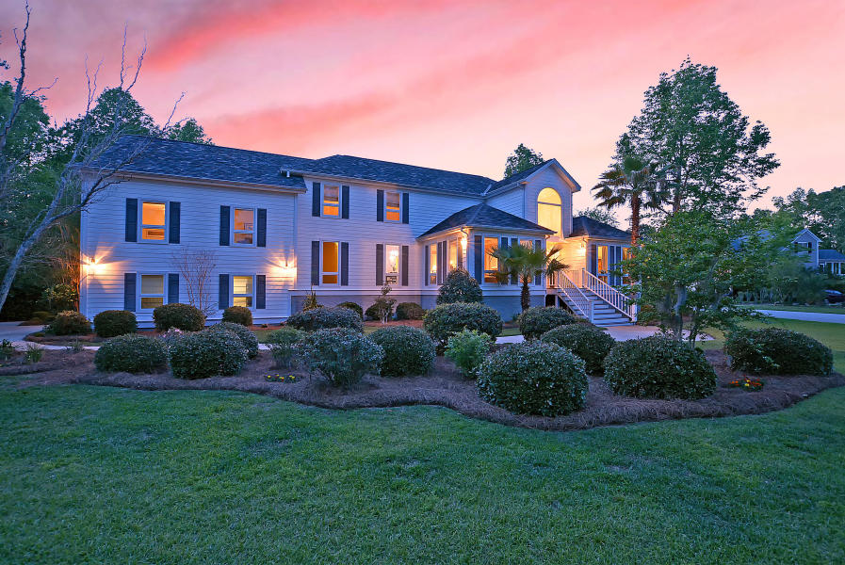
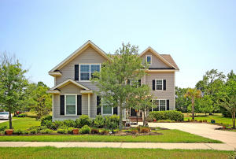
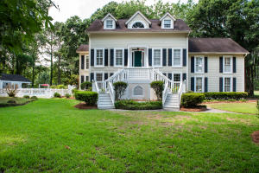
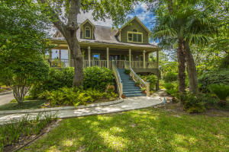
West Ashley's Finest
Open House Tour this Saturday Oct 5th 1-4pm
3002 White Heron Lane
Croghan Landing
Charleston, SC 29414
MLS# 19018683 ~ $598,999
Christopher Smith
843-267-0735
christopher@mattoneillteam.com
Matt O'Neill Real Estate
251 Shadowmoss Parkway
Shadowmoss
Charleston, SC 29414
MLS# 19016699 ~ $575,000
Zelda Bryant
843-330-7507
zeldabryant@gmail.com
Bryant Real Estate Group
Open 1-3pm
5 Cutchin Court
Shadowmoss
Charleston, SC 29414
MLS# 19016970 ~ $635,000
Beth Moore
843-532-4892
bmoore@carolinaone.com
Carolina One Real Estate
201 Marsh Oaks Drive
Marsh Oaks
Charleston, SC 29407
MLS# 18014134 ~ $550,000
Toby Spahr
843-532-1751
tobyspahr@carolinaone.com
Carolina One Real Estate

