Slide 1
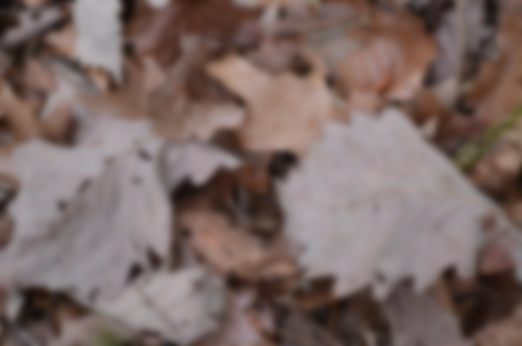
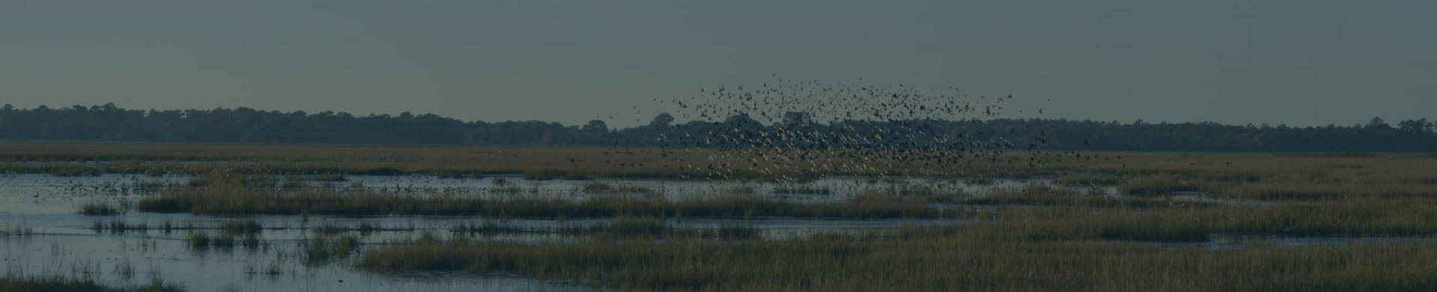

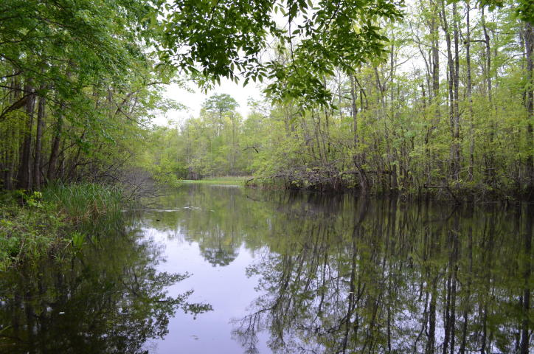
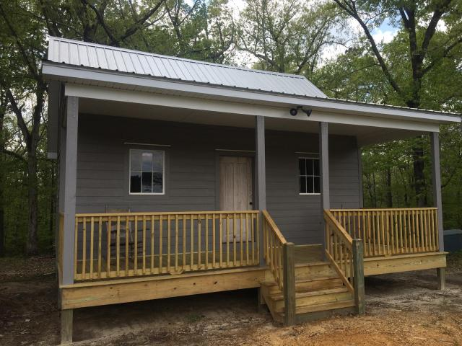
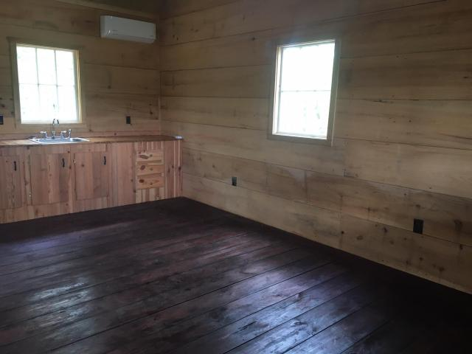
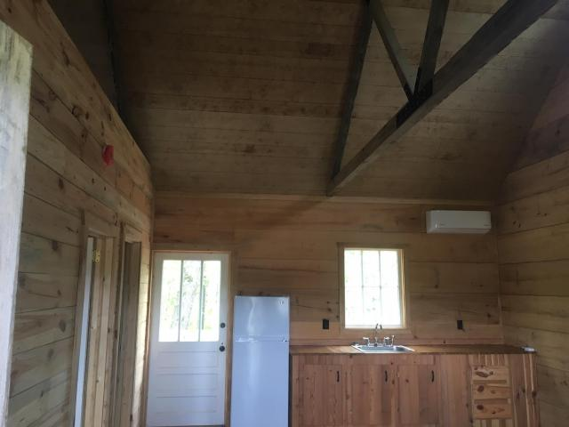
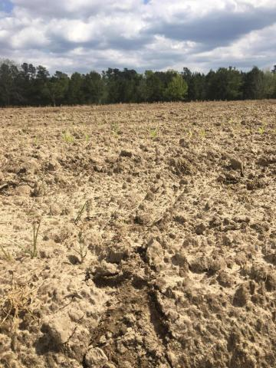
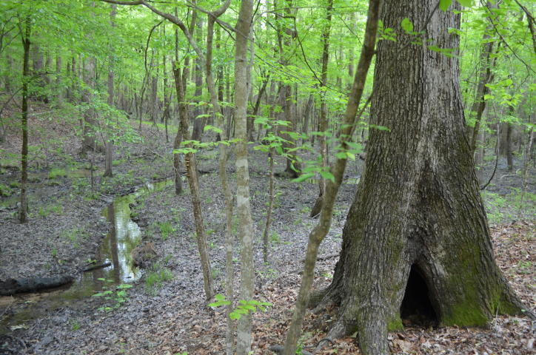
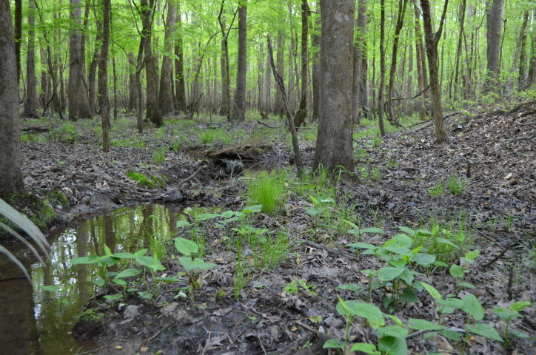
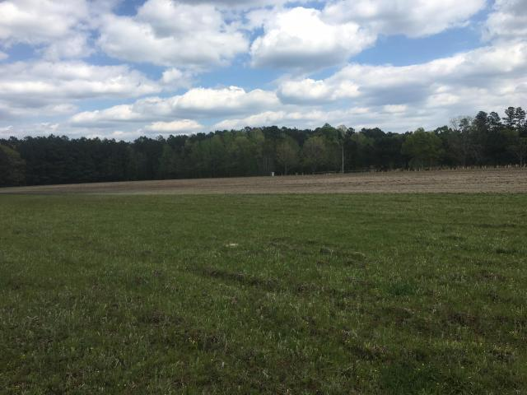
DOUGLAS CUTTING
(843) 534-3911
dcutting2@gmail.com
Willtown Crossing
1 Henry Road ~ Hemingway, SC 29554
MLS# 18019405 ~ $850,000
Willtown Crossing farm sits on the historic 18th Century Wilson's Landing site on Black Mingo Creek, and was once considered the last crossing and crop-loading high ground bluff up Mingo Creek for the Willtown settlement. This property has a boat landing on tidal, boatable water, bluffs on the navigable creek, rolling upland mature hardwood forest, mature pine forest with roads and paths, a small duck impoundment, dove field, newly built small cabin complete with power, well, and septic. It is an extremely secluded property with easy access to a great farming community and stores/diners. Surrounded by excellent wildlife management-oriented neighbors, this tract has excellent populations of deer, turkeys, doves and wood ducks. Price has been recently reduced. Property has a 1980's Ducks Unlimited Conservation Easement that allows timber harvest, ample home square footage, and many other improvements -- including more duck impoundments -- to take place.

