Slide 1
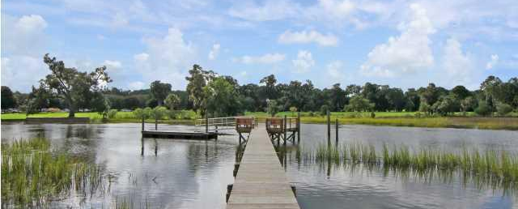
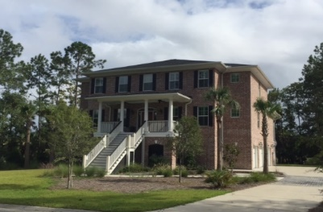
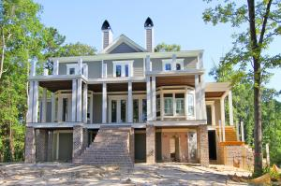
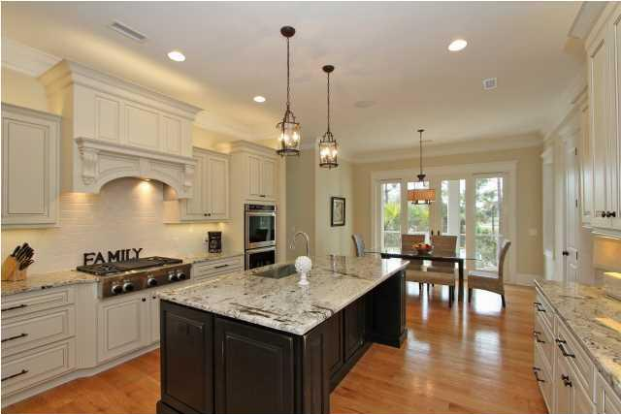
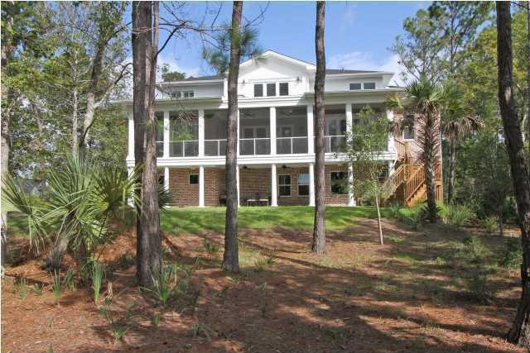
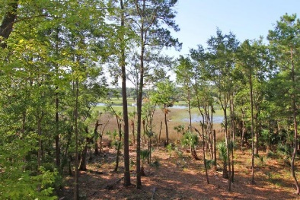
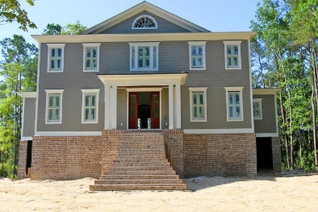

3028 Yachtsman Drive
MLS# 1424532 :: $1,575,000
Dunes West Open House
Sunday October 25th, 2-5p
3024 Yachtsman Drive
MLS# 15016554 :: $1,599,000
Gorgeous custom built, deep water home with all the bells and whistles that a discriminating buyer is searching for. The waterfront home on Wagner Creek is surrounded by 5 plus acres of marsh and woods and overlooks the 9th and 18th holes of the Dunes West Golf Course. Also included is your own private dock with a 14X14 ft pier head with water and electricity and a 8X20 ft floater with 6 to 7 feet of water at low tide. The first floor of this magnificent home includes a spacious entry hall, formal living room, separate formal dining room, great room with fireplace with gas logs, chef's kitchen, master bedroom and bath, powder room, large laundry room, office with built in desk and shelves and a huge screened porch which is accessible from the master bedroom, the great room and the kitchen. The second floor includes 3 large bedrooms and 3 full baths a library with built in shelves and a media room which opens onto a cozy private deck, great for relaxing and enjoying the sunsets. The ground level includes a huge recreation room, a guest room and full bath, covered porch and tons of storage as well as a three car garage. This lovely executive brick home includes so many special features that it is difficult to mention them all. Some of these include an elevator to take you to each floor, beautiful deep moldings throughout, hardwood floors on both first and second levels, central vacuum, surround sound, plantation shutters, double ovens, 2 dishwashers, gorgeous custom cabinets, …
This home is near completion (dock still to be built).On deep water, introducing another luxury home by Seneca Construction, with the imaginative design, intricate detail, and wonderful flow that are the trademarks of this custom builder. Built to capture the water views & the landscape from virtually every room, the visual effect showcases the importance of incorporating the natural surroundings into the home’s interior. In addition to the waterfront setting, the home is located in the exclusive gated community of Dunes West, well-known for its outstanding amenities. Even with much of the interior detail still to be done, it is easy to picture how stunning this spacious and elegantly comfortable home will be. The palladian window at the peak of the roof just adds that nice touch to this handsome home - when the hurricane shutters go on, and the landscaping is in, the effect will be impressive. The same thought went into the extensive interior features starting with the mahogany front door and continuing throughout the house: woodwork, hardwoods, high ceilings, granite, etc. Spacious rooms with bay windows and double glass doors have great views of the water and marsh. Fully-appointed gourmet kitchen with center island and large breakfast area with one of those bay windows. The large laundry/utility room will have 3/4 bead-board walls, and access to the side porch (where gas line is set for grille). Between the kitchen and dining room there is a butler's pantry and food pantry. …
Carolina One Real Estate
1503 Palm Blvd
Isle of Palms, SC 29451
Listed by
Bill Donovan
843-991-0146
donovans@carolinaone.com
Hosted by
Renee Meyer
843-991-0007 - renee@carolinaoneplus.com
Listed by
Gail Young
843-814-9885 - M
gailyoung@carolinaone.com

