Slide 1
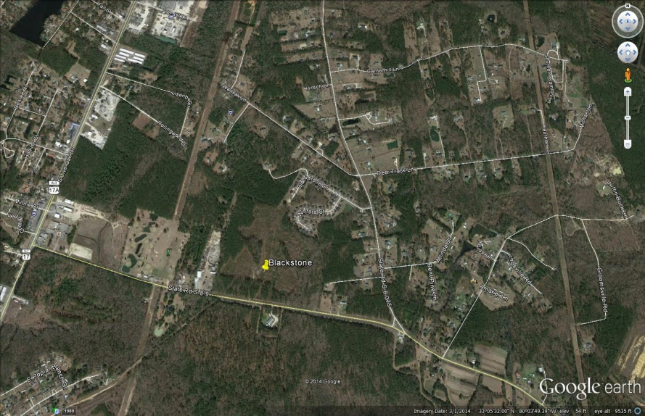
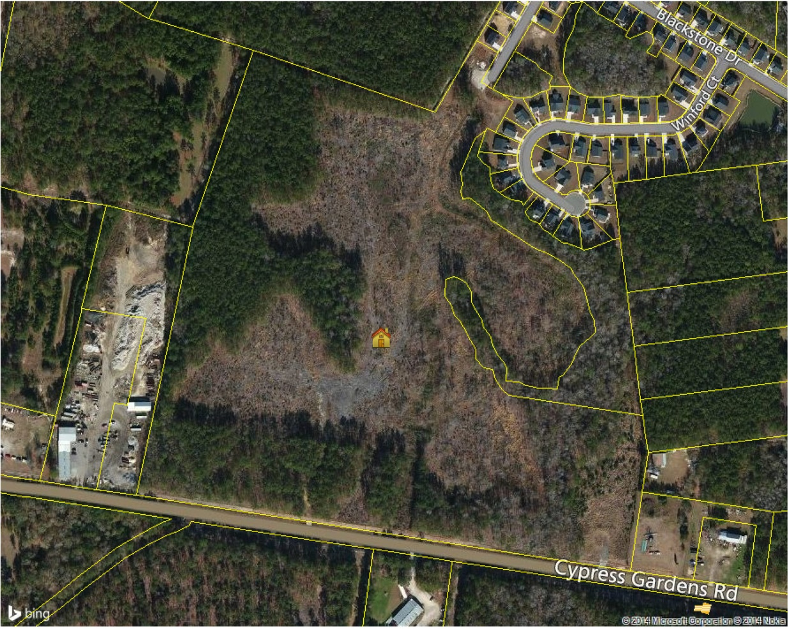
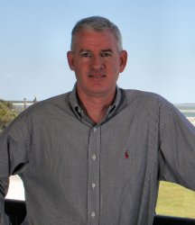

Blackstone
122 Lots
MLS# 1427359
$1,210,000
($9,918/lot)
Ready to be developed
in Berkeley County
PROPERTY FEATURES
122 entitled and engineered SF
Lots rough cleared and ready for development.
Additional 10.5 acres of commercial land zoned GC.
The new phase of subdivision will have new entry directly off of Cypress Gardens Road
Pump station in place
Shovel ready property
See more at www.2011shellring.com
122 entitled and engineered SF lots rough cleared and ready for development. Additional 10.5 acres of commercial land zoned GC . The new phase of subdivision will have new entry directly off of Cypress Gardens Rd. Pump station in place , shovel ready property.
Clay Cunningham
Office - (843) 886-8110
Cell - (843) 345-4647
Fax - (843) 202-2921
clay@carolinaone.com
Clay Cunningham
Broker Associate
Carolina One Real Estate
1503 Palm Blvd.
Isle of Palms,SC 29451
Cell - 843.345.4647
Office - 843.886.8110
Direct - 843.242.3004
Clay@CarolinaOne.com
www.Claysre.com
Carolina One Real Estate
1400-E Palm Boulevard
Isle of Palms, SC 29451

