Slide 1
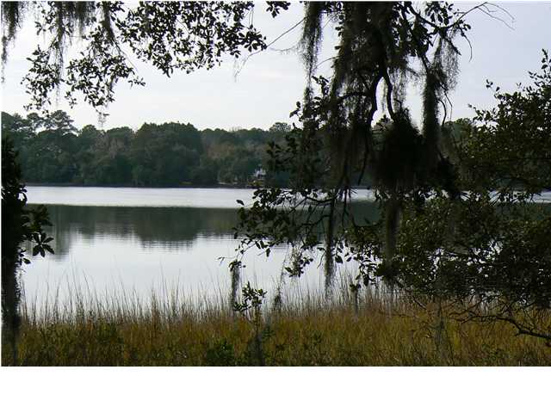
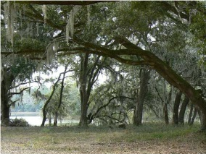
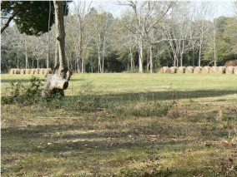
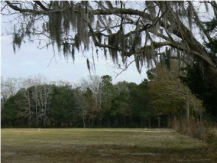
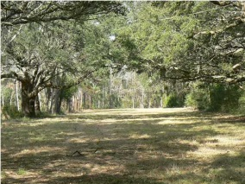
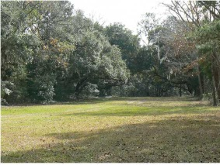

Beautiful Lots ~ Yonges Island, SC
Buy as a 22-acre estate or one of 4 subdivided lots
0 Hwy 165 MLS# 1300556 22.28 Acres $1,465,000 | 0 Hwy 165 (Lot 1) MLS# 1303415 7.32 Acres $375,000 | 0 Hwy 165 (Lot 2) MLS# 1303416 5.90 Acres $400,000 | 0 Hwy 165 (Lot 3) MLS# 1303417 4.81 Acres $360,000 | 0 Hwy 165 (Lot 4) MLS# 1303419 4.25 Acres $330,000
Absolutely beautiful and secluded property on a huge private saltwater lake in the historic town of Meggett on Yonges Island, 20 minutes from Citadel Mall, 35 minutes from downtown Charleston. This pristine piece of land is a birder's, fisherman's, or hunter's paradise, with its own "Avenue of Oaks." 4 Lakefront, estate-sized lots as one parcel; plans ready to submit to county for subdividing. 3 of 4 lots have been cleared of all but hardwoods, one lot remains "natural". Plat is uploaded - view in the pictures on this listing. Price for lots sold separately: Lot 1-$375K, Lot 2-$400K, Lot 3-$360K, Lot 4-$330K. City Water/Sewer at Road. Owners willing to consider financing with a 20% cash deposit, and terms until construction, additional details and requirements apply. Realtor related to Owners. Lot Size and Acreage estimated.
Alex Tumbleston atumbleston@eratidesrealty.com 843-6964184
ERA Tides Realty, 125 Wappoo Creek, Suite F, Charleston, SC 29412

