Slide 1
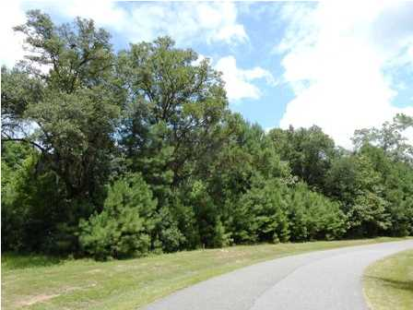
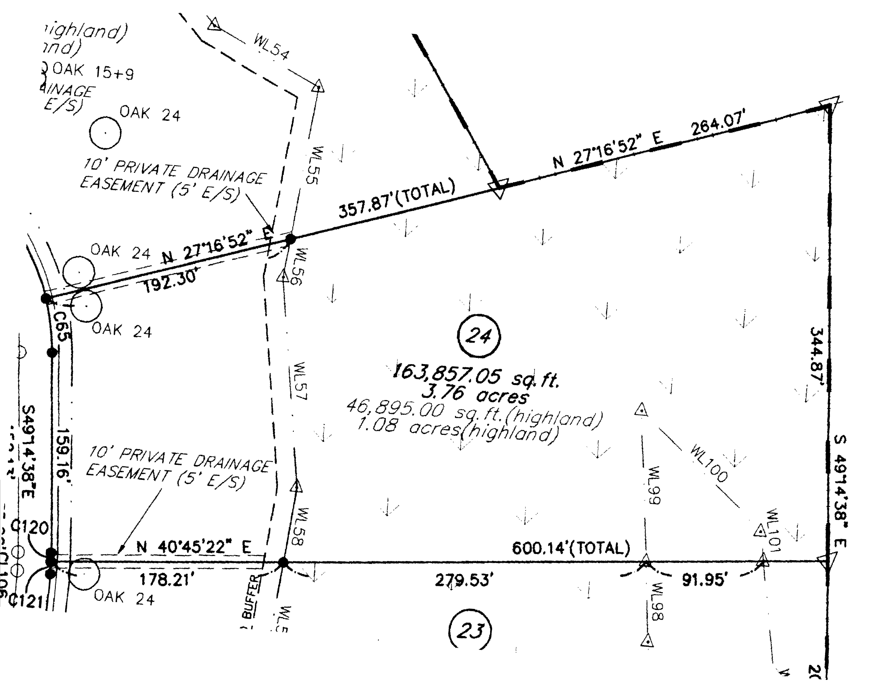
Estate Size Lot in Gated Community
0 Rhetts Way
Boyle Plantation
Summerville, SC
MLS# 1318847 ~ $120,000
BUILD YOUR DREAM HOME ON THIS BEAUTIFUL WOODED 3.76 ACRE BUILDING SITE WITH 1.08 ACRES HIGHLAND. BOYLE PLANTATION IS A GATED COMMUNITY LOCATED ON HWY 165. THE SUBDIVISION CONSISTS OF 77 ESTATE BUILDING SITES RANGING IN SIZE FROM 1.78 TO 7.42 ACRES. NEW ASHLEY RIDGE HIGH SCHOOL ONLY ONE MILE AWAY IN DORCHESTER II SCHOOL DISTRICT. CLOSE PROXIMITY TO SUMMERVILLE, CHARLESTON AND WEST ASHLEY AREAS.
Susan Reubish, EPRO, GRI, RSPS
(843) 860-2337 sreubish@carolinaone.com
Carolina One Real Estate 1503 Palm Blvd Isle of Palms, SC 29451-2280

