Slide 1

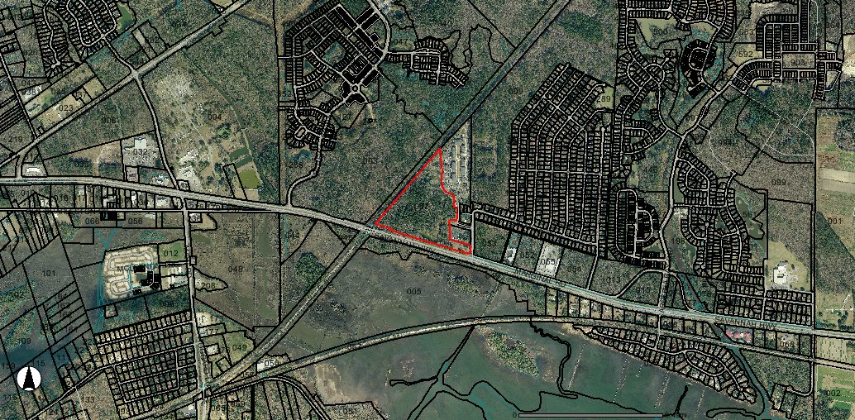


PRIME SAVANNAH HIGHWAY SITE READY FOR DEVELOPMENT
Commercial Frontage Land for Sale
Prime Retail/Office Land ready for development.
Sewer/Water and Power are available and this site is shovel ready. Contiguous to well-established apartment complex and residential subdivisions, this property is prime for a developer representing retail and professional service tenants. Proposed site plans are available. Multiple commercial scenarios exist for your review. Potential for a traffic light to be installed on Savannah Highway (17 South). Presently zoned Planned Unit Development by the City of Charleston and approved for mixed-use development (Multi-Family Prohibited). The Flood Zone is AE with appropriate drainage. This area has an excellent freeway system with 5.35ACRES with Frontage and a Traffic Light is Coming! Next door to Ponderosa residential community.
Acres: 19
Address: SAVANNAH HWY
Area: CHS-W.Ashley outside I-526 to Rantowles
Category: details
City: CHARLESTON
County: Charleston
Listing ID: 1400572
Listing Price: $3,230,000
Property Name: HIGHWAY 17 S INVESTMENTS LAND

