Slide 1
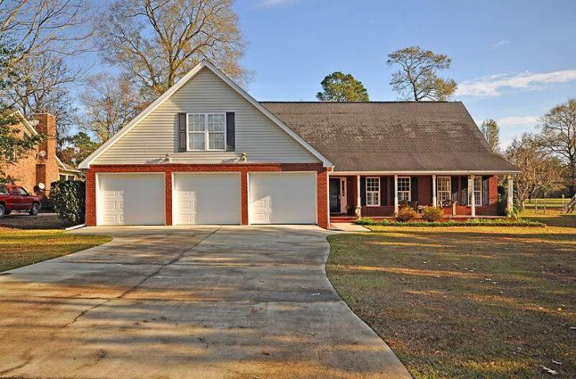
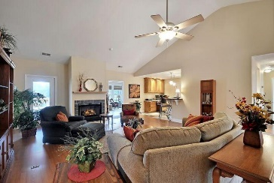
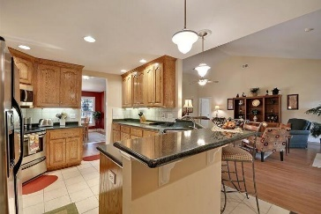
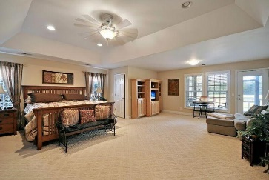
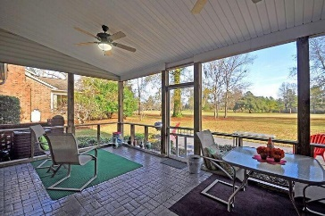
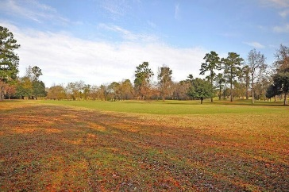


BEYOND YOUR EXPECTATIONS
1010 Cass Drive
Barons Retreat
Moncks Corner, SC 29461
MLS# 16000433
$354,000
FOR THOSE WHOSE EXPECTATIONS ARE AS LIMITLESS AS THEIR IMAGINATION.
This fully detached ranch style brick home with an oversized 3 car garage is situated on a quiet street and is surrounded by a large (approximately .51 acre) golf course lot (14th Fairway). This Remarkable home with selected wood and ceramic flooring and Quality lighting fixtures offers approximately 3000 sq.ft. of luxury living with 3 large bedrooms including the Magnificent and spacious master bedroom suite that offers a Dramatic tray ceiling, His and Her Walk-in Closets, an authentic sitting area and a priceless master bathroom with double vanities, a relaxing jetted tub and a useful walk-in shower.
The kitchen is a chefs delight and offers Distinctive granite counter tops, Modern stainless built-in appliances, stylish ceramic backsplash, crafted 42" custom oak cabinets, a useful pantry, ceramic flooring, a unique computer work station. The Fascinating formal dining room is open, bright and perfectly located adjacent to the kitchen and is perfect for formal or informal dining. The Amazing Gathering Room offers a Stunning Vaulted ceiling, a Classic fireplace with gas logs and beautiful wood flooring.
The Genuine Sun Room is located adjacent to the Gathering room and offers stamped concrete flooring and incredible views of the golf course. The private screened-in porch is accessible from the Sun Room, the Gathering Room or the Master Suite and offers bug-free outside enjoyment. For cook-outs, exit the Screened-in porch and enjoy the oversize stamped concrete patio area. Opportunities like this home are "Few And Far Between"! Bring Your Checkbook!
Age, sqft, taxes, schools, acreage, hoa fees are approx. buyer to verify.
Bill Everett, Jr
Broker
843-693-8539
Bill@TheEverettGroup.net
RE/MAX Pro Realty, 9209 University Blvd, Charleston, SC 29406

