Slide 1
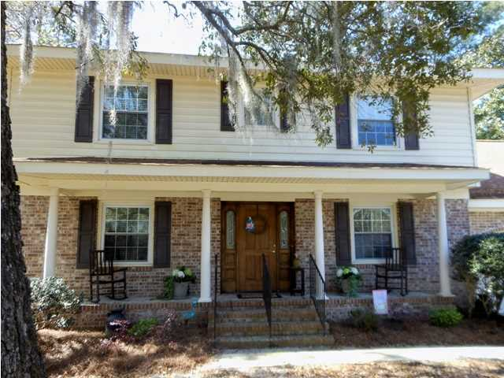
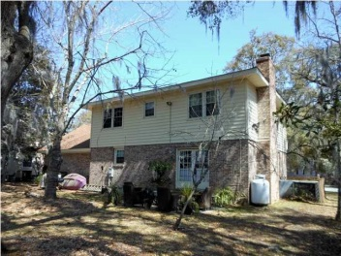
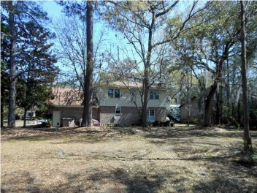
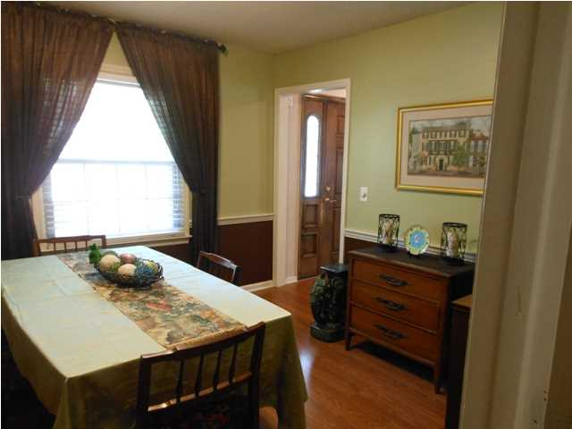
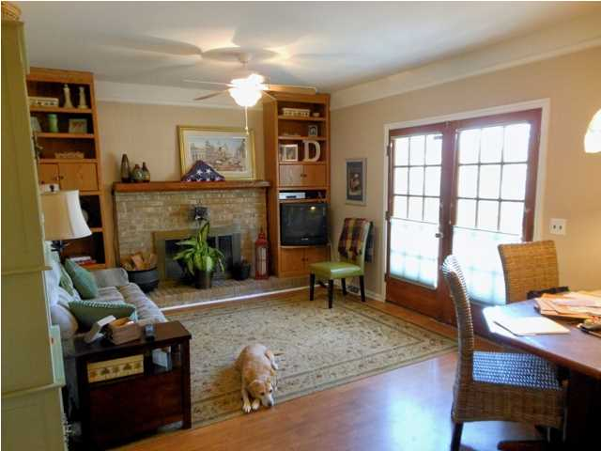
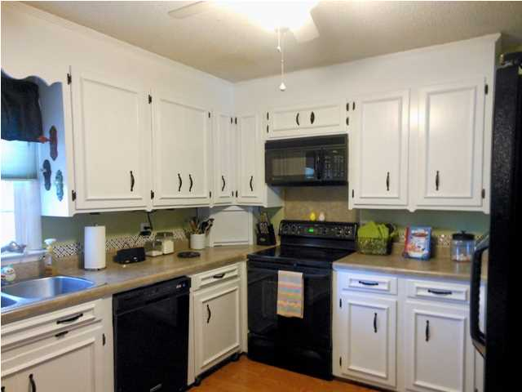
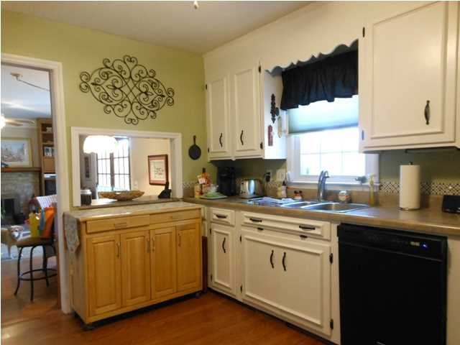
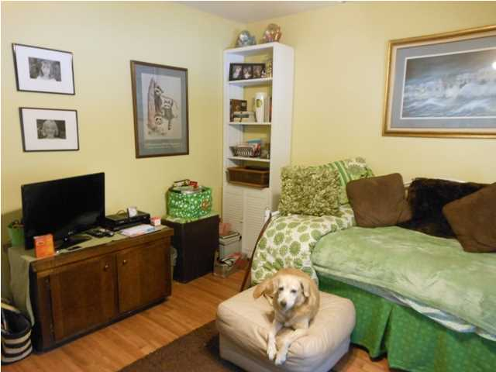
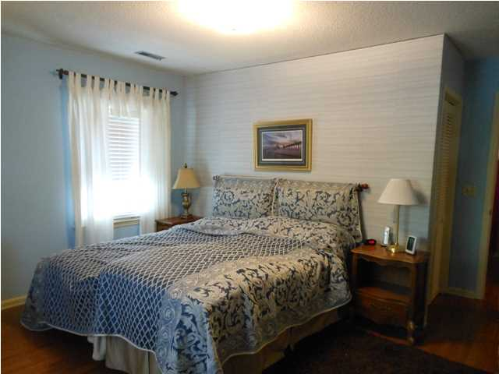
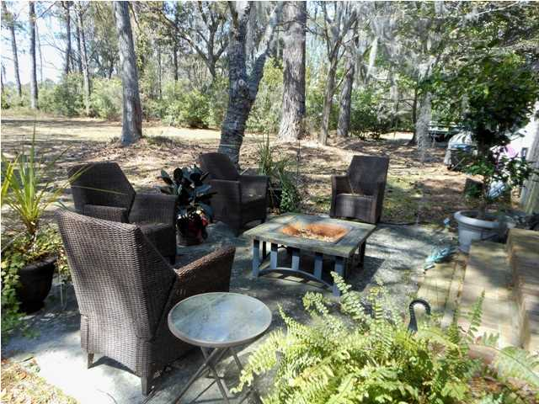

1019 Loyalist Ct Snee Farm MLS# 1308404 $344,900
4 Bedrooms
2 Full / 2 Half Baths
2,322 Square Feet
One owner home - needs some updating, but great buy.
Large lot and super neighborhood.
Convenient location.
Come see and make an offer.
Seller ready to deal!
SELLER JUST REDUCED $15,000
Dog Not Included
Jane Locke
843-819-3508
lockejaneb@aol.com

