Slide 1
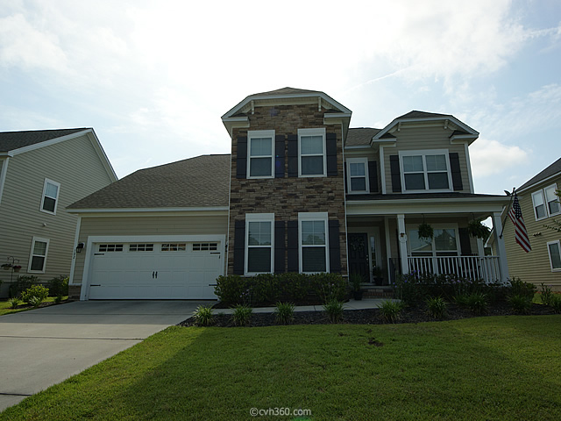
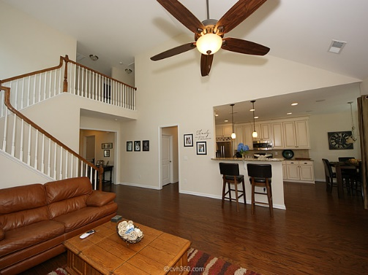
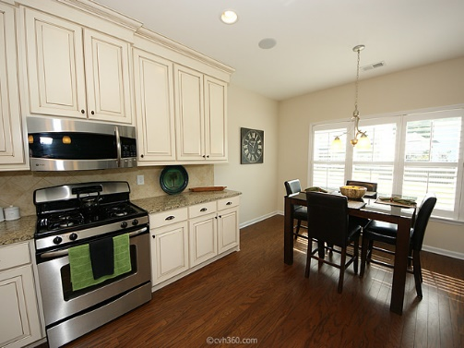
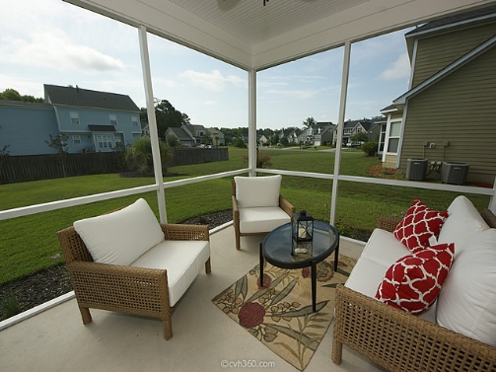
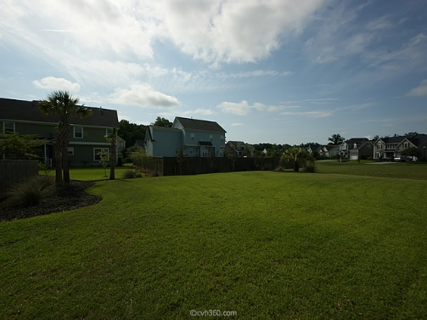


Like-new 5 bedroom in Legend Oaks Plantation!
102 Hanging Moss Rd | Summerville, SC 29485 | MLS# 16007811 | $347,900
137 Beaufain Street
MLS# 15000837 - $1,150,000
Gorgeous 2-story, 5 Bed/3.5 Bath in Legend Oaks Golf Community. This home shows like a model w/tons of upgrades! Upon arrival you will see custom landscaping, formal dining on left & study/play room on right, beautiful hardwood floors throughout. The large living area has tons of natural light with 2 story ceiling & gas fireplace. Amazing kitchen w/custom glazed maple cabinets made from ¾ inch plywood construction, 54’ tall, oversized depth w/ 2 piece rope crown, soft-close dovetail drawers, built-in surround sound. Granite counter-tops w/ custom cabinets are also in laundry room & baths, with ceramic tile floors. Large dual masters one on each level, w/ walk-in closets, garden tubs & stand-up showers, 2 addl nice size rooms on 2nd floor as well as large bonus/5th room. A must see!!
Check out the virtual tour for more pix!
Melissa Britt Thierfelder, MRP
melissabritt@remax.net
Office: 843-442-8787 | Cell: 843.725.8016
www.melissabritt.remax-carolina.com
RE/MAX Elite | 91 Broad St | Charleston, SC 29401

