Slide 1
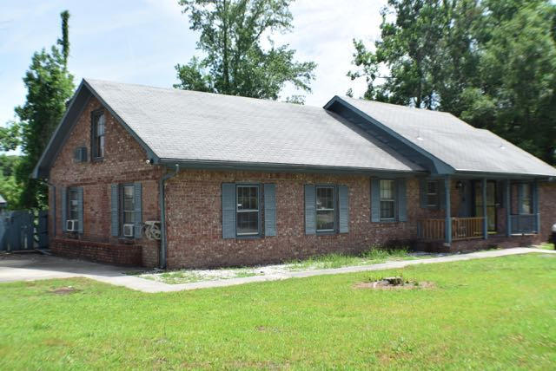
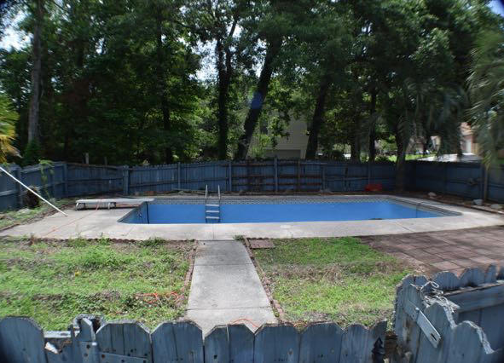
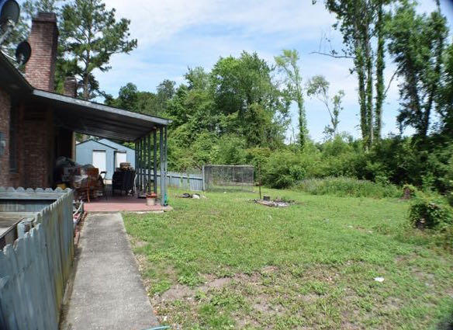
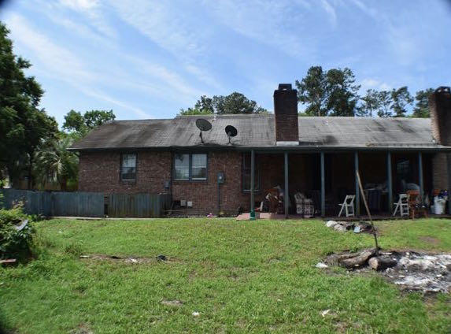
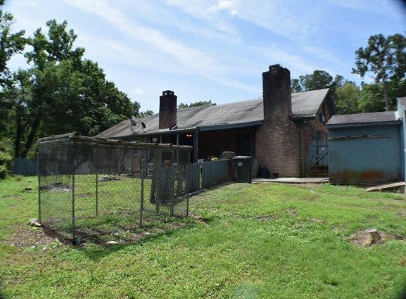

Come check this one out
102 Sawmill Drive ~ Crestwood
$1,500 Bonus
$500 Bonus
$1,000 Bonus
Summerville, SC 29483
MLS# 15013618
$104,900
Buy this property and receive a 5 Day/4 Night cruise for two. Ask for details. This home is the one. Have vision? Come check this one out. Home features a very functional floor plan and lots of space to entertain. Located in the desirable Dorchester 2 school district and close to shopping. The new Walmart market is going in just a block over. Home is located on a corner lot and has it's own swimming pool. Lots of storage space too. The original garage was converted into a huge family room that the current owners have used as additional living quarters. Home needs works and is priced accordingly.
Corwyn J. Melette
Accredited Buyer Representative
(843) 364-3095
corwyn@corwynmelette.com
Exit Realty Lowcountry Group
3618 Ashley Phosphate Rd. #3
North Charleston, SC 29418
exitlowcountry.com

