Slide 1
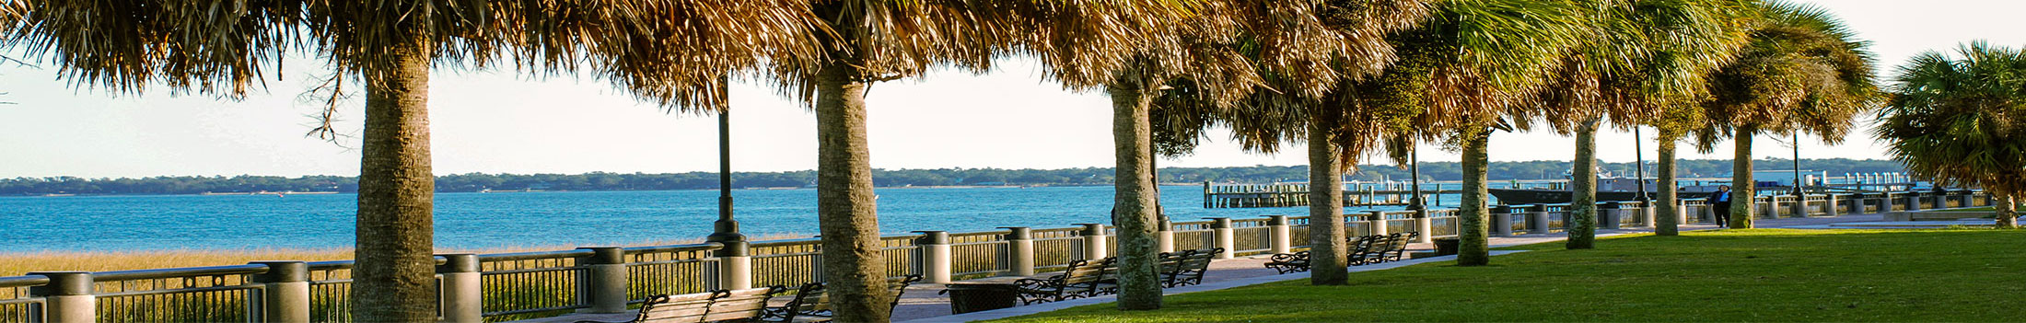



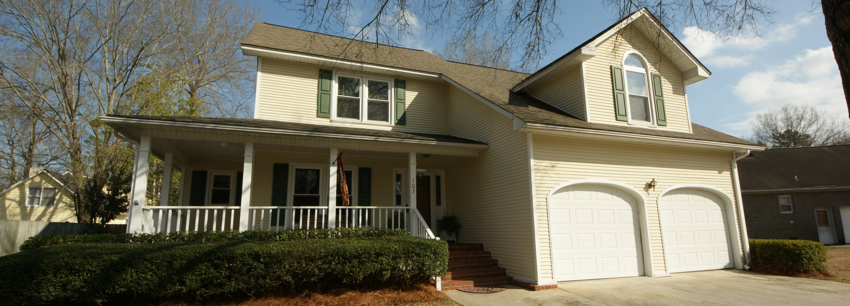
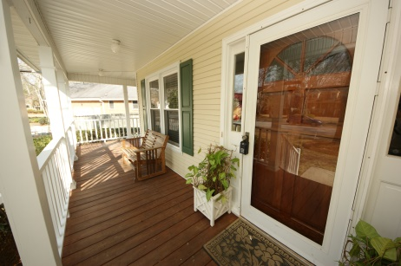
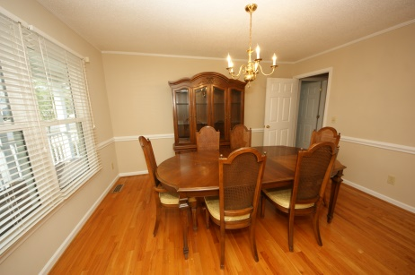
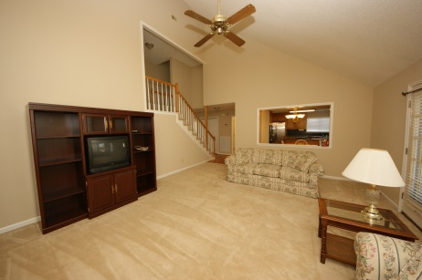
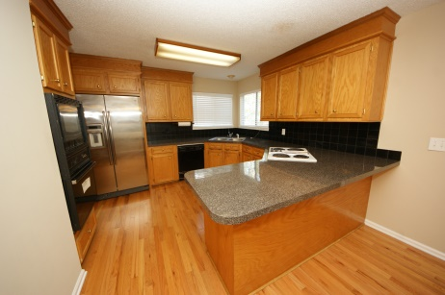
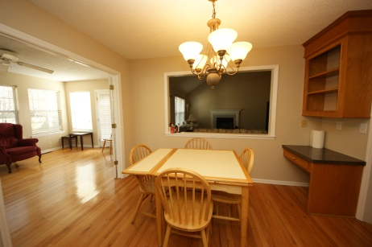
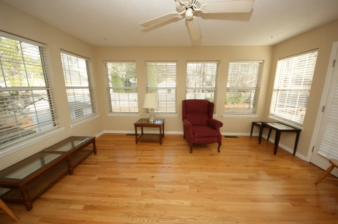
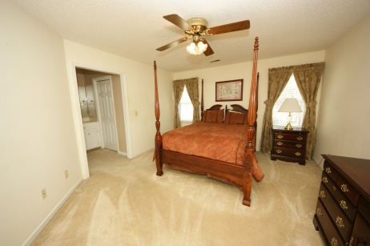
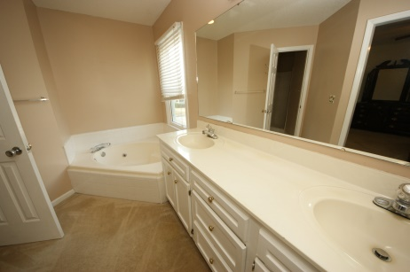
Crowfield Custom Home Just Listed
Lennie Woods
843-864-6760 lenniewoods@gmail.com
103 Forest Ridge Court
Crowfield Plantation ~ Goose Creek ~ MLS# 15001995 ~ $239,900
Clean and well maintained custom built home by Benchmark Builders making it the only known floor plan like it in the community. 4 bedrooms, all with walk in closets. 2 .5 baths. Open concept living space, formal dining and a beautiful sunny sunroom. The kitchen has tons of cabinets with wall oven/microwave and Jenn Aire downdraft cooktop with attachable grill. Hardwood floors in foyer, dining, kitchen, and large sunroom. Professionally cleaned and ready for new owners. A matching custom built playhouse conveys in the fenced in back yard. Nice landscaping too. Plenty of storage in the 2 walk in storage closets and 1 overhead attic storage. All of this on a quiet CUL De sac with wonderful neighbors.

