Slide 1
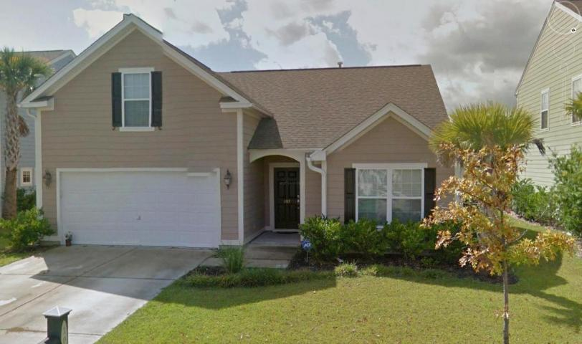
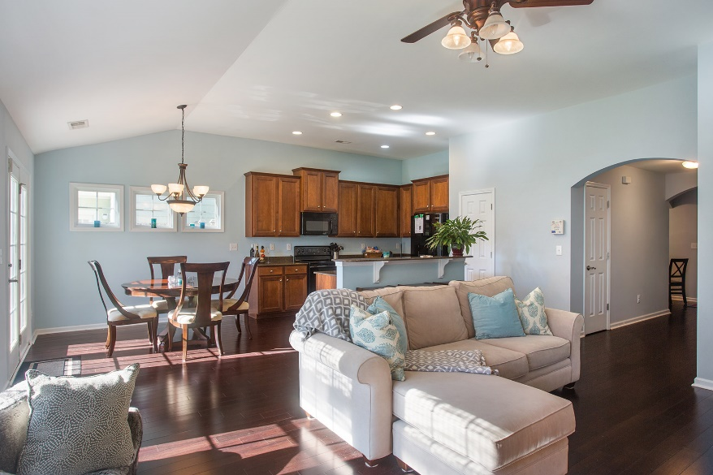
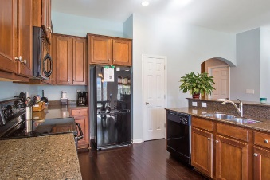



103 Tea Farm Way
Nelliefield Plantation
Wando, SC 29492
MLS# 15025856
$315,000
3 Bedrooms ▪ 2 Baths ▪ Bonus Room
2,129 sq. ft.
Open House ~ Sunday, October 11th ~ 1-4
Just Listed!
ONLY HOME AVAILABLE IN NELLIEFIELD!
Beautiful one story Alston Plan with an open floorplan for easy entertaining. Gorgeous dark wood flooring in foyer, hallway, living room and kitchen. The kitchen has upgraded 42” wood cabinets, Center Island with raised bar, Silestone counter tops and French Doors. Master suite is split from the other bedrooms with master bath featuring a garden tub and separate shower with glass enclosure. Main level has two other bedrooms, another full bath with tub/shower combo, and laundry room. Huge bonus room which could be a 4th bedroom, an upstairs den, media room, you name it! High smooth ceilings, ceiling fans, storage, 2 car garage, large fenced backyard and exterior of home is Hardi-Plank for easy maintenance.
Jennifer Nipper, Realtor®
(843) 478-1800 | jen@AgentOwned.com
www.AgentOwned.com
The AgentOwned Realty Co | 824 Johnnie Dodds Blvd | Mt. Pleasant, SC 29464
Real Estate • Mortgage • Insurance

