Slide 1
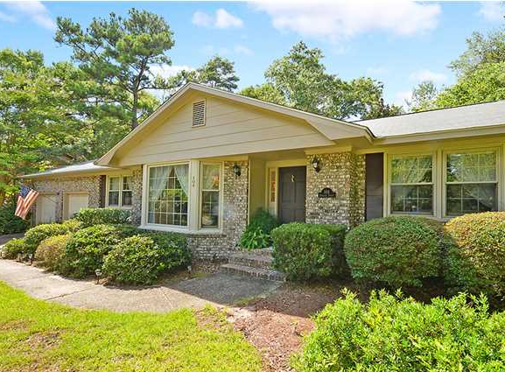
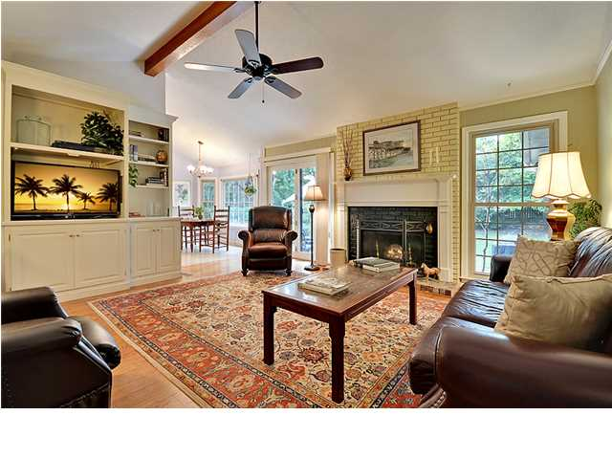
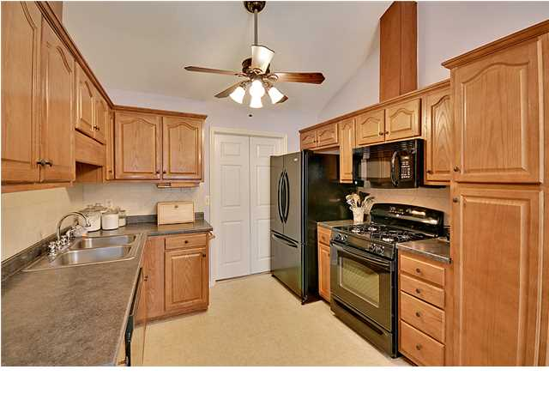
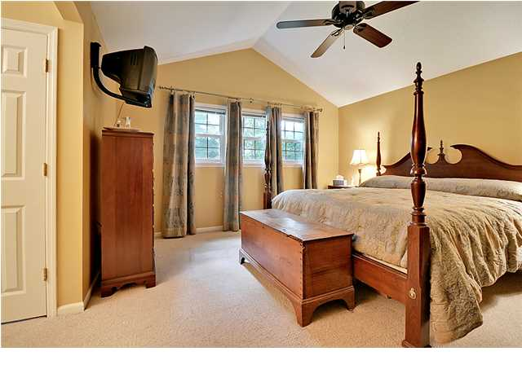
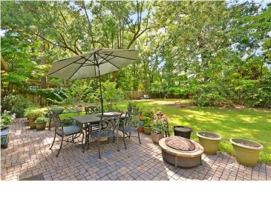


PRICELESS!
104 Endicott St
Ashborough
Summerville
MLS# 1321002
$214,900
Announcing 104 Endicott Street, an Amazing brick ranch home that is situated on a quiet tree-lined street and surrounded by a large, .34 acre, landscaped, fenced yard. Enter this Remarkable home and discover the 3 spacious bedrooms including the important master bedroom with a private bathroom, newer plumbing fixtures, large walk-in closet, vaulted ceilings and a stylish ceiling fan, the popular family room is appointed with newer laminate wood flooring, built-in shelving, a classic fireplace and a vaulted ceiling with a distinctive ceiling fan, the charming living room and authentic formal dining room will accommodate all your special friends and family members for the important celebrations (Thanksgiving/Christmas).
The Modern kitchen with vaulted ceilings is spacious, considered a chef's delight and is appointed with newer upgraded built-in appliance (gas range, dishwasher, micro-wave), stylish plumbing fixtures, crafted wood cabinet, ceiling fan and newer flooring. The valuable finished room over the garage (FROG) included in the total square footage, is perfect for a children's play room, dad's man cave or mom's reading room/office.
There is a French door, located in the family room, that leads to the oversized outdoor patio and huge fenced rear yard is perfect for outside cook-outs. This Stunning home will not disappoint. Age, sqft, taxes, acreage, HOA dues/fees and schools are aprox. buyer to verify. Home inspection dated 8/10/13 available upon request. Partially finished room in garage will be removed upon request.
Bill Everett, Jr
Broker
Office 843-767-7777
Direct 843-693-8539
Fax 843-576-5352
RE/MAX Pro Realty, 9209 University Blvd, Charleston, SC 29406

