Slide 1
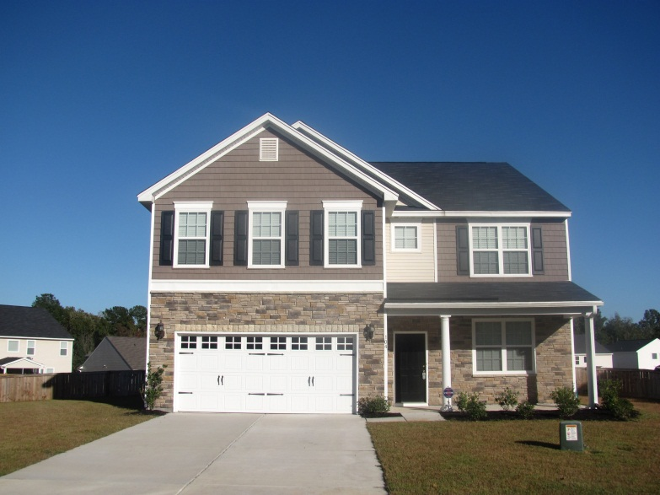
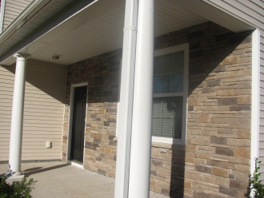
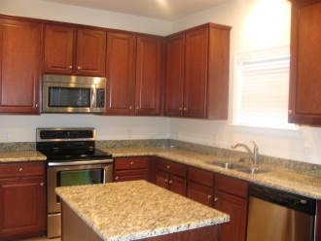
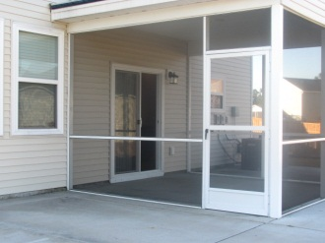
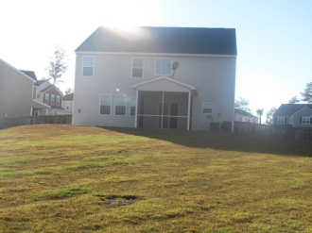
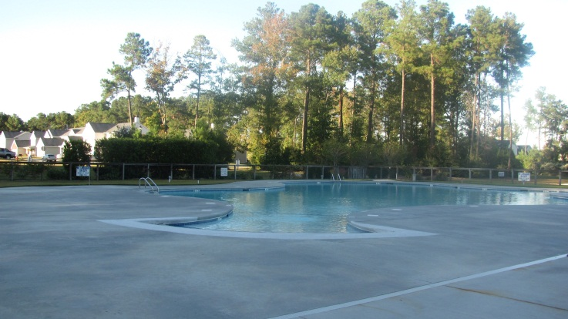



Just Listed: Turnkey in Liberty Hall
104 Hollow Creek Cir
Liberty Hall Plantation
Goose Creek, SC
MLS# 1224301
$265,000
Welcome home! The homeowners have relocated for work and you reap the benefits of the over $30,000 worth of upgrades that they have put in the 3500 sqft home. Immaculate and practically brand new, this 5 bedroom, 2.5 bath home is on one of, if not the largest lot, in Liberty Hall Plantation. The home boasts a gorgeous kitchen with 42' cherry cabinets, granite counter tops, huge walk-in pantry, and center island with an electrical outlet. Appliances are stainless steel including the smooth top range. In addition to the upgraded kitchen, downstairs includes a formal dining room, great room, powder room, guest bedroom and mud room. The remaining four bedrooms are upstairs and all have walk-in closets and ceiling fans. The upstairs master suite has an enormous walk-in closet, dual sinks in the master bath, garden tub and separate shower. The LARGE upstairs media room is perfect for a man cave, kid's playroom or in-home theater. Carpets throughout the home are in pristine shape and tile covers the kitchen and bathroom floors. Relax in the evening on the screened in back porch or barbecue on the concrete patio which is part of the almost 1/2 ACRE fully fenced in backyard. The home also includes an alarm system, programmable Honeywell thermostats, and remote control Hunter fans. The walls have never been painted and there are no holes in any of the walls. This home is like new and just waiting for the perfect homeowner! Make an appointment to see your dream home today!
Shakeima Chatman, REALTOR®
Chatman Realty w/Keller Williams Realty Charleston
496 Bramson Court Suite 200, Mt. Pleasant, SC 29464
843-416- 2000 (O) | 843-532-0330 (C)
Shakeima@chatmanrealty.com | www.chatmanrealty.com

