Slide 1
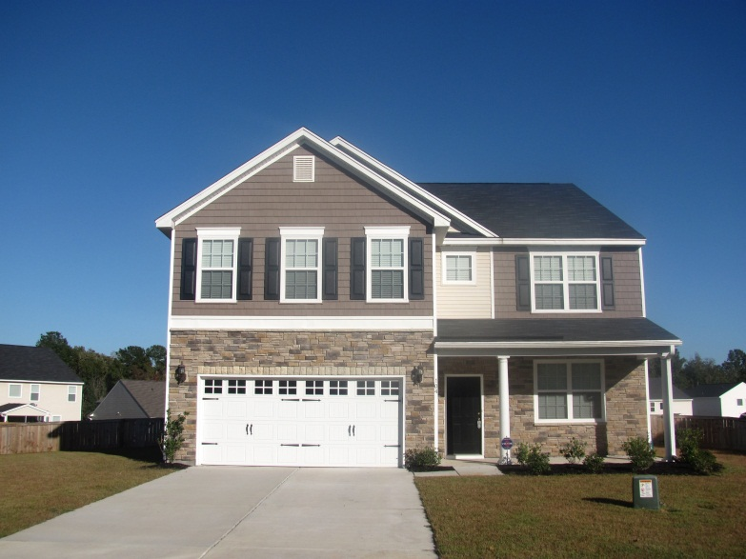
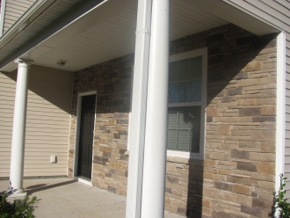
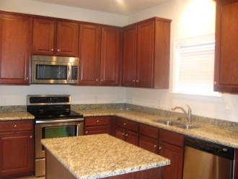
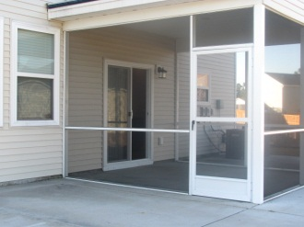
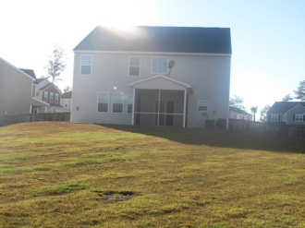
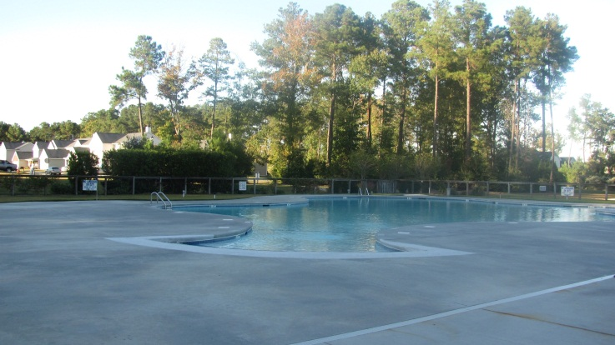



Turnkey in Liberty Hall
Open House
Sunday 1-4pm
104 Hollow Creek Cir
Liberty Hall Plantation
Goose Creek, SC
MLS# 1224301
$265,000
Come see the over $30,000 worth of upgrades that have been put in this 3500 sqft home! Immaculate and practically brand new, this 5 bedroom, 2.5 bath home is on one of, if not the largest lot, in Liberty Hall Plantation. The home boasts a gorgeous kitchen with 42" cherry cabinets, granite counter tops, huge walk-in pantry, and center island with an electrical outlet. Appliances are stainless steel including the smooth top range. The upstairs master suite has an enormous walk-in closet, dual sinks in the master bath, garden tub and separate shower. The LARGE upstairs media room is perfect for a man cave, kid's playroom or in-home theater. This home is like new and just waiting for the perfect homeowner! Come out on Sunday and see your dream home!
DIRECTIONS: Hwy 52 to Liberty Hall Rd, turn left into Liberty Hall Plantation, exit at the first right in the traffic circle, onto Clayburne Dr., left onto Old Carolina, left on Hollow Creek Circle
Shakeima Chatman, REALTOR®
Chatman Realty w/Keller Williams Realty Charleston
496 Bramson Court Suite 200, Mt. Pleasant, SC 29464
843-416- 2000 (O) | 843-532-0330 (C)
Shakeima@chatmanrealty.com | www.chatmanrealty.com

