Slide 1
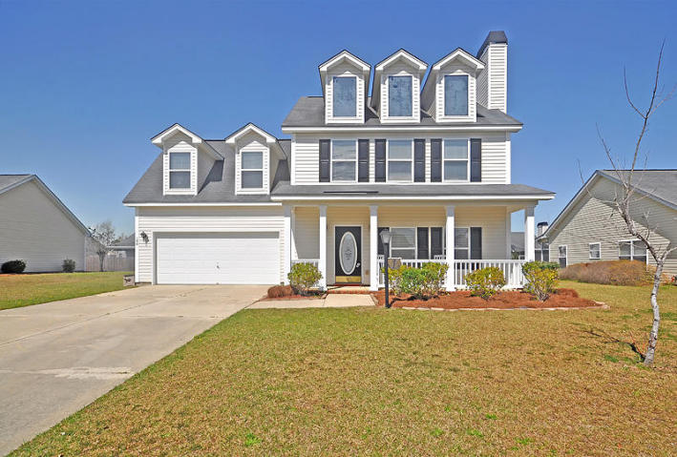
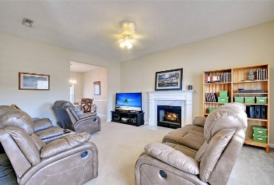
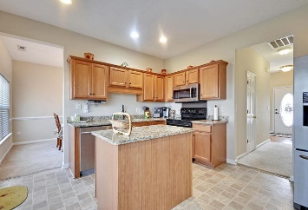
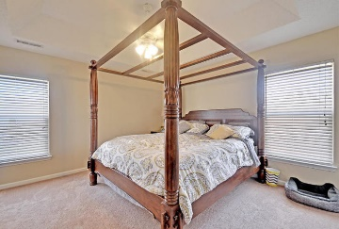
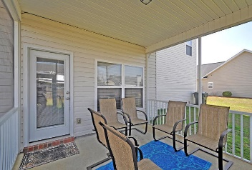
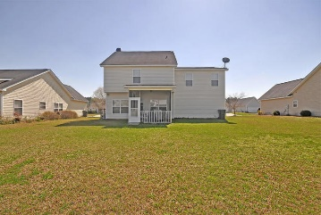


NEW LISTING! WILL NOT LAST!
104 Speer Street
Cokers Crossing
Goose Creek, SC 29445
MLS# 16003853
$192,500
An Amazing fully detached 2 story home that is situated on a quiet street and is surrounded by a large landscaped yard. This Incredible, freshly painted home with a “Rocking Chair Front Porch” has 4 large bedrooms (4th bedroom is the bonus room) upstairs including the spacious master bedroom with a unique tray ceiling, and offers a private master bathroom with double vanities and large his & her closets.
There are several large rooms with 9ft ceilings on the main floor including the awesome and bright great room with a cozy wood burning fireplace, the Distinctive dining room and the modern kitchen that offers crafted wood cabinets, priceless granite countertops, and upgraded built-in appliances. There is a private walk-out to a popular screened-in porch and a large rear yard that is perfect for outside cookouts and relaxing.
The seller is replacing all the wall-wall carpet in the entire home prior to closing with an acceptable offer. The Buyer may have the color selection. A pre-listing home inspection was performed and is available upon request. Recognize a Great Buy When You See One? The Line Forms Here! Age, sqft, regime fee, HOA fee, schools, acreage and taxes are approx. Buyer to verify.
Bill Everett, Jr
Broker
843-693-8539
Bill@TheEverettGroup.net
RE/MAX Pro Realty, 9209 University Blvd, Charleston, SC 29406

