Slide 1
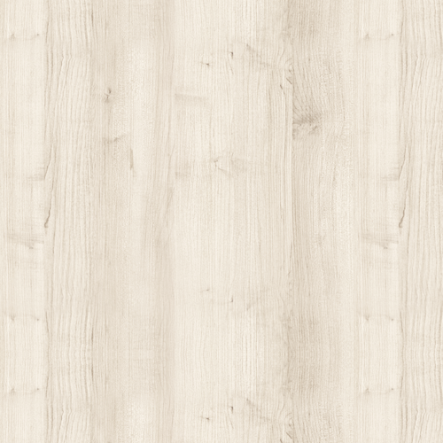
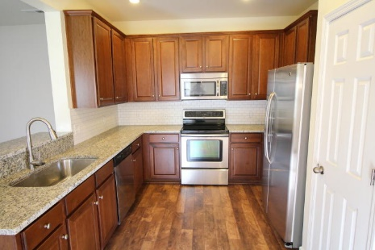
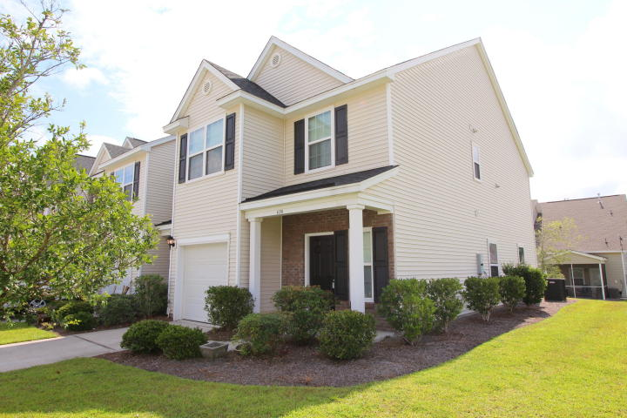
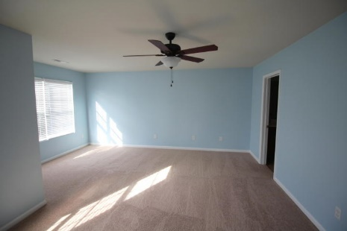
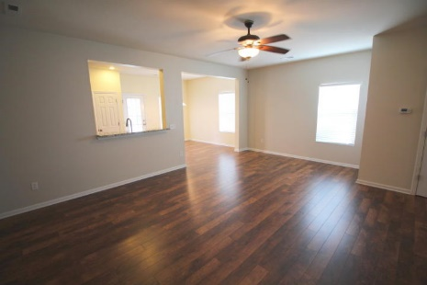
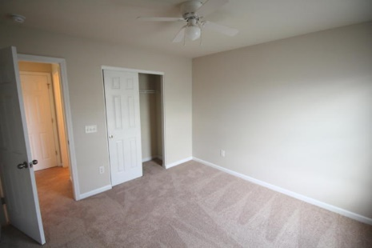


Updated End Unit in Cain Crossing
1051 Bennington Drive
Charleston, SC 29492 ~ MLS# 15023733 ~ $215,000
End unit available in sold out Cain Crossing!!! This recently remodeled home is completely upgraded with stainless appliances, deep stainless sink, beautiful granite countertops, subway tile backsplash, and completely new flooring. The brand new plush carpet runs throughout upstairs and leads you to the 3 bedrooms and laundry room. The spacious master bedroom flows nicely to the ensuite dual vanity bath with adjoining walk-in closet. The remaining bedrooms are located at the end of the hall and share a full bath. Enjoy the neighborhood pool, dog park, irrigation, lawn care and more! a Must see !!!
Peter Stanley
M 843-300-8251 | O 843-885-6199
petermstanleyjr@gmail.com
Colony & Craft LLC
76-A Spring St
Charleston, SC 29403

