Slide 1
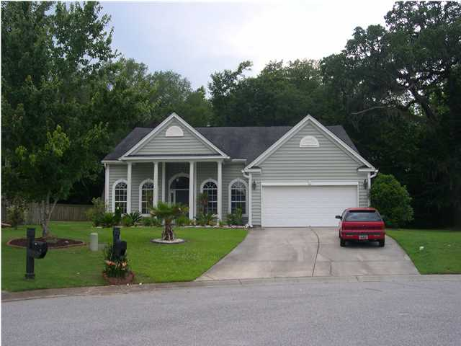
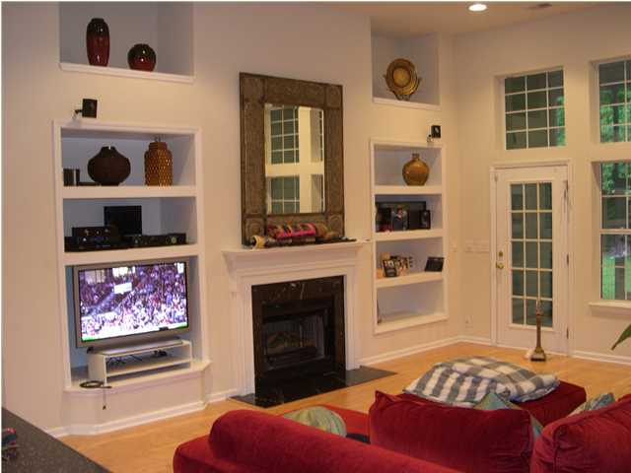
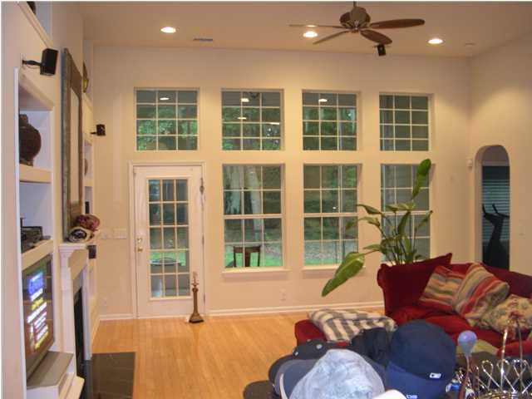
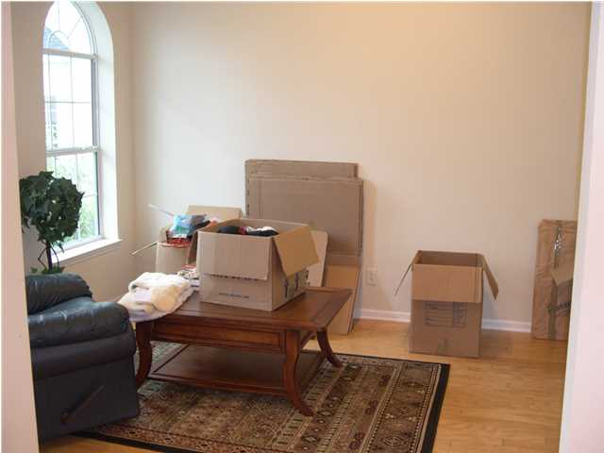
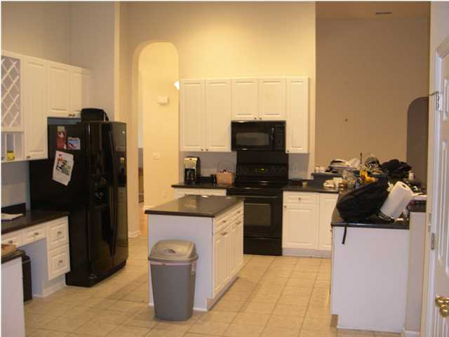
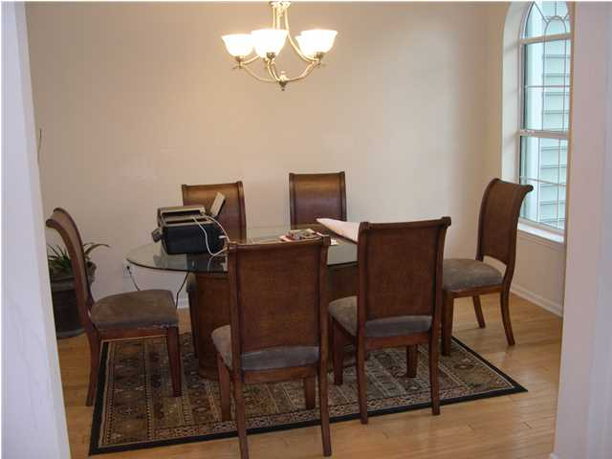
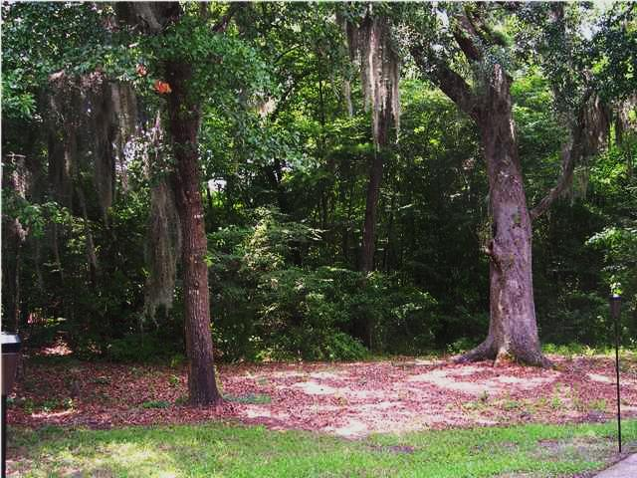
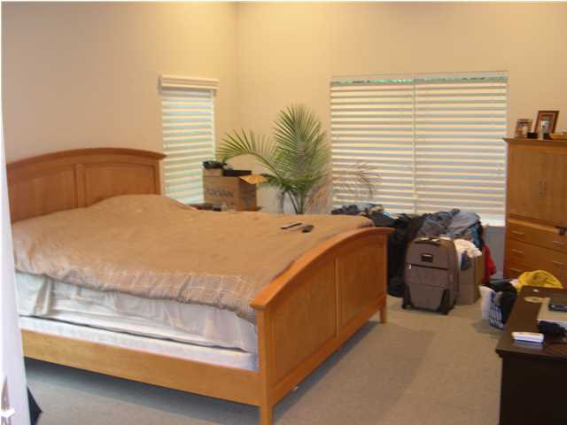
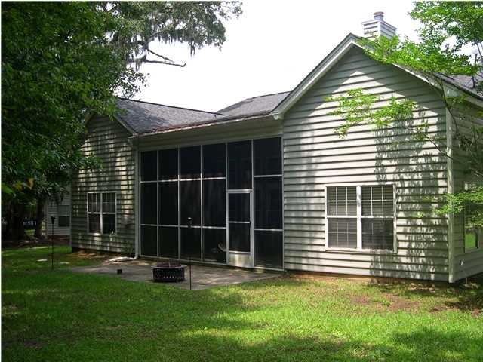
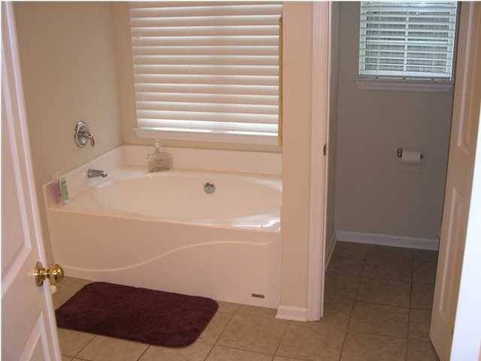
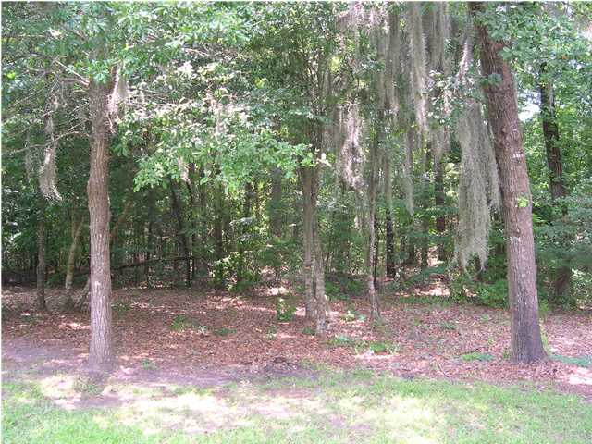
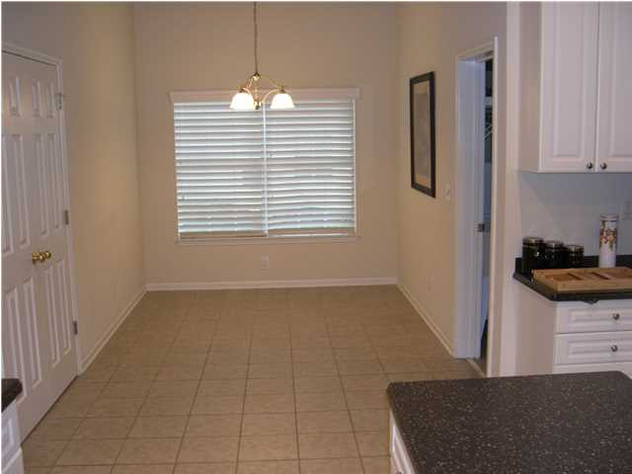
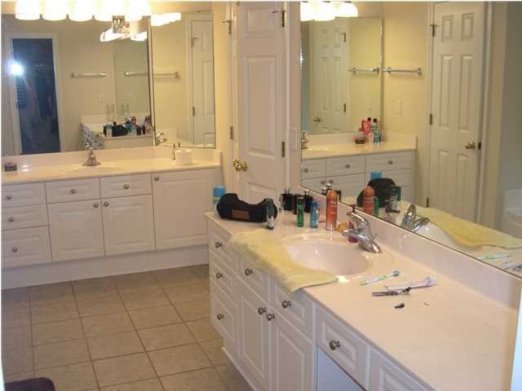
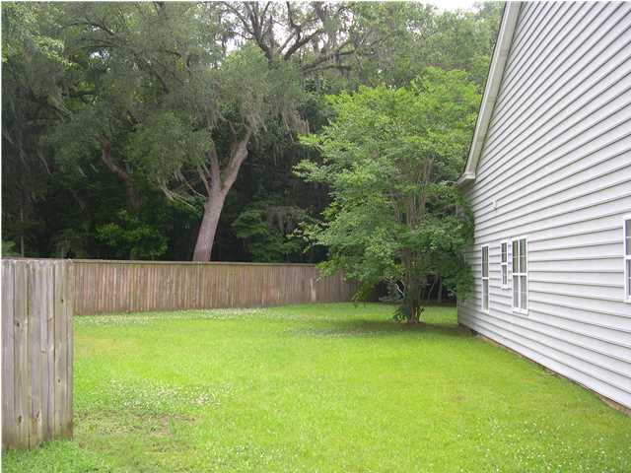
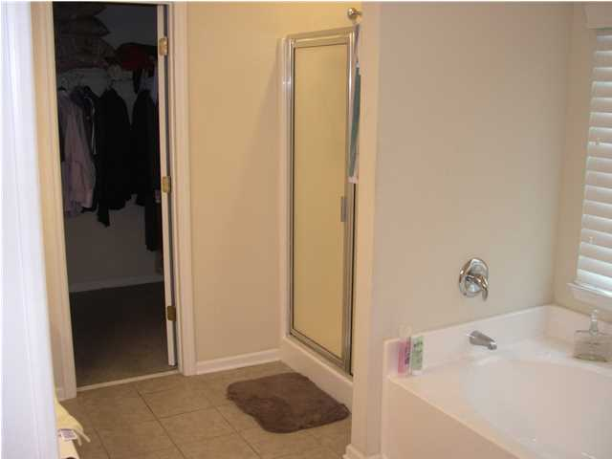
Adorable Home in Legend Oaks Plantation
105 Brandy Ct ~ Summerville
MLS# 1315032 ~ $255,000
Adorable one story home on a cul-de-sac street in beautiful Legend Oaks Plantation. This home sits high on a large lot and has a VERY private backyard that looks out onto woods. There are NO homes behind you! The home features a large foyer which opens to a formal living room and formal dining room all with wood flooring. The kitchen is spacious and looks onto a large family room with lots of built-in bookcases, wired surround sound, and a cozy gas logs fireplace. This is the open floor plan everyone dreams about! The kitchen has an island, and a separate dining area. There is also a huge separate laundry room with sink which leads to the oversize 2-car garage. The master suite has a private bath with garden tub and separate shower, and a large walk-in closet. There are two bedrooms on the other side of the home from the master, with a Jack and Jill shared bath. Walk outside into the high ceiling screened porch and view your private getaway. There is also a patio area for grilling and soaking up the sun! There is even an invisible fence installed for your dog. The only thing left is for you to buy it and call it HOME!!!
Randy Espeseth
(843) 743-1025
randy@randyehomes.com
Brand Name Real Estate | 4 Carriage Ln | Suite 106 | Charleston, SC 29407

