Slide 1
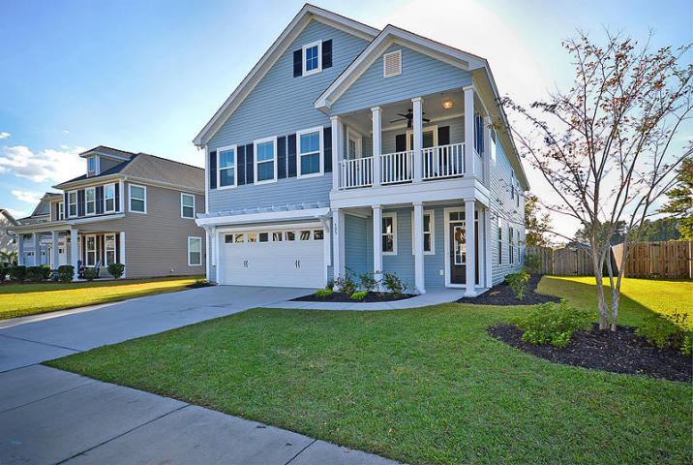
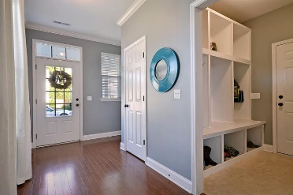
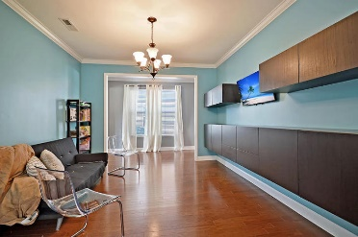
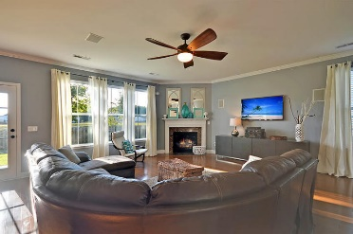
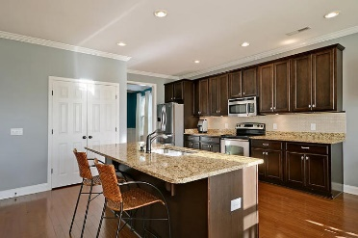
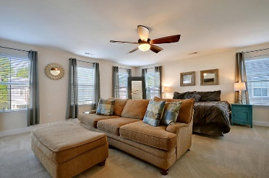
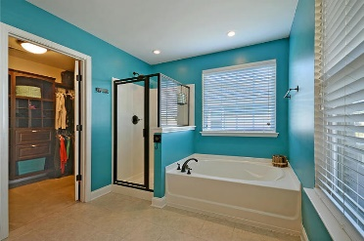
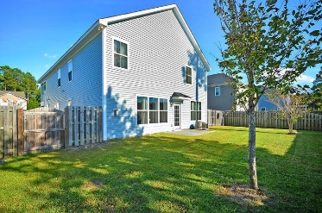
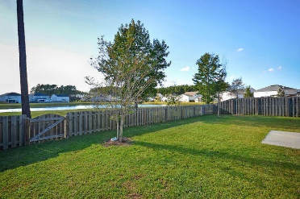


Beautiful Home In Cane Bay Loaded With Upgrades
105 Swiftwater Way
Cane Bay Plantation ~ Summerville
MLS# 16027308 ~ $315,900 ~ 3,207sf
Better-Than-New home in Sanctuary Cove in Cane Bay w/ double front porches & cul-de-sac lot on the POND w/ fenced back yard! TONS OF UPGRADES - antique bronze hardware, wood floors, upgraded lights, extensive crown molding, built-in surround sound, central vacuum system, tankless hot water, monkey bar storage in garage, & 2-inch blinds throughout. Downstairs features huge eat-in kitchen with large island, granite counters, tile backsplash, stainless appliances, & enormous walk-in pantry. Large open-concept family room features gas logs & lots of windows overlooking pond. Mudroom w/ custom built-ins, half bath, formal dining & living/flex space. Upstairs features 5 large bedrooms, 3 full baths and flex space. Master suite is a private retreat with access to upstairs porch. One-of-a-Kind!
Will Oswald
Mobile - (843) 790-4949
swegos@gmail.com
www.HomesInTheLowcountry.com
ERA Wilder Realty, Inc | 234 N Main St | Summerville, SC 29483

