Slide 1
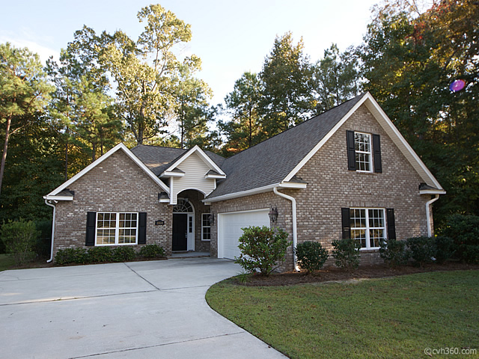
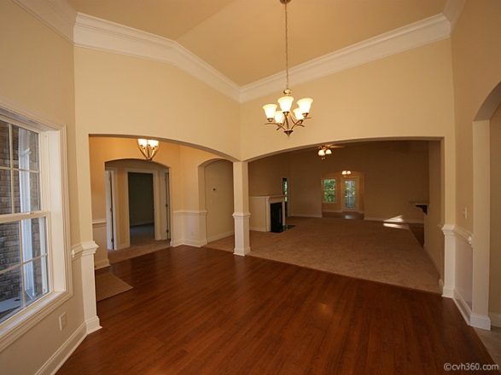
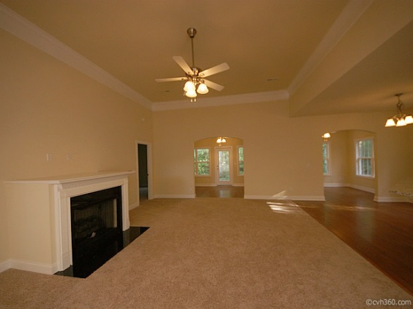
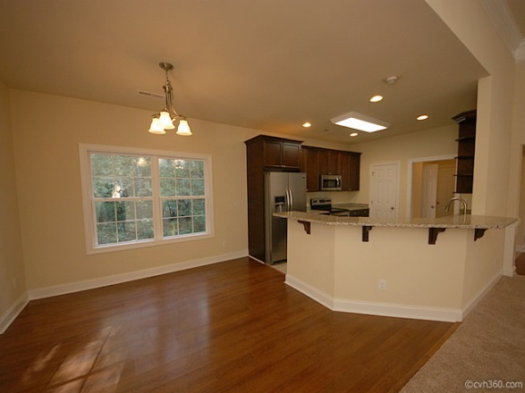
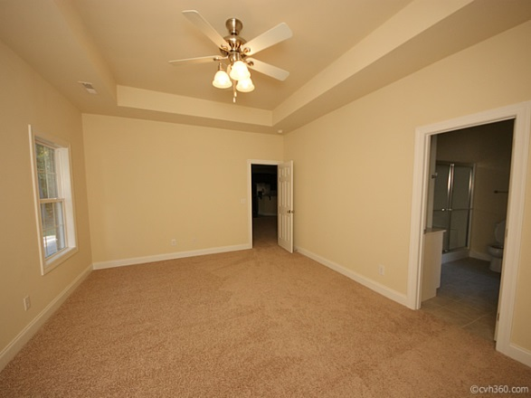
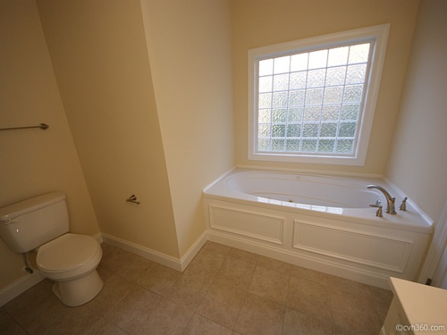




1064 OT Wallace Blvd, moncks corner
New Construction in Berkeley Country Club
New Construction home loaded with upgrades throughout! This is an all brick, single story home with 3 bedrooms, 2.5 baths and a FROG that could serve as a 4th bedroom, office area, or kids play area. Home has a very open floor plan and features granite counter tops, 42" cherry cabinets with crown molding, ceilings fans throughout, stainless steel appliances, built-in microwave, side by side stainless refrigerator that will convey, wood floors in the foyer, dining room, sun room and breakfast area. Ceramic tile in kitchen, bathrooms and laundry room, Heavy trim package, 9' smooth ceilings, gas fireplace, full laundry room complete with utility sink and cabinets. Sun room over looks the peaceful wooded backyard. The Master Suite is large with tray ceiling and ceiling fan. The Master Bath serves as a perfect retreat complete with a separate jetted tub, shower and large walk-in closet. Home boasts a 2 car side entry garage complete with a garage door opener, gutters, architectural shingles and backs to woods for privacy and quiet. This is a beautiful home with lots of upgrades, you will not be disappointed!
Asking $250,000
MLS# 1327490
2,455 SqFt
3 Bed/2½ Baths
Private & Quiet
www.troyaphillips.com
Troy Phillips
C 843-296-7403 O 843-797-7799
tphillips@carolinaone.com www.troyaphillips.com

