Slide 1
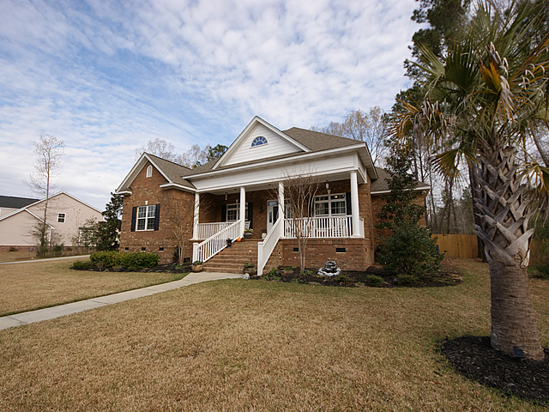

Realtor Luncheon Open House
Thursday 11-1
Drawing for a $50 Gift Card
1069 Blockade Runner Pkwy
River Birch ~ Summerville
Marc Horne
M 843-303-1059
O 843-875-4676
HORNE REALTY, LLC
PO BOX 50823
SUMMERVILLE, SC 29485

