Slide 1
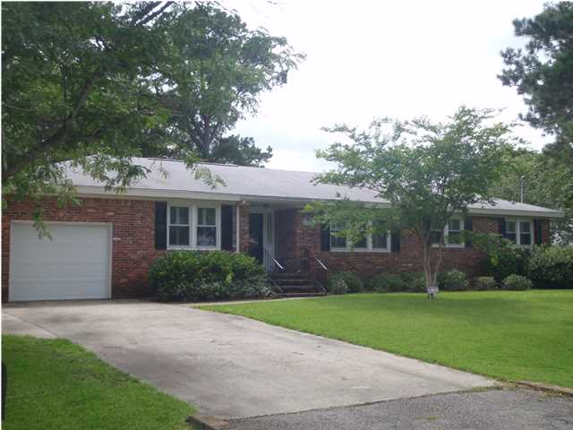
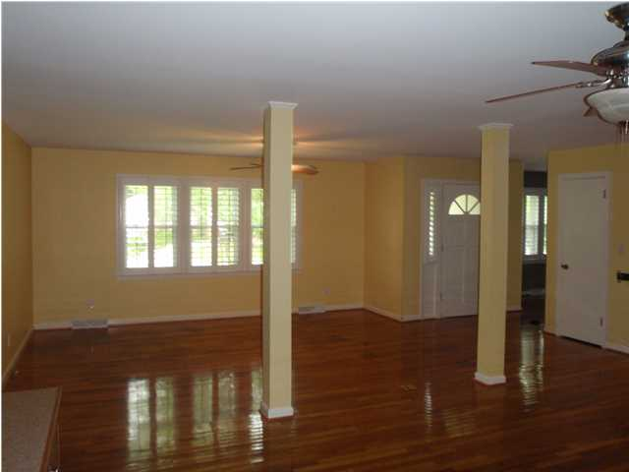
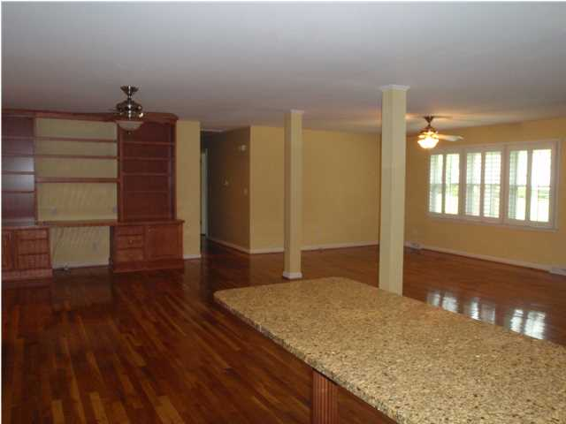
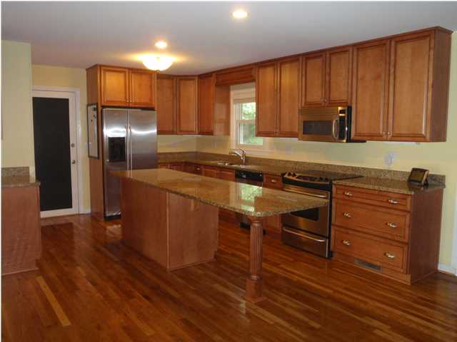
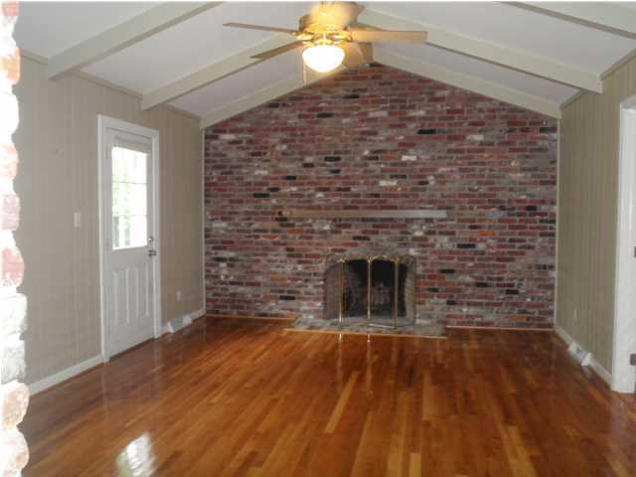
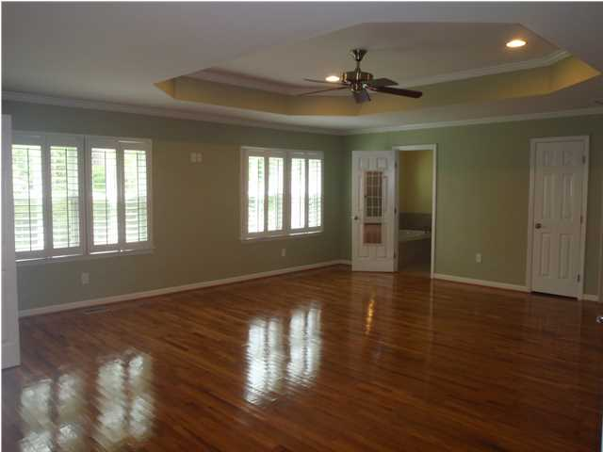
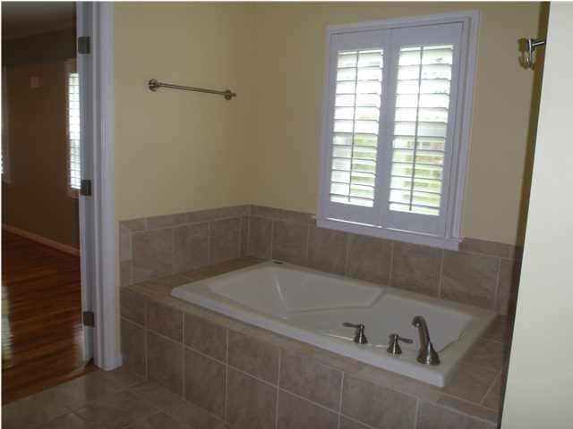
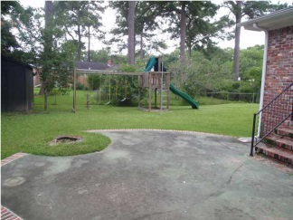
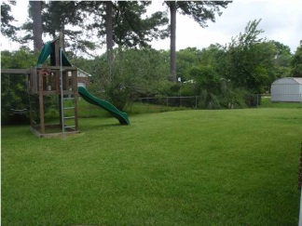


Location! Location! Location!
1069 Northbridge Terrace
MLS# 1309014 ~ $339,000
Enjoy this well-established neighborhood conveniently located to shopping and restaurants and just minutes from I-26, airport and downtown Charleston. Beautifully renovated and well- maintained home in Northbridge Terrace. Home boasts open great room concept with large renovated kitchen with stainless appliances, granite countertops and custom cabinets. Kitchen has plenty of storage, large island and open flow which is perfect for entertaining. Gleaming hardwood floors throughout home including bedrooms (Bathrooms are tiled). There is a formal dining room in addition to a built-in study area off kitchen area. Brick archway leads to a separate den/playroom with fireplace just off kitchen with access to backyard patio area. A beautiful 650sqft master suite has been added by previous owners with walk-in closet and bathroom complete with waterfall shower, separate tub and dual sinks. Laundry area has been moved from garage into the master bedroom for added convenience. Large backyard with stone patio perfect for grilling and storage shed. The neighborhood has swimming pool which buyers have option of joining, play park and tennis courts. Neighborhood also has $10/year voluntary dues. Orange Grove School is a charter school which is lottery based. Please do due diligence on schools, square footage and information Buyer deems important.
Megan Schwerin
(843) 478-5867 C (843) 766-6662 O mkschwerin@gmail.com www.findyourcharleston.com

