Slide 1
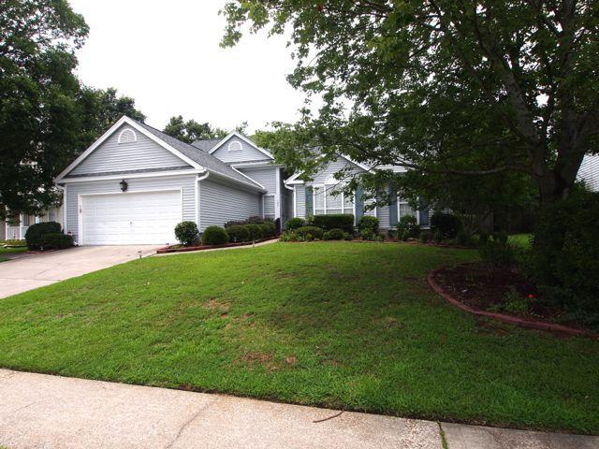
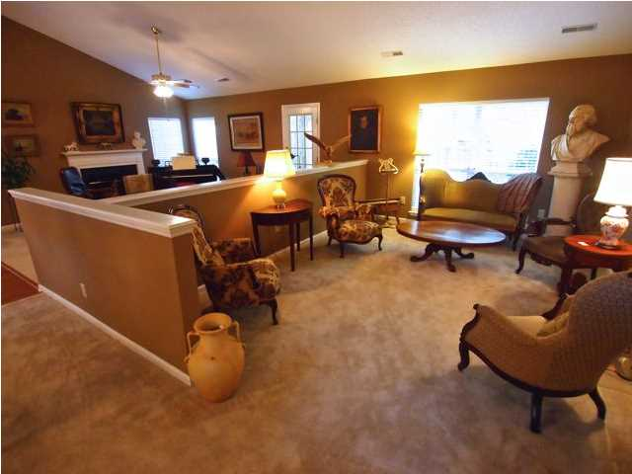
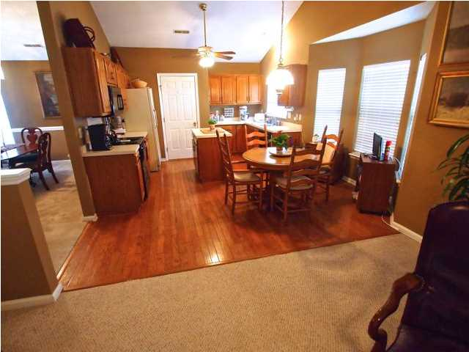
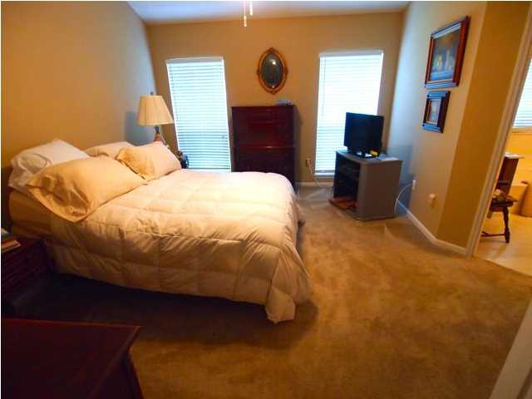
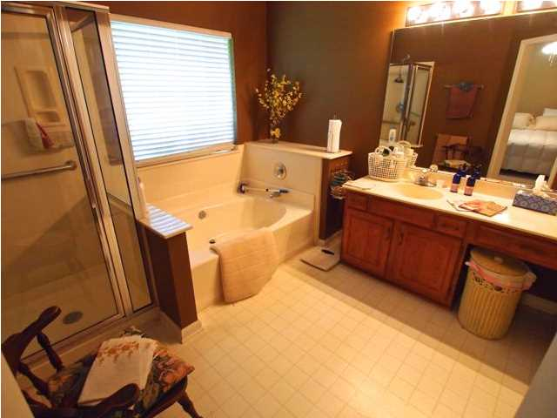
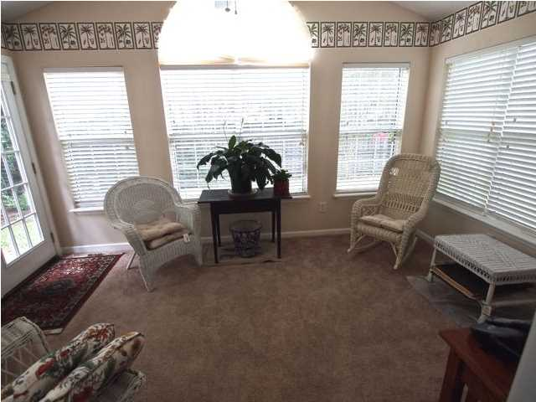
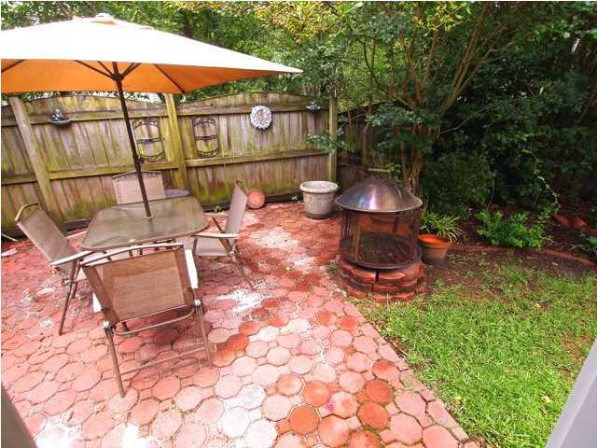

106 Barrie Court Crowfield Plantation Goose Creek, SC MLS# 16026359 $196,000 1,806 Sq Ft - 3 Bedroom - 2 Bath
$1,000 Bonus for a ratified contract by 11/18/16
Looking for a quiet street where all one can hear are the singing of the birds and the chorus of children at play? Looking for a home on a cul-de-sac? Looking for a home with an open floor plan? Looking for a home that has been well maintained? Then look no further than 106 Barrie Ct. The cathedral ceilings, hardwoods in the kitchen and foyer, the island in the kitchen, fireplace in the family room, the heavy chair rail in the formal dining room, the formal living room, the light and airy sun room with its own AC/heater, the large master suite with its cathedral ceiling , large walk -in closet, separate shower and tub. Has a laundry room, ceiling fans, 2" plantation blinds, professionally landscaped yard with a privacy fence. Not much this house doesn't have. So come and join the chorus.
Liz & Bob Simonds
843-261-7138 O | 843-437-9696 M lizandbob@agentownedrealty.com
AgentOwned Realty Co. Premier Group, Inc. | 141 A N. Main St | Summerville, SC 29483

