Slide 1
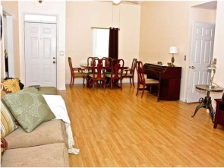
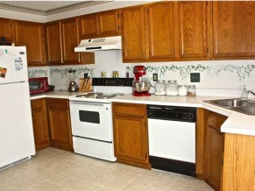
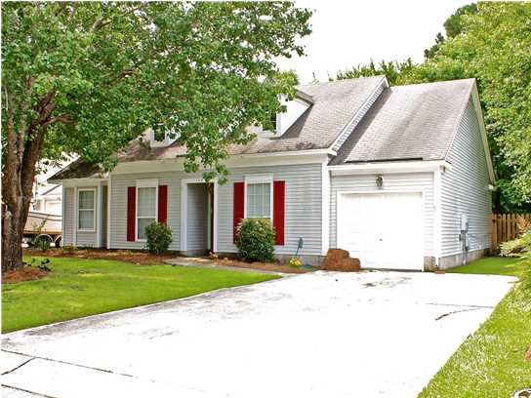
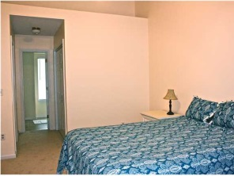
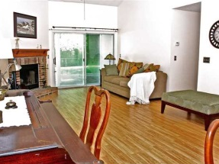
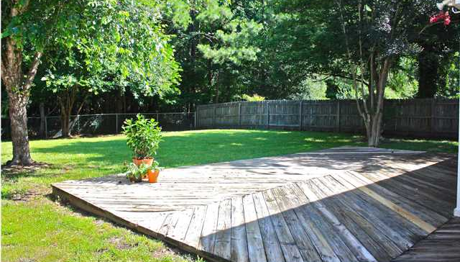



** PRICE REDUCED ** MOTIVATED SELLER **
106 Mapperton Ct Summerville Place
Summerville, SC
MLS# 1317045
$135,000
This is a great 3 bedroom, 2 bath open floor plan home located in a cul-de-sac in Summerville Place. It is convenient to shopping areas and serviced by Dorchester County II schools. The fenced backyard backs up to a wooded area and has a great deck for the ultimate backyard barbecues. Laminate flooring and carpets have been replaced in the home making it move in ready!!! Owner is willing to leave, washer, dryer and refrigerator with an price offer!! Make an appointment to see you new home today!
Shakeima Chatman, REALTOR®
Chatman Realty w/Keller Williams Realty Charleston
496 Bramson Court Suite 200, Mt. Pleasant, SC 29464
843-416- 2000 (O) | 843-532-0330 (C)
Shakeima@chatmanrealty.com | www.chatmanrealty.com

