Slide 1
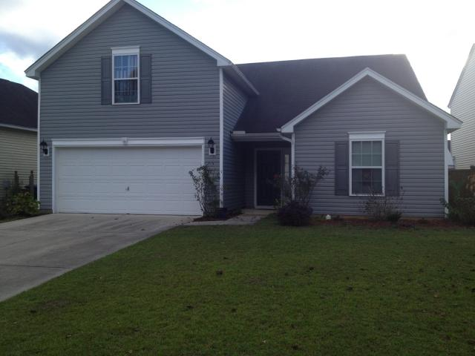
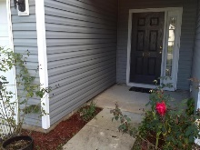
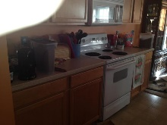
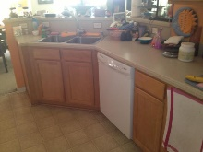
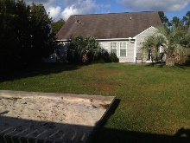
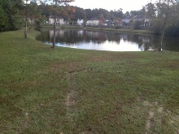
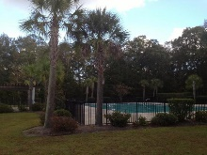


Compare the Price for These Features!
106 Sparkleberry Lane
Summerhaven
Summerville
MLS# 15028628
$188,000
Dorchester District II Schools
4 Bedrooms, Master is Downstairs
Completed Subdivision With Pool and Sidewalks
Compare the Price for These Features!
John Crowley
843-819-4951
John.Crowley@AgentOwnedRealty.com
AgentOwned Preferred Group | 1400-G Palm Blvd | Isle Of Palms, SC 29451

