Slide 1
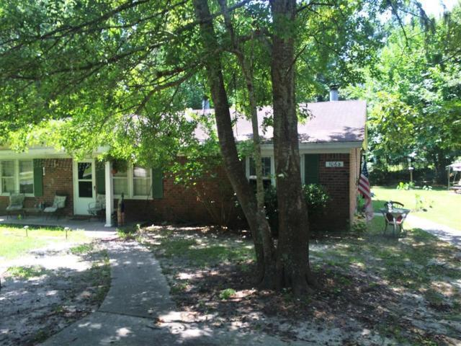
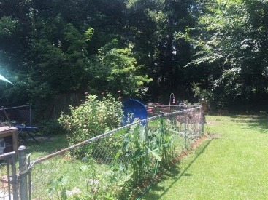
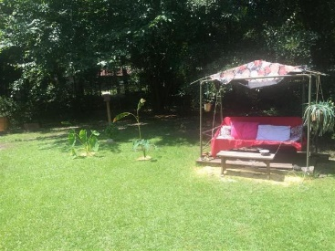


106 Susan Drive A&B
Greenhurst | Summerville, SC 29485
MLS# 16004479 | $116,000
Attention Investors!
Summerville Duplex with Nice Cash Flow!
Great rental property or live in one side and rent the other. Side A has 2 BR, 1 BA. Tenant is month to month at approximately $600/mon. Side B has 1 BR/1BA with month to month tenant at approximately $500/mon. Both sides have fenced back yards. A new roof was installed in 2015 and both sides were re-plumbed in 2016. Side B has a new air handler. Fantastic rental property for investors.
Jeanette Henderson
(843) 834-0068
jeanette.henderson@carolinaone.com
www.jeanettehendersonrealty.com
Carolina One Real Estate
628 Long Point Rd.
Mt Pleasant, SC 29464

