Slide 1
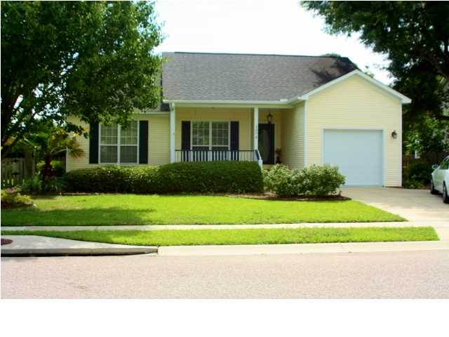
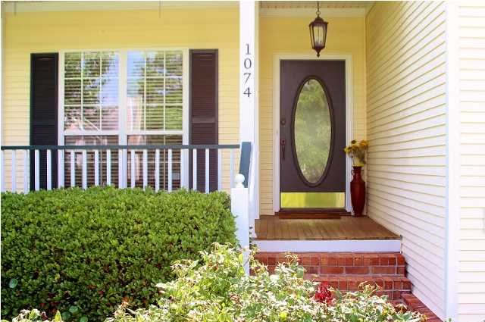
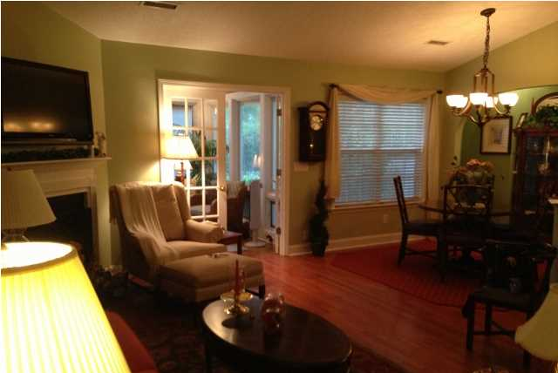
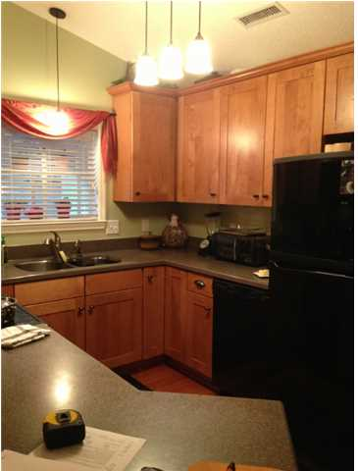
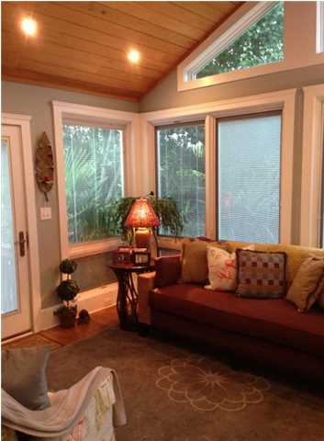
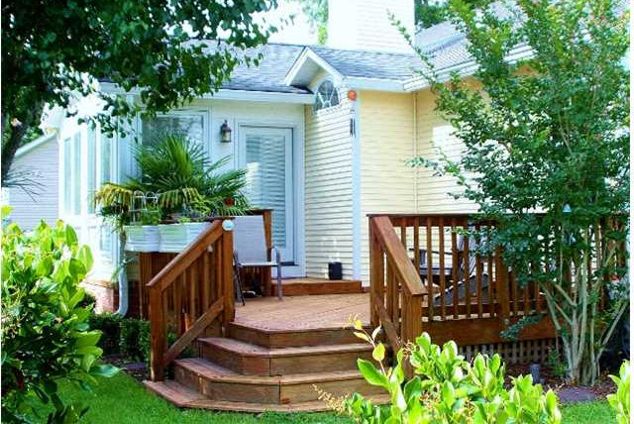
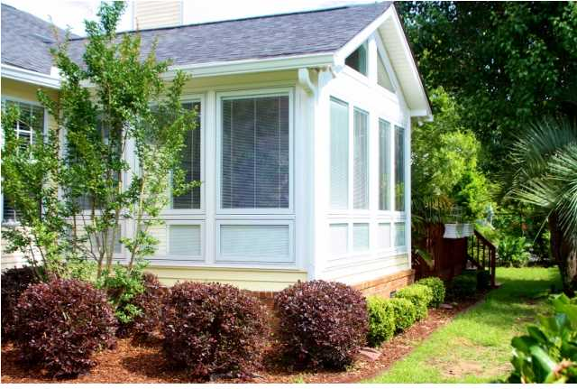

1074 Wayfarer Lane Bayview Farms ~ Charleston MLS# 1314878 ~ $279,000
Beautiful Home on Tidal Creek in Bayview Farms
Open House Dec 16th 1:00-4:00
Light Refreshments
Bayview Farms is located in the heart of James Island. It is a great family and professional neighborhood with one of the lowest HOA fees for common area upkeep and amenities. Some of the amenities include two swimming pools, a clubhouse that can be reserved for social events, tennis courts, fenced playground area and lighted sidewalks.
The homeowner has taken great pride in the care of their home as you will see when visiting 1074 Wayfarer. This immaculate 3-bedroom has an open living/dining room/kitchen areas, and a vaulted ceiling sun room (added in 2009). With the addition of the sun room in 2009, there is a new HVAC, hot water heater, roof, deck, irrigation and privacy fenced in back yard.
There are hardwood floors throughout, new upgrades to both bathrooms with beautiful stone vanities, tiled floors and showers. Bedroom closets have professionally installed California Closets. All kitchen appliances and the washer and dryer convey at closing. The third bedroom is set up as an office/study with no closet. The homeowner is offering a $500 allowance to convert one of the two closets of the 2nd bedroom.
This home is move in ready, minutes from downtown Charleston and beaches.
Jeffrey Bell jeffgbell@msn.com 843-412-6566 {M}
Wilkinson & Associates ERA Powered , 125 Wappoo Creek, Suite F, Charleston, SC 29412

