Slide 1
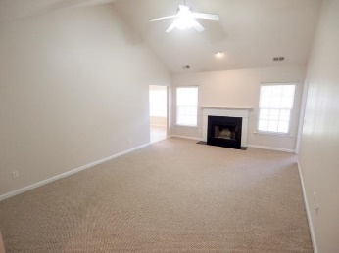
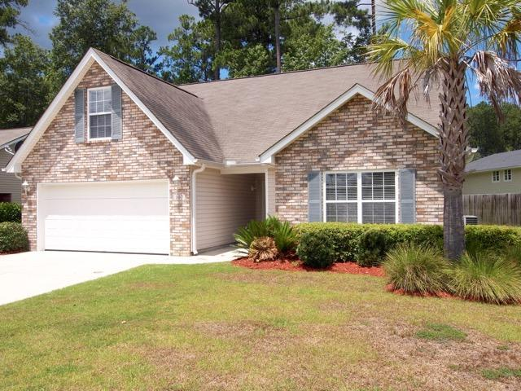
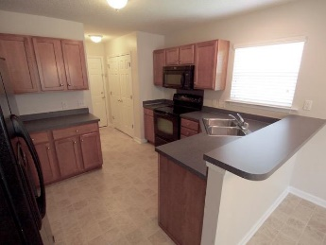
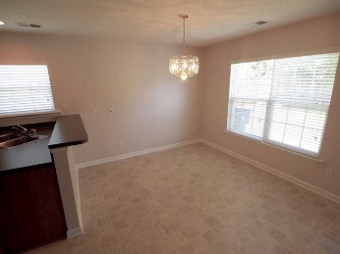
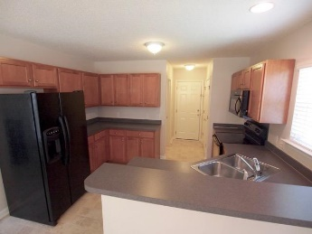
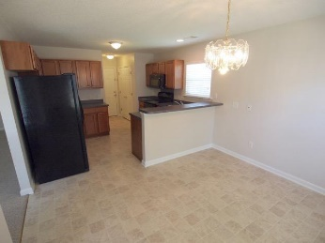
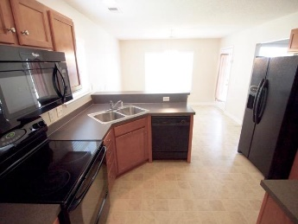
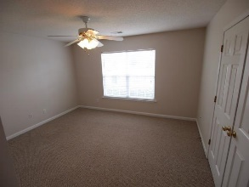
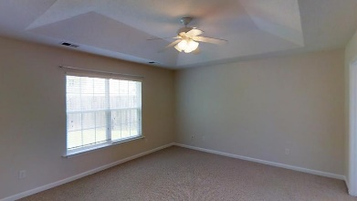
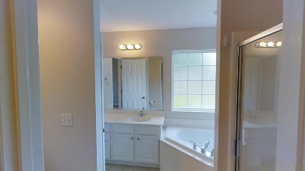
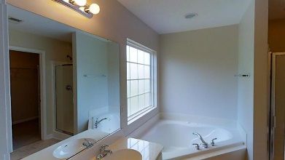
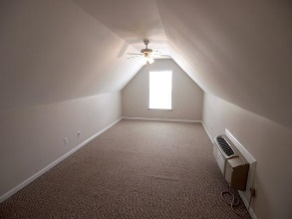


Available
Nov 1st!
All Gussied Up and ready for a new Beau!
107 Felder Creek Road
Felder Creek ~ Summerville, SC 29483
MLS# 16020099 ~ $199,999
When you approach this home you will immediately realize that this former model is "not dancing in the dark" for she is primed from the driveway to the frog and everything in between. Powerwashed, gutters cleaned and shrubs trimmed, and fresh mulch is down She has freshly painted. The huge vaulted ceiling family room the wood burning fireplace will catch your attention-a gathering spot for friends and family on those cool winter evenings. Eat-in kitchen is stunning with its pretty maple cabinet and black appliances. Master is big and so is the master bath with its jetted tub and separate shower. Frog has its own HVAC. Garage is a must see. It has been painted and has its own HVAC. This former model will "light some's fire!" Check her out! Now don't be afraid to check out the garage for she will really make your heart thump! It has been painted too and has its own HV AC unit- sparks flying yet! Be sure to notice how finished the garage is with her baseboards, closet and all. Now the family room is exciting with a fireplace for those cool nights and the vaulted ceiling for that airy heavenly feel not to mention how big it is. Next is the large master and master bath and the huge walk-in closet. Tub is jetted tub and has separate shower which makes a relaxing oasis when you need it or a quick place to get ready for the day. The other two bedrooms are good sized and so are the closets with another full bath to round up the downstairs. Lastly, is the Frog. Man Cave, extra sleeping area, kids play room- you decide!
Liz & Bob Simonds
843-437-9696
lizandbob@agentowned.com
AGENTOWNED REALTY CO. PREMIER GROUP, INC.
141-A N. MAIN STREET
SUMMERVILLE, SC 29483

