Slide 1
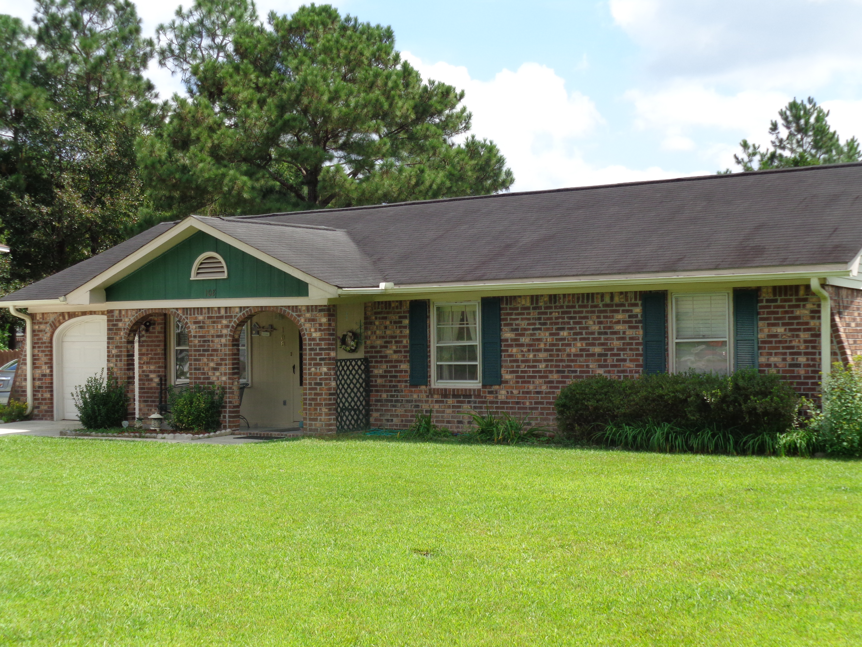
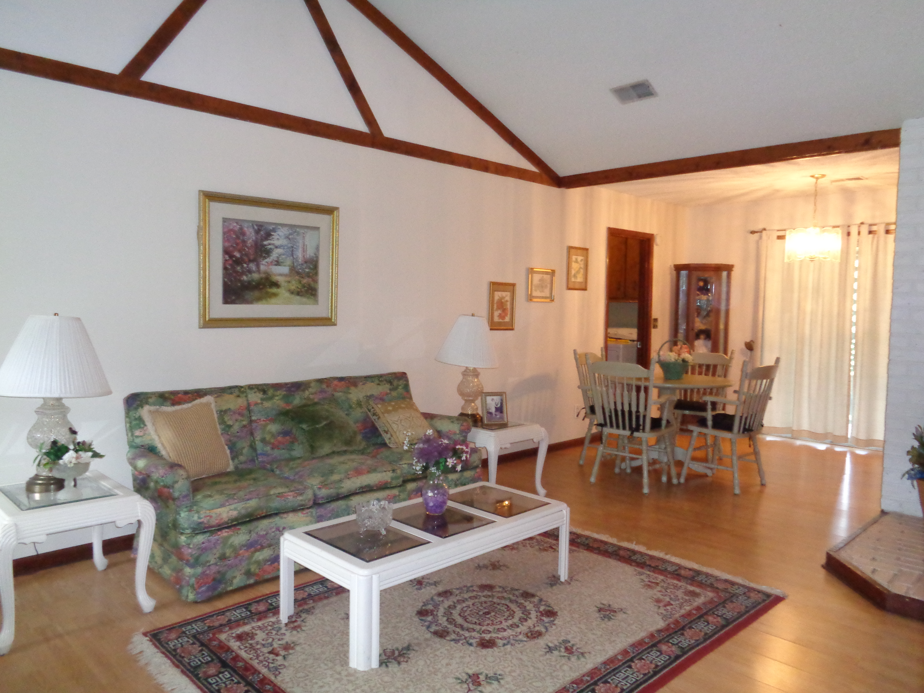
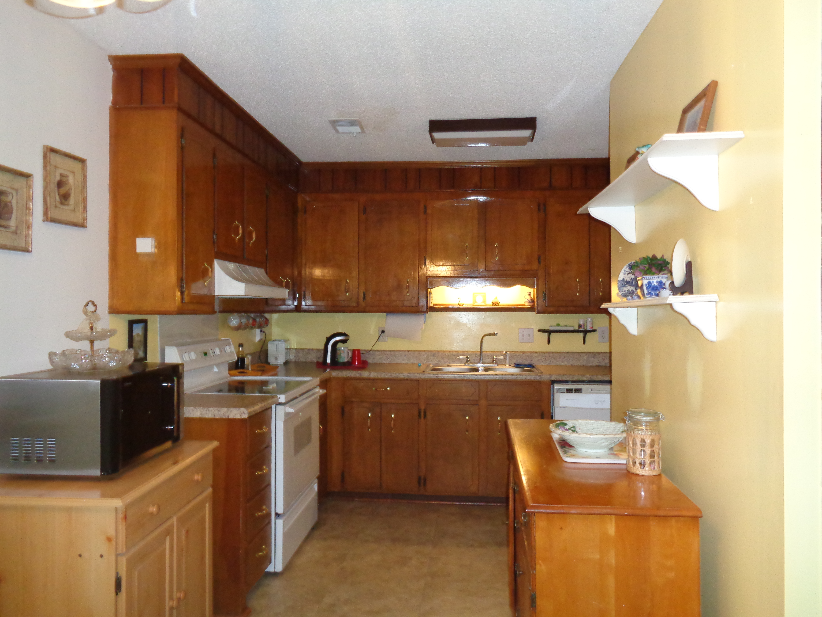
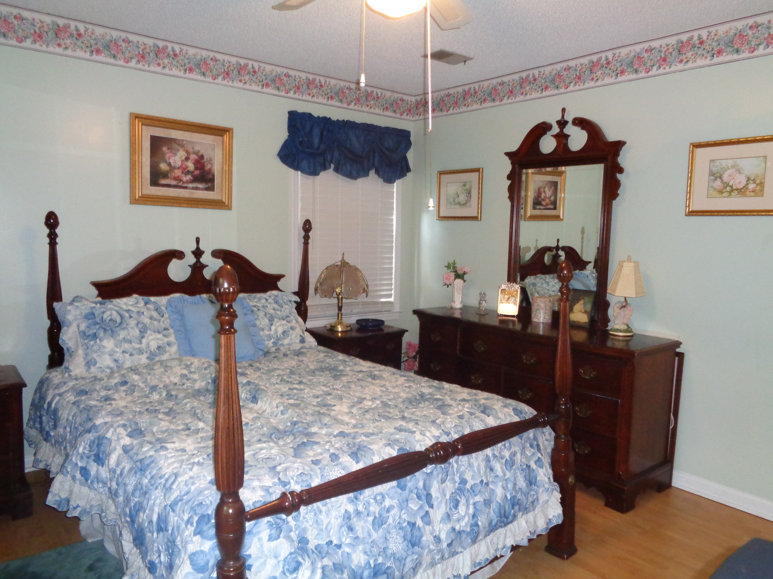
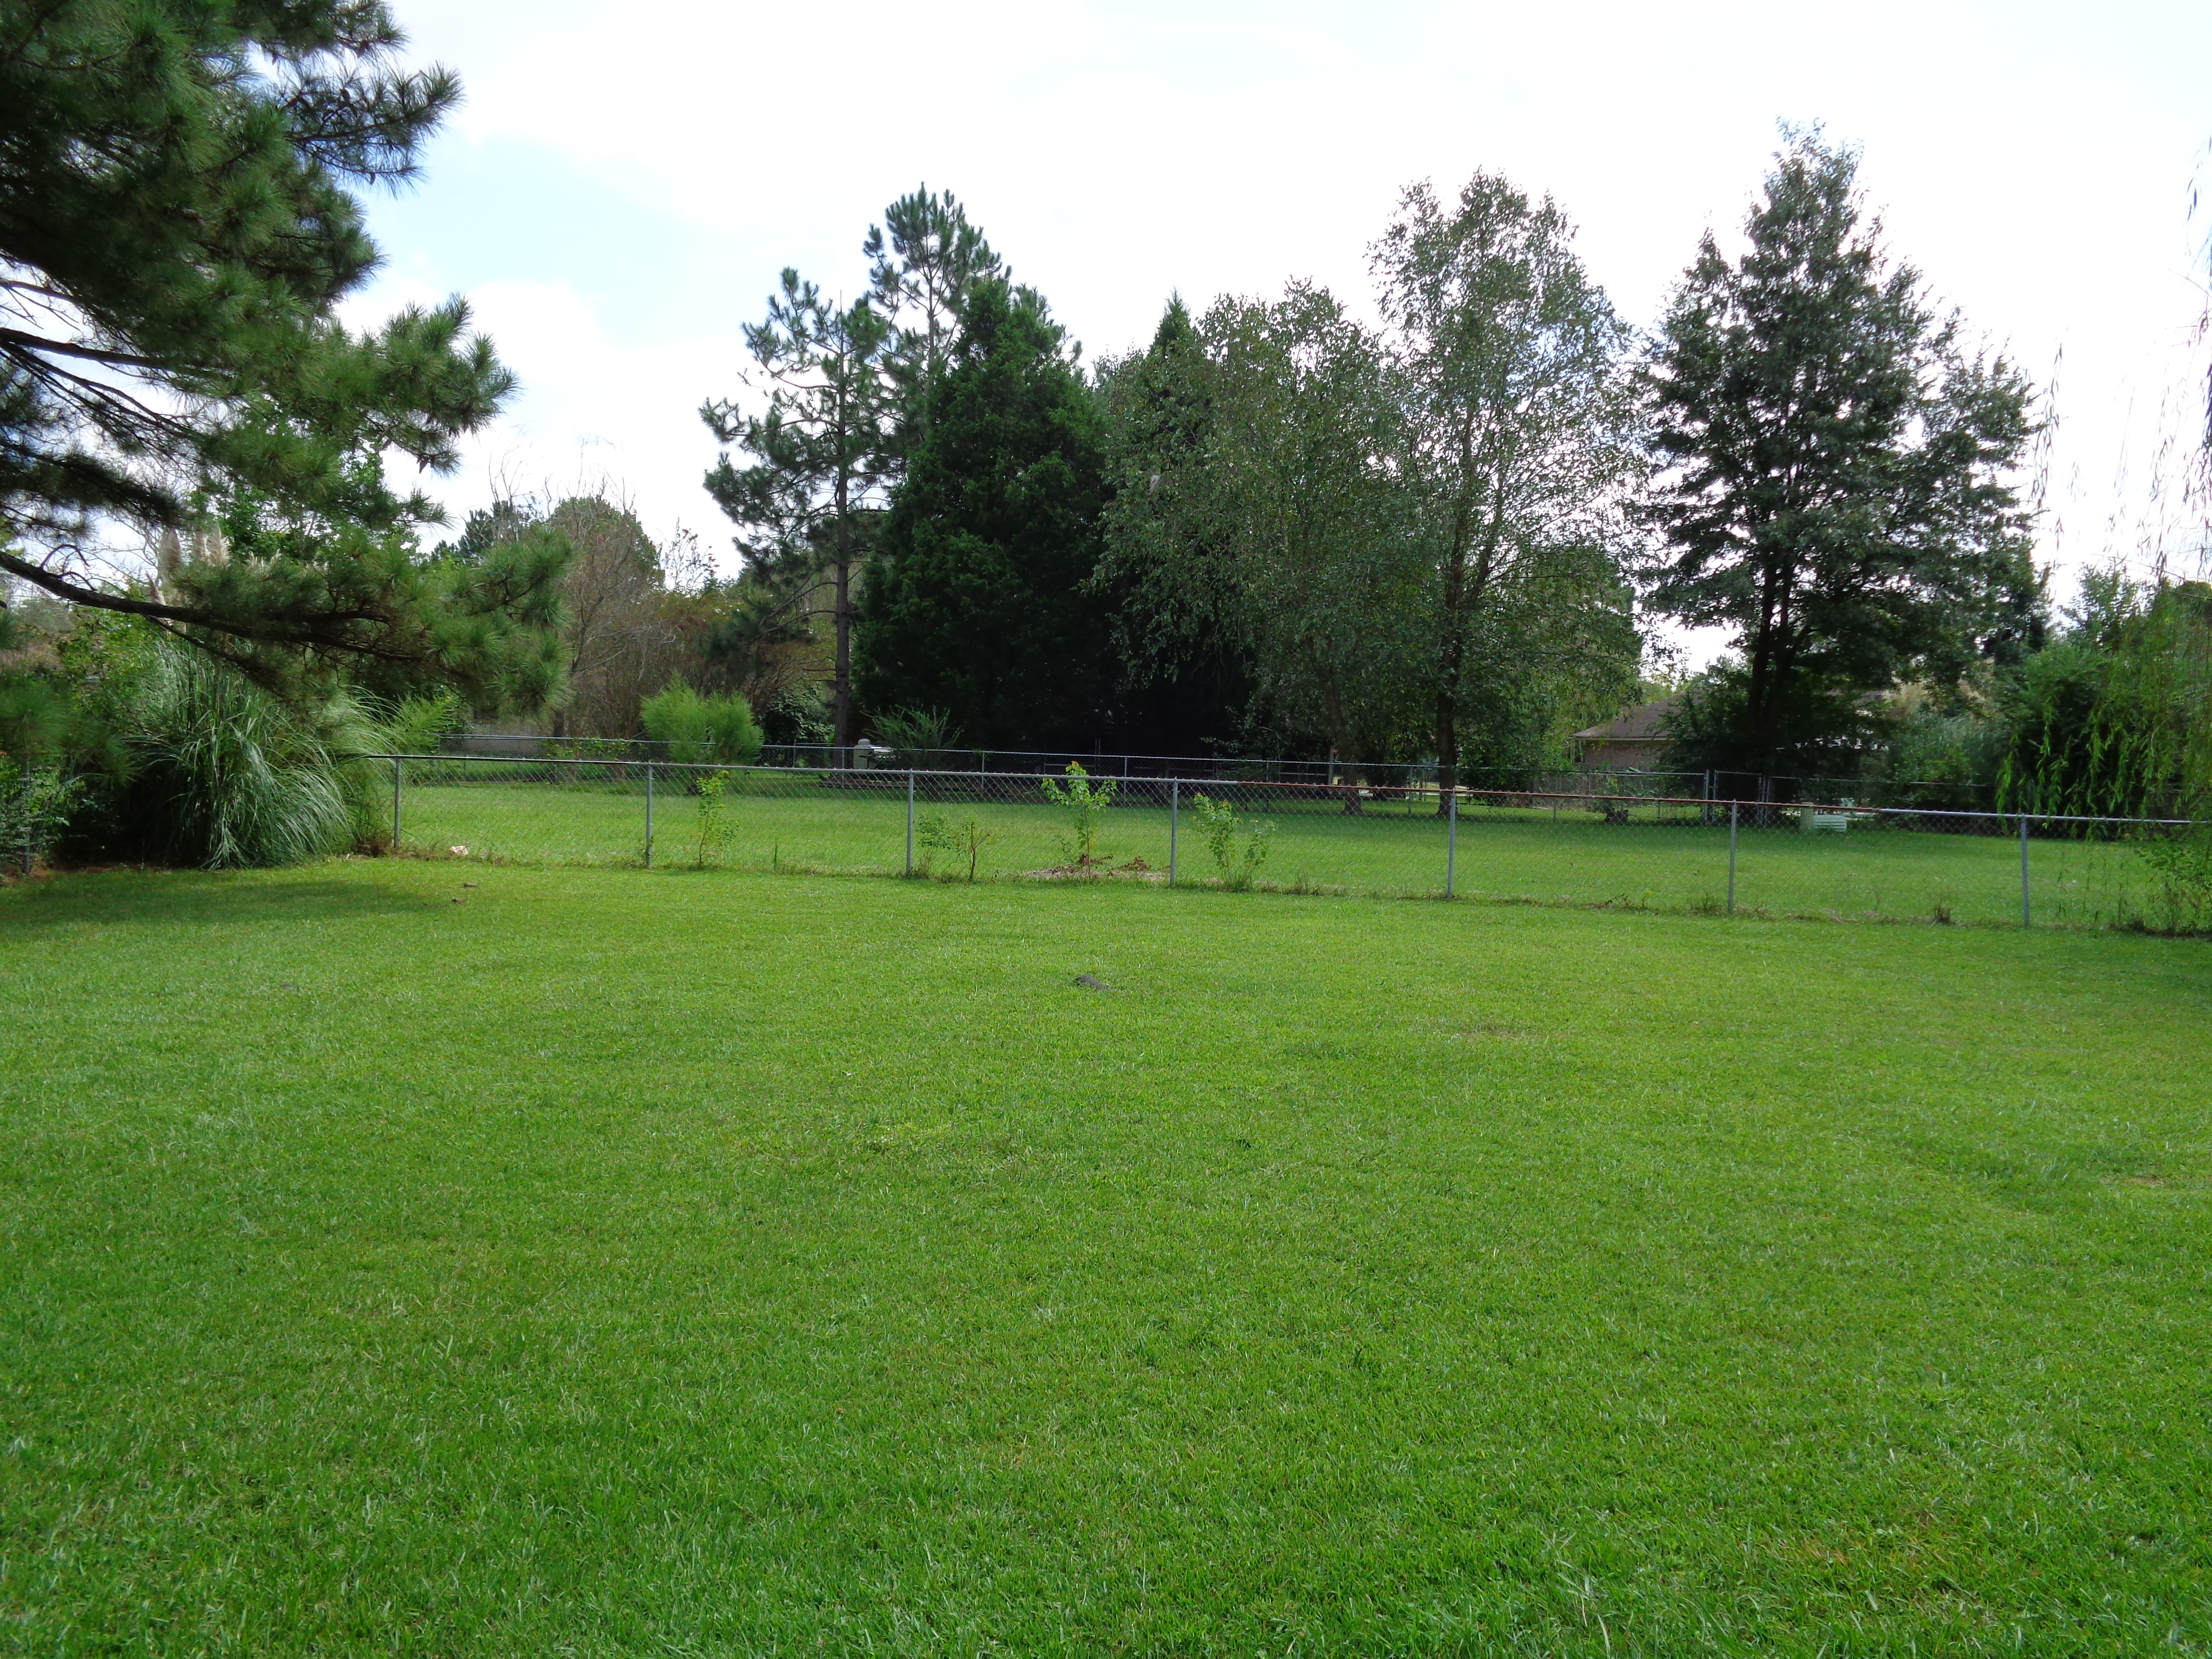


Price Reduction!
108 Pickett Court
Sangaree · Summerville · MLS# 15024077 · $115,000
Just reduced to $115,000 and Seller will pay up to $3000 toward buyer's closing costs. Lovely brick ranch home located on quiet cul-de-sac. Living room and dining area have cathedral ceilings with wood beams, easily maintained laminate wood floors, Electric free-standing FP in living area. Kitchen has elec, self cleaning smooth top range (2001), dishwasher, Frigidaire refrigerator(6 months old), nice counter tops, lots of cabinets. Good sized master bedroom with full bath. The 3rd bedroom was converted to a den/study by previous owner but can be converted back to bedroom for around $2000. Nice covered front porch as well as a screened in back porch with adjoining covered patio. Large fenced back yard. 1 car garage. HVAC and thermostat replaced in 2012, new roof in 2003
Teresa Porter
(843) 300-5822
teresa.porter@agentownedrealty.com
www.agentownedrealty.com
AgentOwned Preferred Group · 824 Johnnie Dodds Blvd · Mt Pleasant, SC 29464

