Slide 1
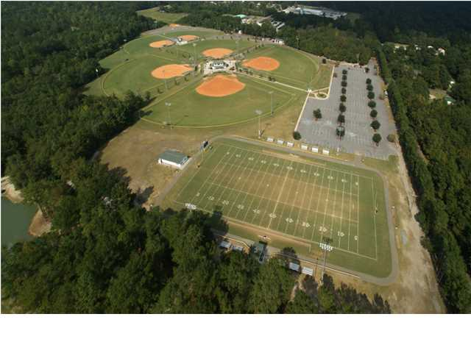
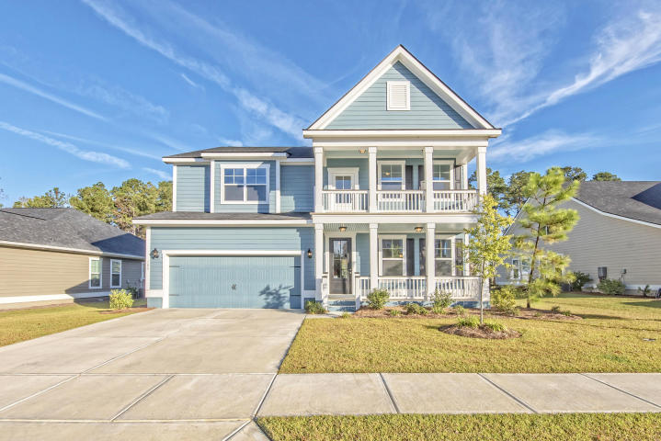
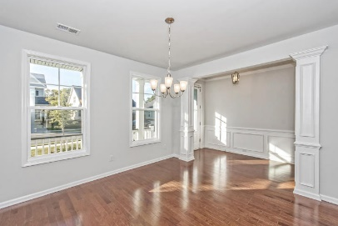
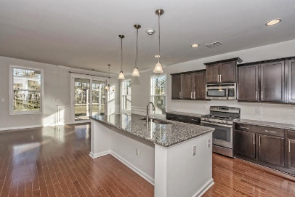
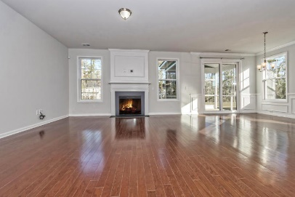
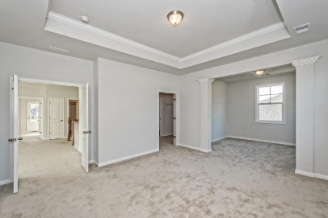
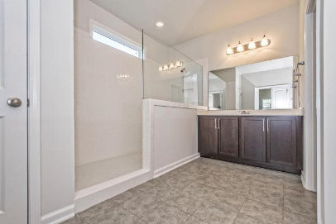
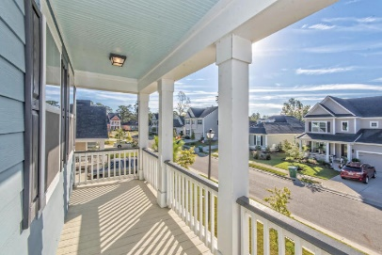
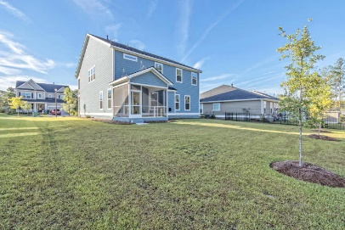


108 Riviera Drive
Pine Forest Country Club | Summerville | MLS# 16027500 | $349,900
Open House 11/5 & 11/6 from 2-5
$13,000 BELOW NEW CONSTRUCTION PRICES and MOVE-IN READY!
Why wait to build when you can be in this beautiful home in time for the holidays!!! There is so much to love about this fully upgraded Harbor Oak model from the Hardie Board Siding and Double Porches to the Light and Bright Open Floor Plan w/Hardwoods, Upgraded GE SS Appliances, Gorgeous Granite Counters and plenty of Cabinets in Eat-In Kitchen, Spacious Great Room w/Gas FP, Bedroom and full Bathroom on main level, Master Bedroom up plus two additional Bedrooms, Full Bathroom w/Double Vanity and a huge Loft(16x21). Master Suite offers Double-Door entry, Tray Ceiling, Sitting area, Gorgeous Spa Bathroom w/Tile walk-in Shower, Transom Window, Double Vanity w/lots of drawer and cabinet space. Tile in Bathrooms and Laundry Room, Carpet in Bedrooms and Loft. Access to Laundry Room upstairs from Hallway or Master Bedroom Oversized Closet. Every room is wired for TV, Cable and Ceiling Fans/Lights. Drop Zone by the Garage Door into the home. Heavy-Duty Sliding Glass Doors lead to the Screened Porch. Extra storage under the stairs. Builder is not offering Hardie Board Siding in the new phase, just vinyl.
Beth Mandell
M 843-900-1296 | O 843-871-2121
bmandell@century21properties.com
www.bestcarolinahomedeals.com
Century 21 Properties Plus of Summerville | 118 W Richardson Ave | Summerville, SC 29483

