Slide 1
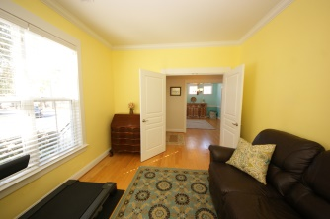
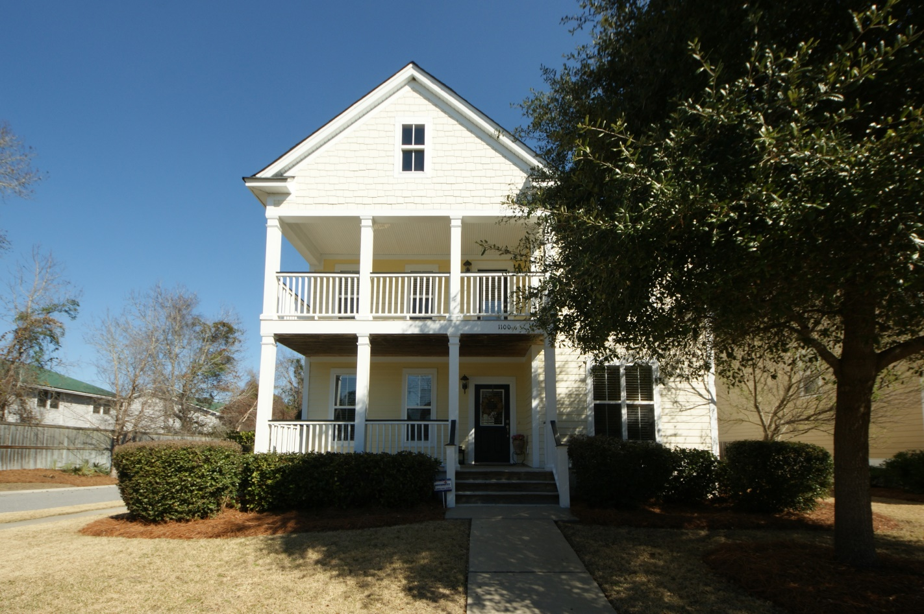
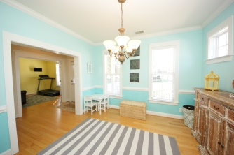
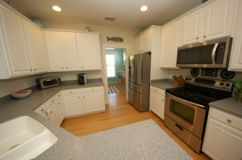
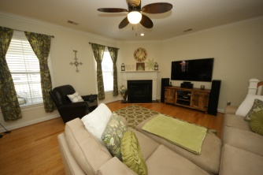
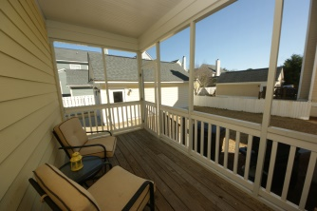
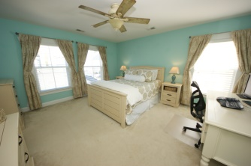
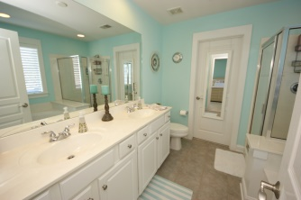
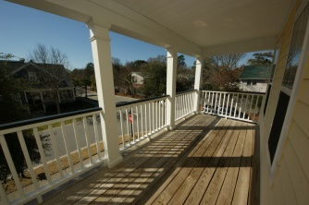

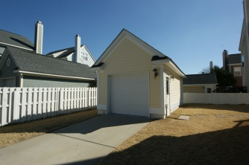
If you’re looking for a Lowcountry home with contemporary qualities, this may be it.
1100 Dawn View Terrace
New Parrish Village
Mount Pleasant
MLS# 00000000
$000,000
You'll love to call this home!
Sought after neighborhood on James Island close to Downtown Charleston, Folly Beach, restaurants and shopping! Great lakefront property! Enjoy the lake views from the Master Bedroom balcony, the Screen Porch that extends the full length of the home, and the expansive deck along the shore line! Home boasts a first floor bedroom with access to a full bathroom and lots of natural light! 3 additional spacious bedrooms upstairs to include 2 guest bedrooms and a large master suite with tray ceilings, balcony overlooking the lake, HUGE walk-in closet. Master bathroom has a jetted separate tub, extra-large shower, and double sink vanities. Many upgrades include gas fireplace with custom mantle; 1st floor hardwood floors; crown molding; tank less gas water heater; natural gas community; home is professionally painted; tiled bathrooms; large laundry room with additional shelving; recessed lighting; and lots of natural light. Gourmet kitchen is spacious with lots of granite counter space, 42'' cabinets, and stainless steel appliances to include a gas range, built in microwave, refrigerator and dishwasher. Kitchen has a large eat in breakfast room that opens to the balcony. Additional rooms are the dining room and family room with 2 story ceilings. The home is elevated offering LOTS of storage, parking and some recreational space. All the luxuries of new construction but in an established high end neighborhood close to Downtown Charleston. Bound to sell quickly! Please note wood blinds and stainless steel refrigerator convey.
Karla Leahy
Realtor CRP, ASP, QSR
karlaleahy@gmail.com | (M) 843-452-6670
www.yourlowcountryproperties.com
Harbor City Real Estate Advisors | 510 Live Oak Drive | Mt Pleasant SC 29464

