Slide 1
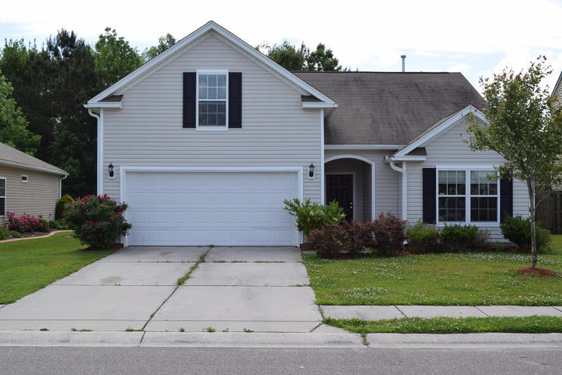
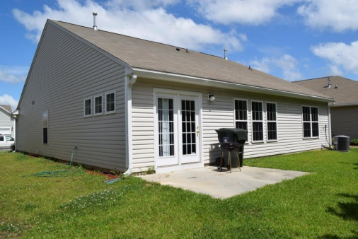
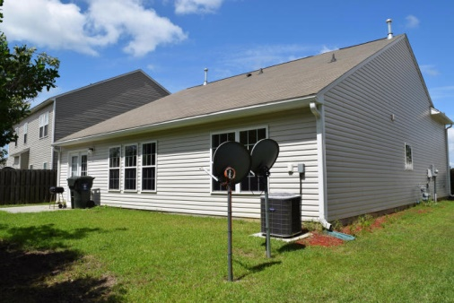

Don't miss out on this one! 1102 Cates ~ Myers Mill
$1,500 Bonus
$500 Bonus
$1,000 Bonus
803 Reserve Way
Kings Grant ~ Summerville
MLS# 15008049
$104,900
MLS# 15012253
$184,900
Buy this property and receive a 5 Day/4 Night cruise for two. Ask for details. This three bedroom, two bath room home is ready for immediate occupancy. Inside you will find an open floor plan. With a wide foyer, the home is very inviting. This home features a split layout with bedrooms at the front of the home and master towards the rear. The kitchen is very open and overlooks the family room, so the cook is never left out. Newer appliances and lots of counter space make meal preparation easy. The master is open with trey ceiling and the master bath is pleasant. The real bonus in this home is the bonus room/bedroom upstairs. With loads of space, this could easily be the man cave or woman's corner you always wanted.
Corwyn J. Melette
Accredited Buyer Representative
(843) 364-3095
corwyn@corwynmelette.com
Exit Realty Lowcountry Group 3618 Ashley Phosphate Rd. #3
North Charleston, SC 29418
exitlowcountry.com

